Slide 1
Module 5: Considering success in business
Made by: Elmira A.A.

Slide 2
Plan:
Greetings.
Warm-up.
Vocabulary.
Reading.
Home assignment.

Slide 3
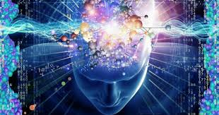
Warm-up
What words do you associate with “businessman/businesswoman”?

Slide 4
Vocabulary task
Brick-and-mortar store -
Branch out (into) sth -
Hydroponics -
Joint venture -
Jumble -
Entrepreneurship -
Carbon neutral -
Fleet -
Conversion -
Naively -
Fiver -

Slide 5
Check the vocabulary
Brick-and-mortar store - existing as a physical building, especially a shop, rather than doing business only on the internet.
Branch out (into) sth - to start to do something different from what you usually do, especially in your job.
Hydroponics - the method of growing plants in water to which special chemicals are added, rather than growing them in earth.
Joint venture - a business or business activity that two or more people or companies work on together.
Jumble - an untidy and confused mixture of things, feelings, or ideas.
Entrepreneurship - skill in starting new businesses, especially when this involves seeing new opportunities.
Carbon neutral - if an organization, activity, etc. is carbon neutral, it does not add to the total amount of carbon dioxide in the atmosphere, for example by doing things such as planting trees in order to remove as much carbon dioxide as it creates
Fleet - a number of buses, aircraft, etc. under the control of one person or organization.
Conversion - the process of getting a customer who visits a website, sees an advertisement, etc. to buy a product, or a customer who does this.
Naively - in a way that shows you are too willing to believe that someone is telling the truth or that life is pleasant or fair.
Fiver - five pounds, or a note worth five pounds.

Slide 6
Reading and speaking
What do you think are the advantages and disadvantages of each person’s job in the texts?
What was each person’s inspiration for starting their business?
Who impressed you? What is the secret of his success?

Slide 7
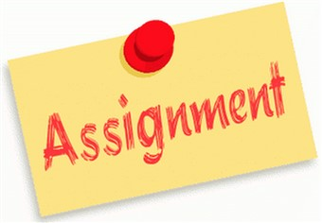
Home assignment
Ex. 7 p. 65.

