Slide 1
“Maadai-Kara”
Made by Elmira A.A.

Slide 2
Plan:
Checking home assignments.
Warm-up.
Vocabulary.
Reading.
Exercises.
Home assignment.

Slide 3
Warm-up
What is Kai?

Slide 4
Vocabulary
To defeat -
A slave -
To descend -
To dwell -
To release -
To be guilty of -
Committing terrible acts -
A branch -
The Heaven -
To remain -
A trunk -
To belong to -
A glorious reign -
An enemy -

Slide 5
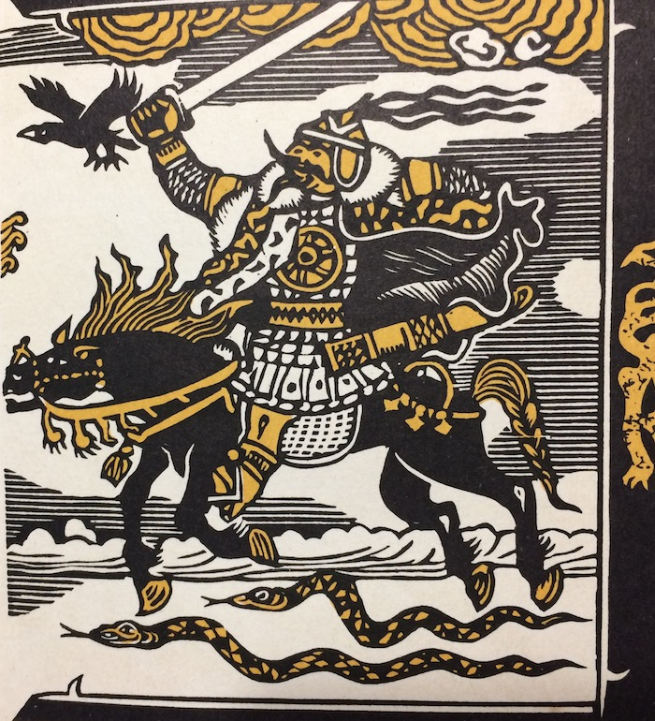
Reading

Slide 6
Exercises
Do ex. 5 and 6 p. 59.

Slide 7
Exercises
Fill in these words into the sentences: sweet-smelling, chamber, lit, whispered, defeated, poisonous, enemy.
Jack … a candle to see in the dark.
Vlad Dracula … the Ottoman army of Mehmed.
He gave her such … flowers.
Joker is an … to Batman.
Don’t eat it! This food is … .
The Queen sleeps in the Royal … .
I couldn’t hear her because she … words.

Slide 8
Home assignment
Workbook: page 38.

