Slide 1
Module 8 Healthy habits

Slide 2
Vocabulary Healthy and unhealthy habits get a good night’s sleep do a physical activity eat too much junk food surf the internet for too long eat fruit and vegetables watch too much TV drink plenty of water play video games too often have a hobby eat late at night

Slide 3
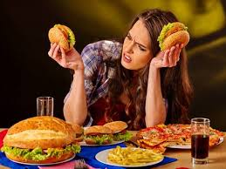
What should /shouldn’t we do to have a healthy lifestyle?
get a good night’s sleep
watch too much TV
eat too much junk food
eat fruit and vegetables
surf the internet for too long
do a physical activity

Slide 4
Ex.3 p.88 Read the text and mark the statements 1-6 as True or false

Slide 5
What is best alternative title for the text? A. Don’t snooze your life away! B. Healthy sleeping habits. C. The link between sleep and success.

Slide 6
Match the words
Balanced
Feel
Night’s
Keep
Physical
Sleep
Fit
Activity
Diet
Positive

Slide 7
Answer the questions Do you have a healthy lifestyle? Why? How much sleep do you get every night?

Slide 8
Home work Ex. 3 p. 88 Ex 10 p.89

