Slide 1
The Presentation Was created by Terskikh Dasha Form 10 The Teacher: Tatyana Voropaeva The School-gymnasium №1 North Kazakhstan, mamlutka
Top 10 high-level attractions

Slide 2
Everyone struggles in his own way with stress, but not everyone knows that the most terrible attractions of the world will be a good helper in this matter. Top 10, which include falling from a huge height, frenzied speed, a "dead loop". This method, along with extreme sports, is one of the most effective in solving psychological problems. Therefore, adults like the magnet attract parks of entertainment - there you can get a good portion of adrenaline, which will make it stronger, more energetic, help to cope with any life's troubles.

Slide 3
The Giant Canyon. Colorado, United States Opens the list of the most popular attractions, located in the state of Colorado. It is a swing for 4 people, swinging at a speed of 80 km over a precipice depth of 400 meters. The duration of the session is only 1 minute, but the impressions received will last for the rest of your life. Before using the swing, each visitor signs a document that is warned about the possible consequences - injuries or even death, and the organizers are not responsible for any incident.

Slide 4
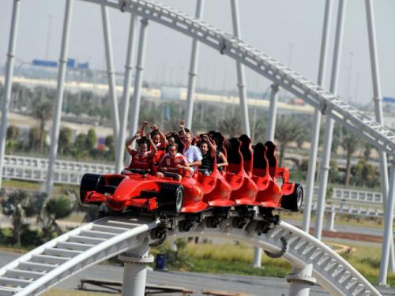
Formula Rossa. Abu DhabiB (UAE) The fastest hill, made as an American, has a height of 52 m. It is located in Abu Dhabi. The trolley accelerates 240 km in less than 5 seconds, which is not possible for every sports car. One of the most dangerous rides of the world, included in the top 10, imitates the world famous race track Monza. Visitors will experience their courage through various ascents and descents. Because of the huge speed of the "riders" are obliged to wear special glasses, protecting from getting into the eyes of small particles that are in the air. The duration of the trip is one and a half minutes.

Slide 5
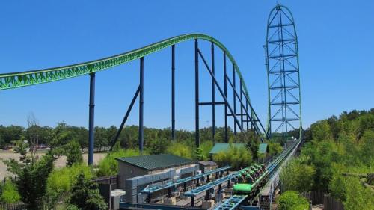
Kingda Ka. New Jersey (USA) Kingda Ka is another scary attraction, rightfully taking eighth place in our top 10. The construction is almost 140 meters high in New Jersey, USA. For 4 seconds the cabin accelerates to 200 km. After the trip, each visitor will always have unforgettable impressions, for it is not for nothing that the name "car of fear" is firmly entrenched behind this attraction.

Slide 6
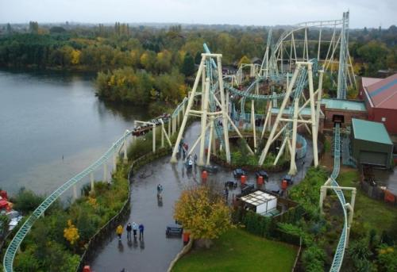
Colossus. Cherpsey (England) The most convoluted large-scale attraction is located in the park of the English city of Cherpsey. The height of the structure is 30 meters, the speed of movement is 60 km. During the movement along the route (length 850 meters), visitors turn ten times upside down, after which some of them lose their orientation in space.

Slide 7
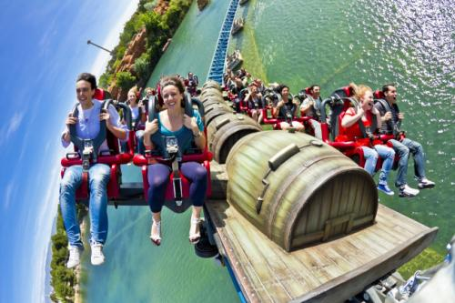
Furius Baco. Salou (Spain) One of the most extreme attractions in the world, rightfully ranked 6th out of the top 10 most terrible, is in the Port Aventura park in Spain. Within a few seconds the capsule with the passengers accelerates to a huge speed - 135 km. Sharp sensations are added by the originally designed chairs located on the sides of the rail. Such seats deprive the legs of any support, which creates the impression of a free flight. Before the end of the road, the trains run right above the surface of the water. The length of the route is 850 meters.

Slide 8
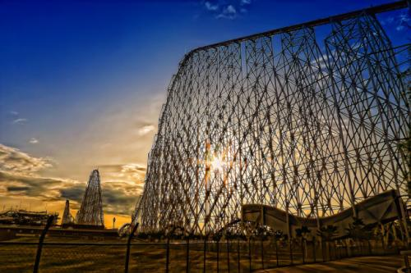
A steel dragon. Nagashima (Japan) The longest "roller coaster", almost 2.5 km long, is located in Japan - it is a worthy contender for the 5th place in the top 10 most terrible rides of the world. The design reaches a height of almost 100 meters, the duration of the trip is about 4 minutes at a speed of 150 km. The attraction, created at the beginning of this century, has long been considered the highest and fastest, but today is inferior to those in analogues in other countries. Thanks to the huge amount of used steel, the construction is resistant to earthquakes.

Slide 9
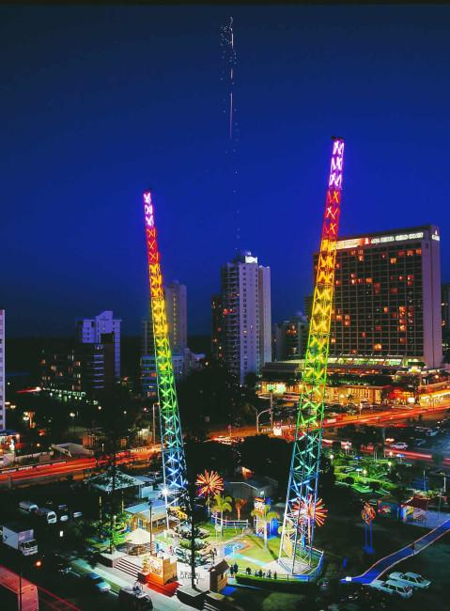
Catapult "Flying Dutchman". Ust-Kamenogorsk (Kazakhstan) Dynamically illuminated by multi-colored lights, the construction, 35 meters high, which corresponds to a 10 to 15-story house, allowed this attraction to take the 4th place among the top 10 most terrible entertainment around the world. The cabin with the passengers soars up in just a few seconds, then flies down, and again up. The whole process can be removed using a video camera, then to show to friends.

Slide 10
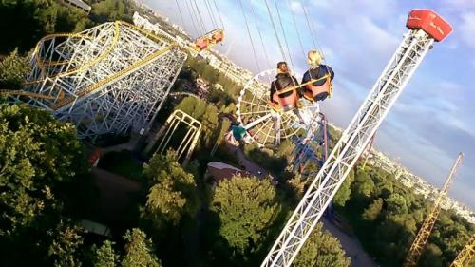
Catapult. Saint-Petersburg, Russia) The height of the catapult located on the "Divo Island" is more than 50 meters, which allowed it to take the third position of the top 10 most extreme rides of the world. The structure consists of 3 impressive columns with firmly fixed metal cables, under tension of which the capsule with the passengers instantly flies up and then descends. During the session the cabins constantly rotate around their axis, which adds to the sensations of piquancy.

Slide 11
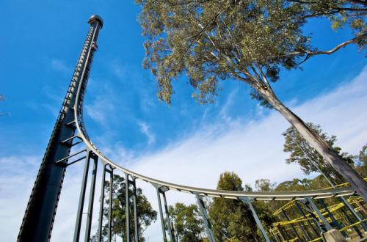
Tower of Terror. Queensland, Australia Attraction, ranked 2nd among the most terrible in the world, is located in the Australian city of Queensland. In a matter of seconds, passengers climb to a height of more than 100 meters, and after a sudden stop at the top, they fall sharply downwards, having time to feel a state of weightlessness. Ascent - descent is repeated 2 times. During the session many adventurers lose their speech.

Slide 12
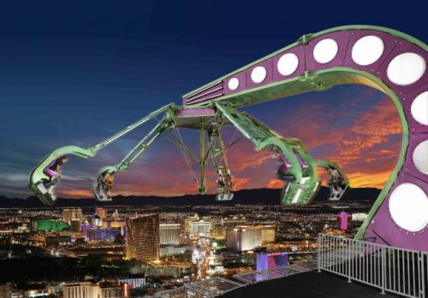
Unique Stratosphere. Las Vegas (USA) The American observation tower, which occupies the second highest place in the world (350 meters), is distinguished by the fact that three of the most terrible attractions are located on its roof, DEEPLY TO TAKE FIRST PLACES IN MY SURVEY

Slide 13
https://www.google.kz/
http://www.topnews.ru/photo_id_10664.html
http://www.topnews.ru/photo_id_10664_2.htm

