Slide 1
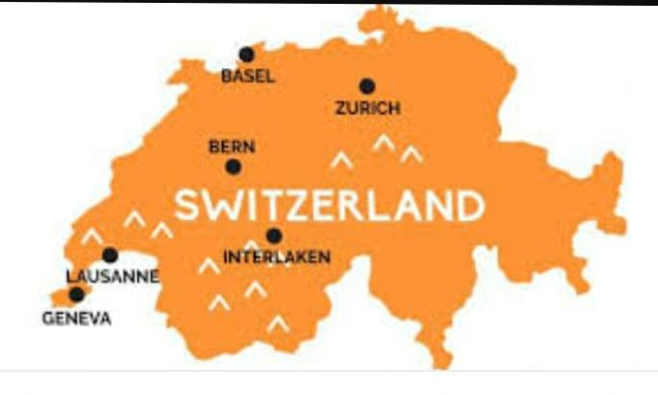
SWITZERLAND
The Ptesentation is created by
Nasyrova Galina
Form: 9 “A”
The School-Gymnasium №1
of Mamlutka
Teacher: Tatyana Voropaeva

Slide 2
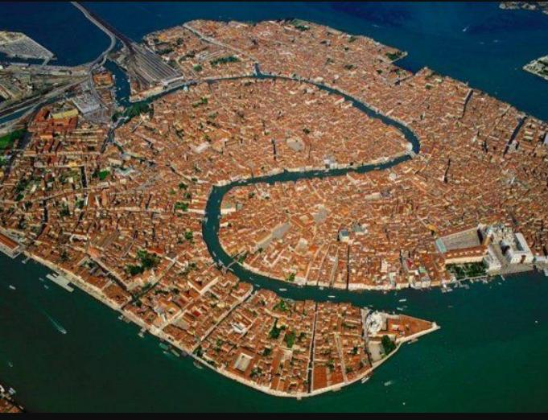
Switzerland, located in Central Europe, is a country of countless lakes, villages and high Alps. The country is famous for its ski resorts and hiking routes. Banking and financial institutions play a leading role in the country's economy, and Swiss watches and chocolate are known all over the world.

Slide 3
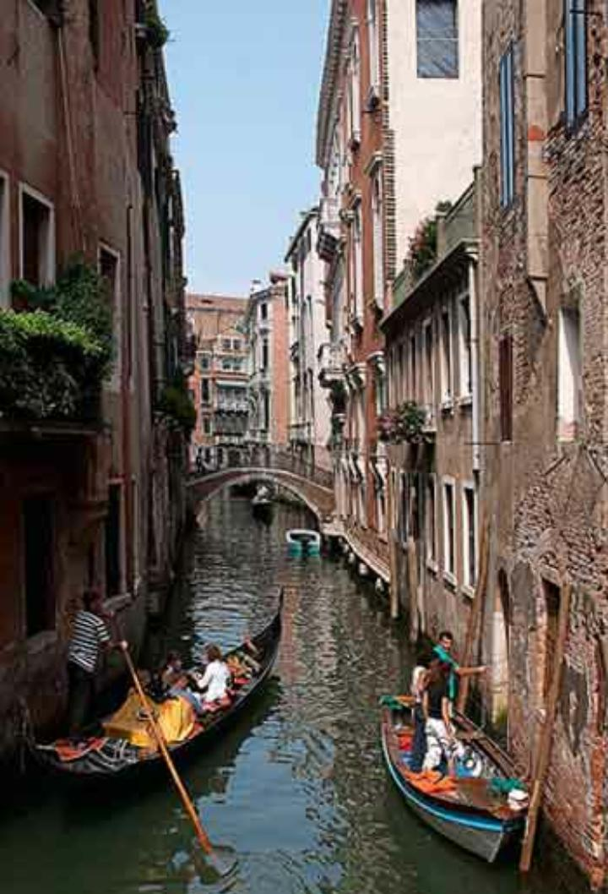

Slide 10
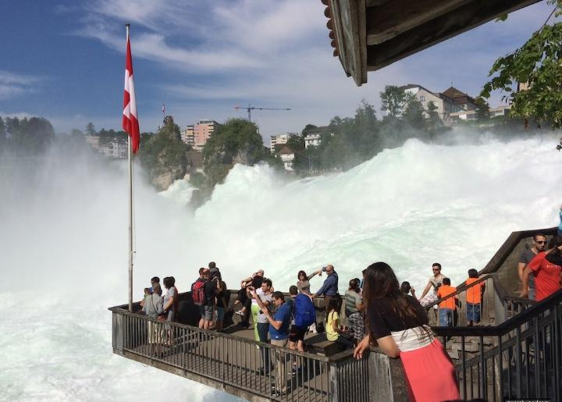

Slide 11
Switzerland Attractions

Slide 12
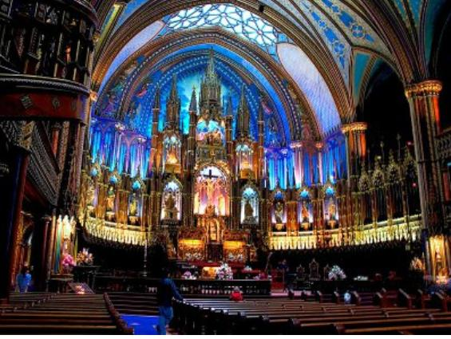
Basilica of Notre Dame This is the main temple, located in Geneva. The main basilica was built in the middle of the 19th century, it is sustained in the Gothic style. The basilica boasts a rich decoration, it is decorated with a large number of bas-reliefs and stained glass. The basilica itself is made of sandstone.

Slide 13
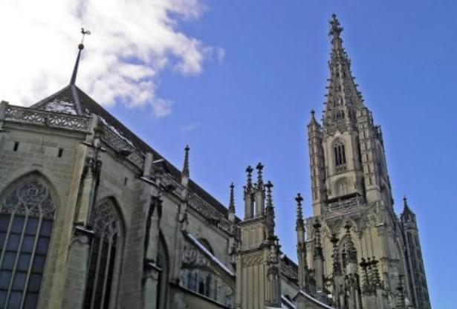
Bern Cathedral This unforgettable beauty cathedral is located in the city of Bern, the cathedral is a magnificent example of late Gothic, it is considered the largest temple located in Switzerland, its spire rushes to the sky at a height of 100 meters.

Slide 14
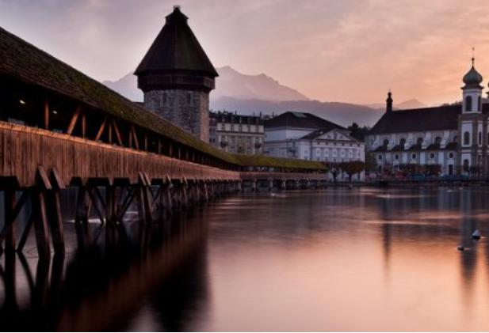
The Kapellbrücke Bridge The bridge is a visiting card of the city of Lucerne and one of the most important sights of Switzerland. The bridge is the oldest wooden bridge in Europe, surviving to this day, its length is 200 meters.

Slide 15
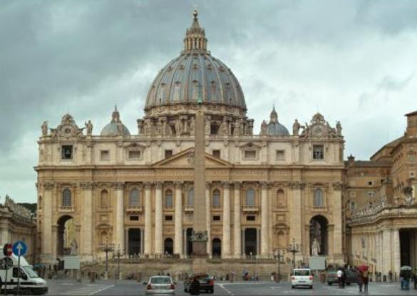
Saint Paul's Cathedral This is the main religious landmark of Geneva. The cathedral was built in the beginning of the 13th century. The architectural ensemble of the cathedral is difficult to meet in any other buildings, it is unique. Despite the variety of styles in the construction of the ensemble, it looks very harmonious.

