Slide 1
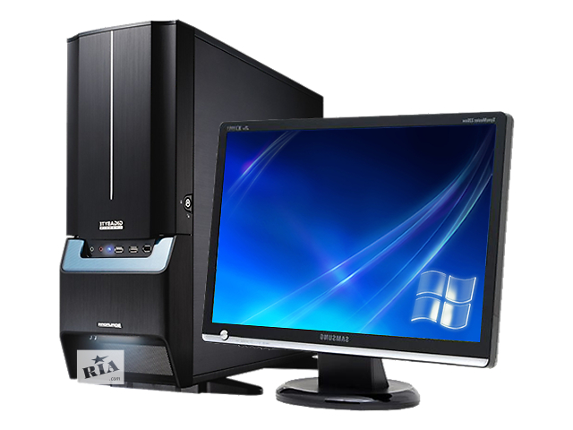
PC–Personal Computer
The Presentation is created by Basanov Rustam
Form: 10 “A”
The School-Gymnasium №1
Teacher: Tatyana Voropayeva

Slide 2
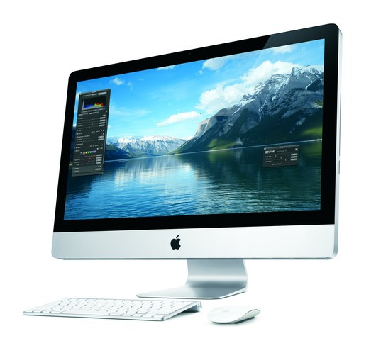
Definition
A device that computes, especially a programmable electronic machine that performs high-speed mathematical or logical operations or that assembles processes information.

Slide 3
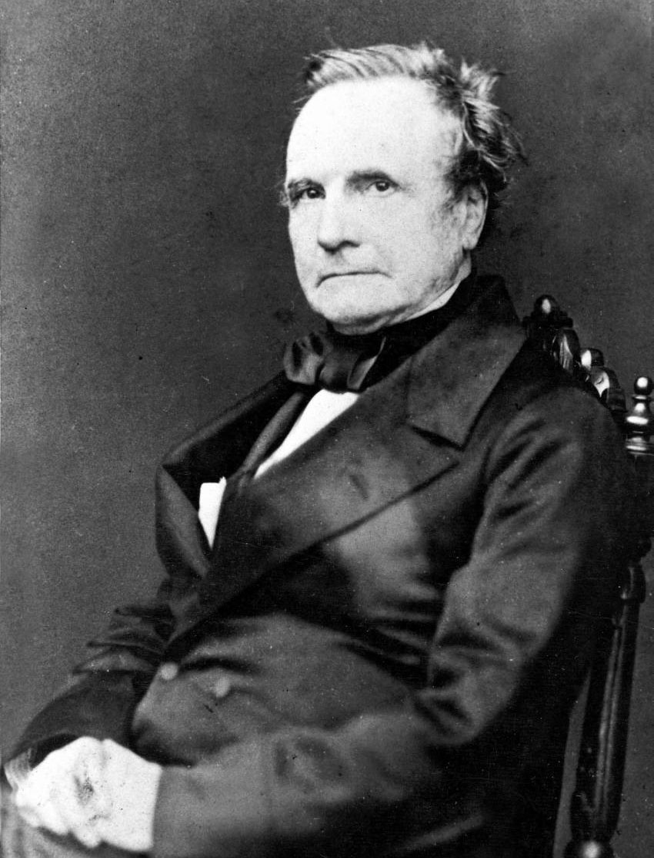
History of computers
Considered a “father of the computer” Charles Babbage(1791-1871) is credited with inventing the first mechanical computer that eventually led to more complex designs.

Slide 4
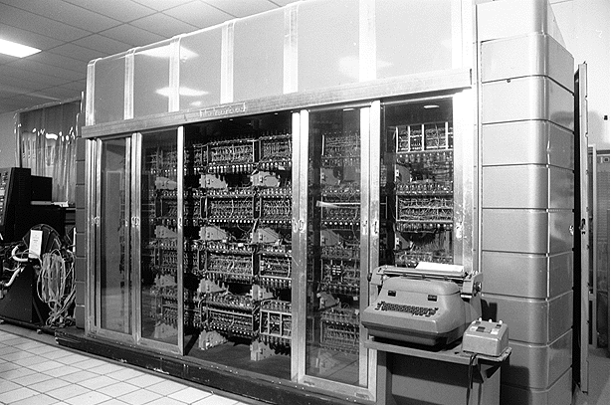
5 generations
First Generation 1940-1956: Vacuum Tubes The first computers used vacuum tubes for circuitry and memory, and were often enormous taking up entire.

Slide 5
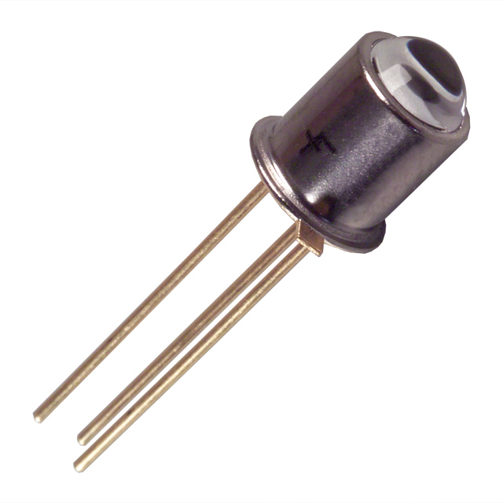
Second Generation 1956-1963: Transistors
Transistors replaced vacuum tubes and ushered in the second generation of computers. The transistor was invented in 1947 but did not see widespread use in computers until the late 50s.

Slide 6
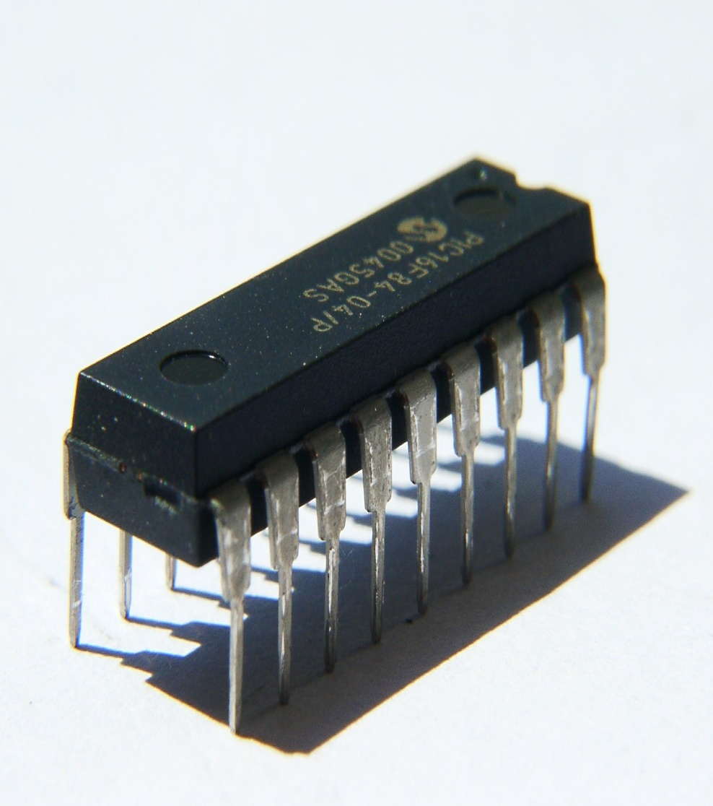
Third Generation 1964-1971: Integrated Circuits
The development of the integrated circuit was the hallmark of the third generation of computers Transistors were miniaturized and placed on silicon chips, called semiconductors, which drastically increased the speed and efficiency of computers.

Slide 7
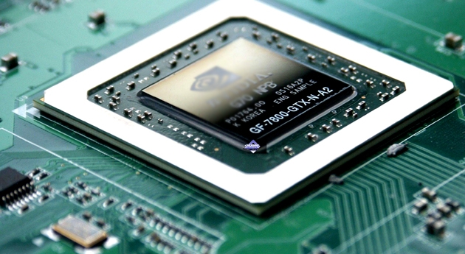
Fourth Generation 1971-Present:Microprocessors
The microprocessor brought the fourth generation of computers, as thousands of integrated circuits were built onto a single silicon chip.

Slide 8
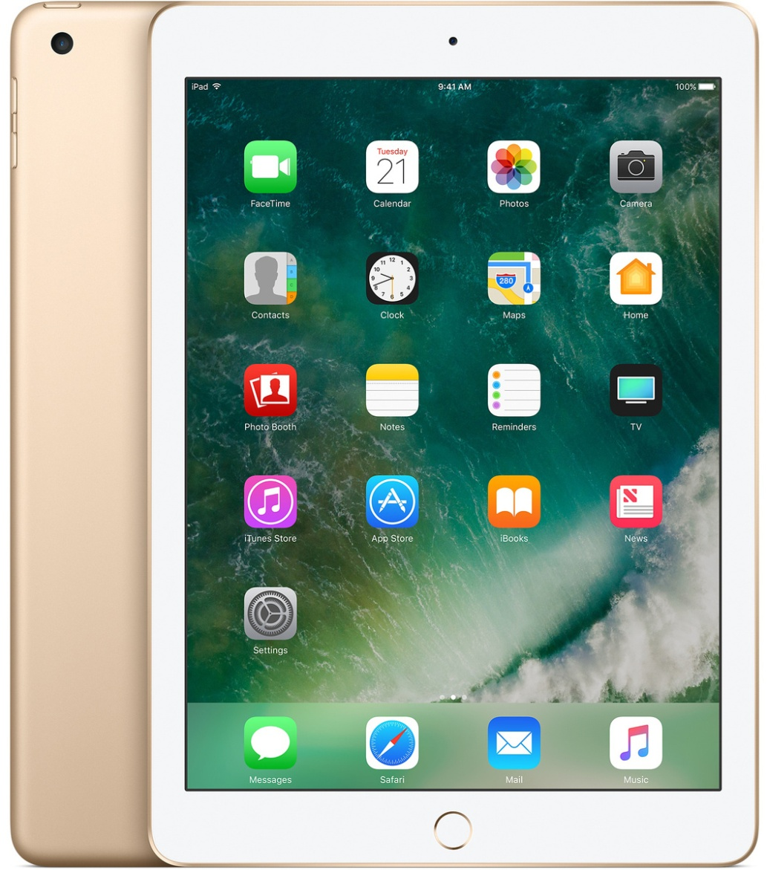
Fifth Generation of Computers
Fifth generation computing devices, based on artificial intelligence, are still in development, though there are some applications, such as voice recognition, that are being used today.

Slide 9
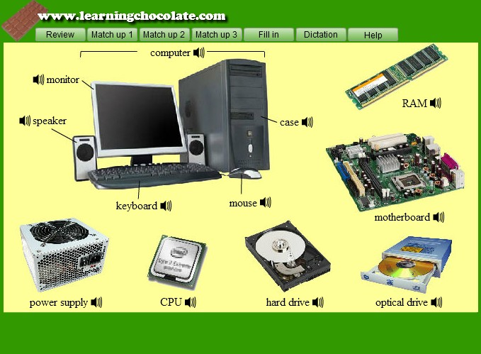
Computer hardware
Computer hardware is the collection of physical elements that constitute a computer system

Slide 10
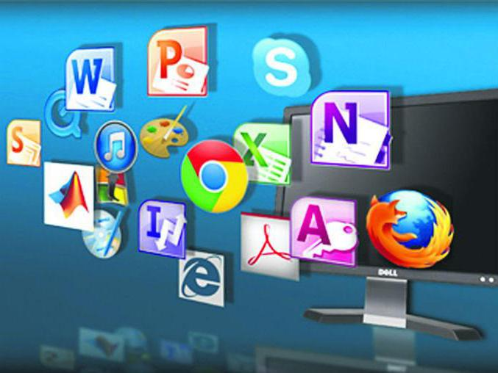
Computer software
Computer software, or just software, is any set of machine-readable instructions that directs a computer’s processor to perform specific operations.

Slide 11
Thanks For Attention

