Slide 1
The presentation was prepared by Boyko Alina The School-Gimnasium#1 The Form: 9 «A» The teacher: Tatyana Voropaeva

Slide 2
The most beautiful animals of the world

Slide 3
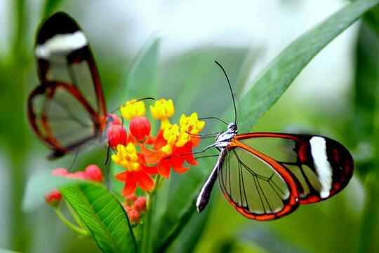
The most beautiful butterfly
These insect wings are covered with scales. In two pairs of wings of butterflies. For the beauty and variety of colors of butterfly wings called flying colors. Butterflies are one of the most beautiful animals in the world

Slide 4
Colorful birds

Slide 5
Paulk
The peacock is a very beautiful bird. It has a long beautiful neck and crest on its head. Its long feathers have moon-like spots. The colour of peacock is dark greenish blue. The peacock eats fruits, seeds, grains, worms and insects, etc. It generally lives in gardens. It is found also in places where there are large groves of trees. It is very graceful. It dances in rainy season. When the peacock spreads its tail, the tail looks like a big colourful fan. It is a national bird of India.

Slide 6
Humming bird
The smallest bird on earth - hummingbirds. This is one of the most beautiful creations of nature. One needs only to list the names of which were awarded this bird "topazny hummingbird", "emerald neck", "flying amethyst" and "fire topaz".

Slide 7
Owl
The owl is a bird of prey. It has large eyes and a flat face. It has powerful talons which help it to catch and kill prey. It can turn its head as much as 270 degree. It generally active at night. An owl has three eyelids: one for blinking, one for sleeping and one for keeping the eye clean and healthy.

Slide 8
Dolphins
Dolphins are one of the most beautiful animals in the word. Dolphins are mammals. They are carnivores (meat eaters). They are bright greenish blue above, and yellow colour on it’s sides. All over the sides of their bodies they have Irregular blue or golden blotches.Their skin is very sensitive and has no protection from bumps or bruises. They have excellent eyesight and hearing.They are warm blooded.

Slide 9
A dog is friends of man

Slide 10
Poodle
There is an opinion that this breed belongs to the category of glamorous decorative dogs. All the blame for curly haircuts and an impressive appearance, which flaunts poodles in the photo. In fact, this is an old hunting breed. Poodles are brave. They were used as dog officers, and also accompanied by soldiers during the war.

Slide 11
Dalmatian
Dalmatians are popular. Probably, there is no person in the whole world who does not know these refined and clever spotted dogs. Of course, everyone in childhood saw the famous film "101 Dalmatian". The image of good, faithful and slightly eccentric pets is forever imprinted into memory. But far from everyone knows that Dalmatians are the ideal working dogs

Slide 12
Husky
Now more and more popular among urban residents is a special and rare breed of dogs - the Siberian husky. These dogs do not look like the rest either in appearance, in character, or in relation to people. They are very friendly and sociable, intelligent and attentive, possess the ability peculiar only to them (because of what the dog of this breed named Mishka became popular on the Internet) - to make sounds resembling human speech.

Slide 13
dear children! take care of animals, because they are our smaller brothers

