Slide 1
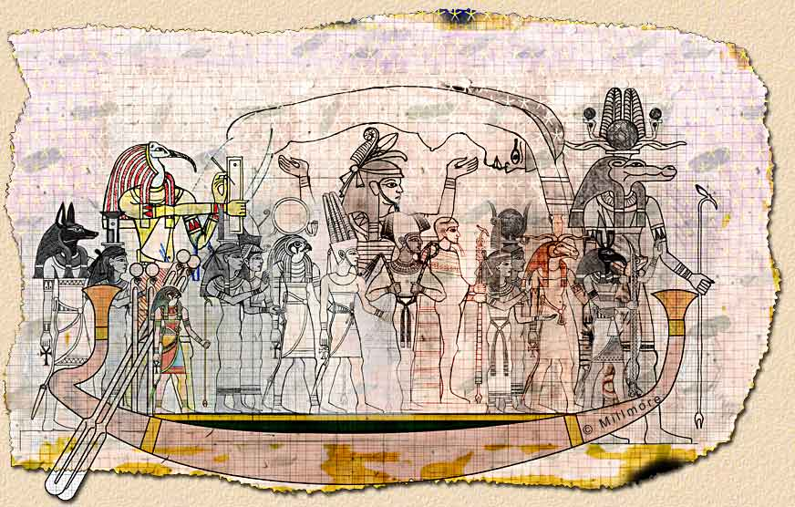
Ancient Egyptian Gods and Goddesses
Egyptian Gods
The Presentation is created by
Chernyayeva Kseniya
Form: 9 “A”
School-Gymnasium №1
of Mamlutka
Teacher: Tatyana Voropayeva

Slide 2
Ancient Egyptian Gods and Goddesses
For all ancient people, the world was filled with mystery. Much of what they experienced in the world around them was unknowable and frightening. The ancient Egyptian gods and goddesses represented aspects of the Egyptians' natural and “supernatural” surroundings and helped them understand its many aspects.

Slide 3
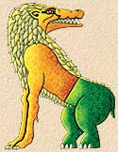
Demons were more powerful than human beings but not as powerful as gods. They were usually immortal, could be in more than one place at a time, and could affect the world as well as people in supernatural ways. But there were certain limits to their powers and they were neither all-powerful nor all knowing. Among demons the most important figure was Ammut – the Devourer of the Dead – part crocodile, part lioness, and part hippopotamus. She was often shown near the scales on which the hearts of the dead were weighed against the feather of Truth. She devoured the hearts of those whose wicked deeds in life made them unfit to enter the afterlife. Apepi, another important demon, (sometimes called Apophis) was the enemy of the sun god in his daily cycle through the cosmos, and is depicted as a colossal snake.
Demons

Slide 4
Ancient Egyptian Gods and Goddesses
Most Egyptian gods represented one principle aspect of the world: Ra was the sun god, for example, and Nut was goddess of the sky.The characters of the gods were not clearly defined. Most were generally benevolent but their favor could not be counted on. Some gods were spiteful and had to be placated. Some, such as Neith, Sekhmet, and Mut, had changeable characters. The god Seth, who murdered his brother Osiris, embodied the malevolent and disordered aspects of the world.

Slide 5
Ancient Egyptian Gods and Goddesses
The physical form taken on by the various Egyptian gods was usually a combination of human and animal, and many were associated with one or more animal species. And an animal could express a deity's mood. When a god was angry, she might be portrayed as a ferocious lioness; when gentle, a cat. The convention was to depict the animal gods with a human body and an animal head. The opposite convention was sometimes used for representations of a king, who might be portrayed with a human head and a lion's body, as in the case of the Sphinx. Sphinxes might also appear with other heads, particularly those of rams or falcons.

Slide 6
Many deities were represented only in human form. Among these were such very ancient figures as the cosmic gods Shu of the air, Geb of the earth, the fertility god Min, and the craftsman Ptah. There were a number of minor gods that took on grotesque forms, including Bes, a dwarf with a mask-like face, and Taurt, a goddess whose physical form combined the features of a hippopotamus and a crocodile.

Slide 7
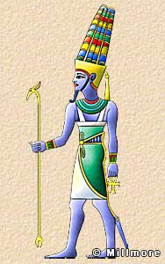
Also Known as Amen, Amun, Ammon Amun was the chief Theban deity whose power grew as the city of Thebes grew from an unimportant village, in the old Kingdom, to a powerful metropolis in the Middle and New Kingdoms. He rose to become the patron of the Theban pharaohs and was eventually combined with sun god, Ra who had been the dominant deity of the Old Kingdom to become Amun-Ra, King of the Gods and ruler of the Great Ennead.
Amun's name means “Hidden One, Mysterious of Form,” and although he is most often represented as a human wearing a double plumed crown, he is sometimes depicted as a ram or a goose. The implication is that his true identity can never be revealed.
Amun

Slide 8
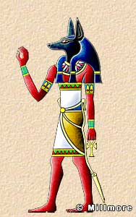
Protector of the Dead Anubis is shown as a jackal-headed man, or as a jackal. His father was Seth and his mother Nephythys.His cult center was Cynopolis, now known as El Kes. He was closely associated with mummification and as protector of the dead. It was Anubis who conducted the deceased to the hall of judgment.
Anubis

Slide 9
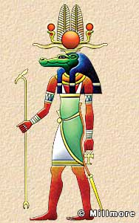
Sobek was a crocodile god, depicted as a crocodile on an altar or as a man with a crocodile head wearing a headdress in the form of the sun disk with upright feathers and horns. Sobek's main cult centers were at Medinet el Fayum and at the temple of Kom Ombo, which he shared with Horus and which still exists today. There was a pool at Kom Ombo containing sacred crocodiles and it is still possible to see original mummified crocodiles at the temple.
Sobek

Slide 10
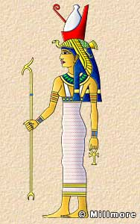
Mut formed part of the Theban Triad. She was one of the daughters of Ra, the wife of Amun, and mother of Khonsu. She was the Vulture goddess and is often depicted as a woman with a long, brightly colored dress and a vulture headdress surmounted by the double crown. In her more aggressive aspect she is shown as a lion-headed goddess.
Like Isis and Hathor, Mut played the role of divine mother to the king. Her amulets, which depict her as a seated woman suckling a child, are sometime confused with those of Isis.
Mut

Slide 11
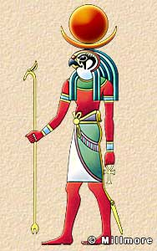
Also known as Khons Khensu, Khuns Khonsu was the son of Amun and Mut, with whom he formed the Theban triad. He was a moon god depicted as a man with a falcon-head wearing a crescent moon headdress surmounted by the full lunar disc. Like Thoth, who was also a lunar deity, he is sometimes represented as a baboon. Khonsu was believed to have the ability to drive out evil spirits. Rameses II sent a statue of Khonsu to a friendly Syrian king in order to cure his daughter of an illness.
His temple was within the precincts of Karnak.
Khonsu

Slide 12
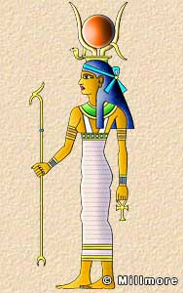
Hathor was the daughter of Ra and the patron goddess of women, love, beauty, pleasure, and music.She is depicted in three forms; as a cow, as a woman with the ears of a cow, and as a woman wearing the headdress of a cow's horns. In this last manifestation, she holds the solar disc between her horns.She was the consort of Horus, and her name actually means “House of Horus.” She had many temples the most famous of which is at Dendara.
There was a dark side to Hathor. It was believed that Ra sent her to punish the human race for its wickedness, but Hathor wreaked such bloody havoc on earth that Ra was horrified and determined to bring her back. He tricked her by preparing vast quantities of beer mixed with mandrake and the blood of the slain. Murdering mankind was thirsty work, and when Hathor drank the beer she became so intoxicated that she could not continue her slaughter.
Hathor

Slide 13
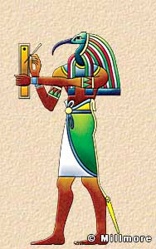
Thoth was the god of writing and knowledge, and was depicted as a man with the head of an ibis holding a scribe's pen and palette, or as a baboon. The Greeks associated him with Hermes and ascribed to him the invention of all the sciences as well as the invention of writing. He is often portrayed writing or making calculations.
Thoth stands apart from most of the other gods. He was as old as the oldest gods and often acted as an intermediately between gods. He was associated with the moon, and is sometimes shown wearing a moon disk and crescent headdress. One of his most important roles was to record the deeds of the dead at the day of their judgment and is often seen doing this in the Book of the Dead. His main temple was at Hermopolis in Middle Egypt.
Thoth

