Slide 1
Speedcubing
And
Rubik's Cube
Presented by Utebaev Tamerlan The 10-th form «A»
School-Gymnasium №1
North-Kazakhstan region, Mamlyutka
Teacher: Tatyana Voropaeva

Slide 2
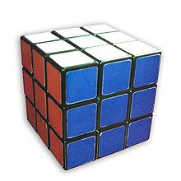
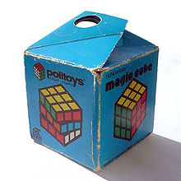
History
Rubik's Cube is a 3-D combination puzzle invented in 1974 by Hungarian sculptor and professor of architecture Ernő Rubik. Originally called the Magic Cube, the puzzle was licensed by Rubik to be sold by Ideal Toy Corp.

Slide 3
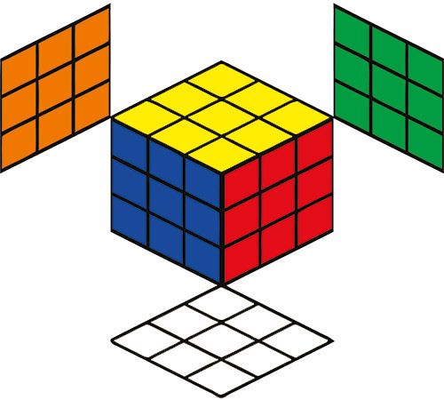
On a classic Rubik's Cube, each of the six faces is covered by nine stickers, each of one of six solid colours: white, red, blue, orange, green, and yellow. In currently sold models, white is opposite yellow, blue is opposite green, and orange is opposite red, and the red, white and blue are arranged in that order in a clockwise arrangement

Slide 4
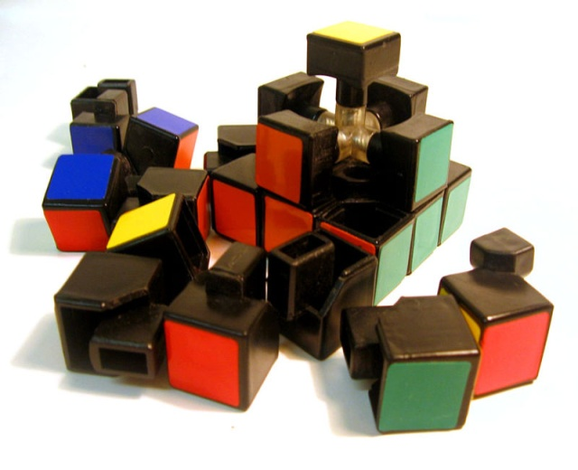
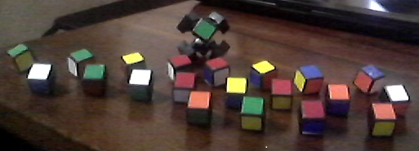
Mechanics
A standard Rubik's Cube measures 5.7 centimetres (2 1⁄4 in) on each side. The puzzle consists of twenty-six unique miniature cubes, also called "cubies" or "cubelets". Each of these includes a concealed inward extension that interlocks with the other cubes while permitting them to move to different locations. However, the centre cube of each of the six faces is merely a single square facade; all six are affixed to the core mechanism

Slide 5
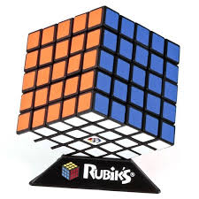
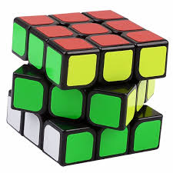
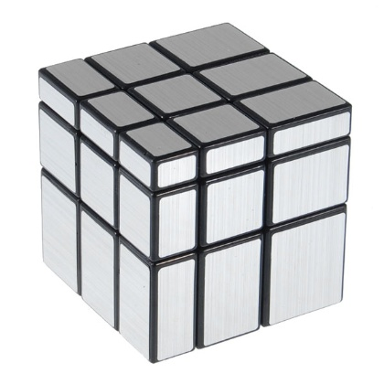
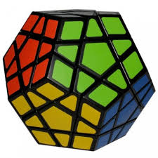
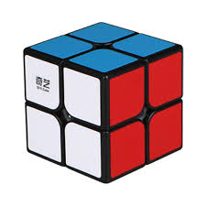
Different kinds

Slide 6
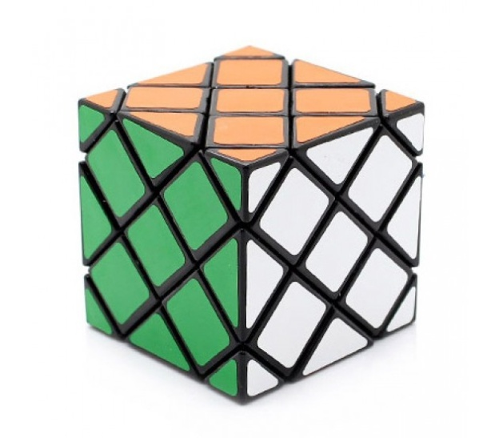
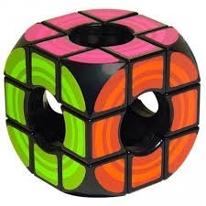
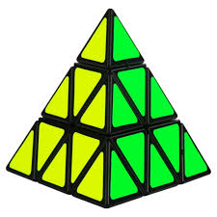
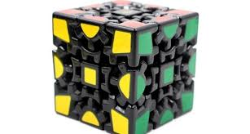
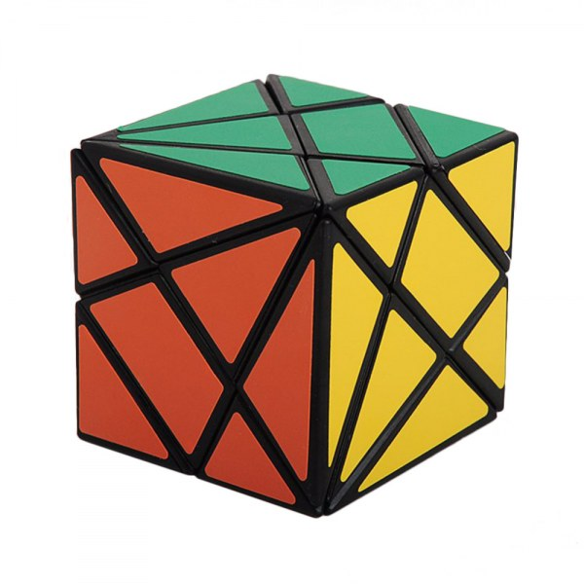

Slide 7
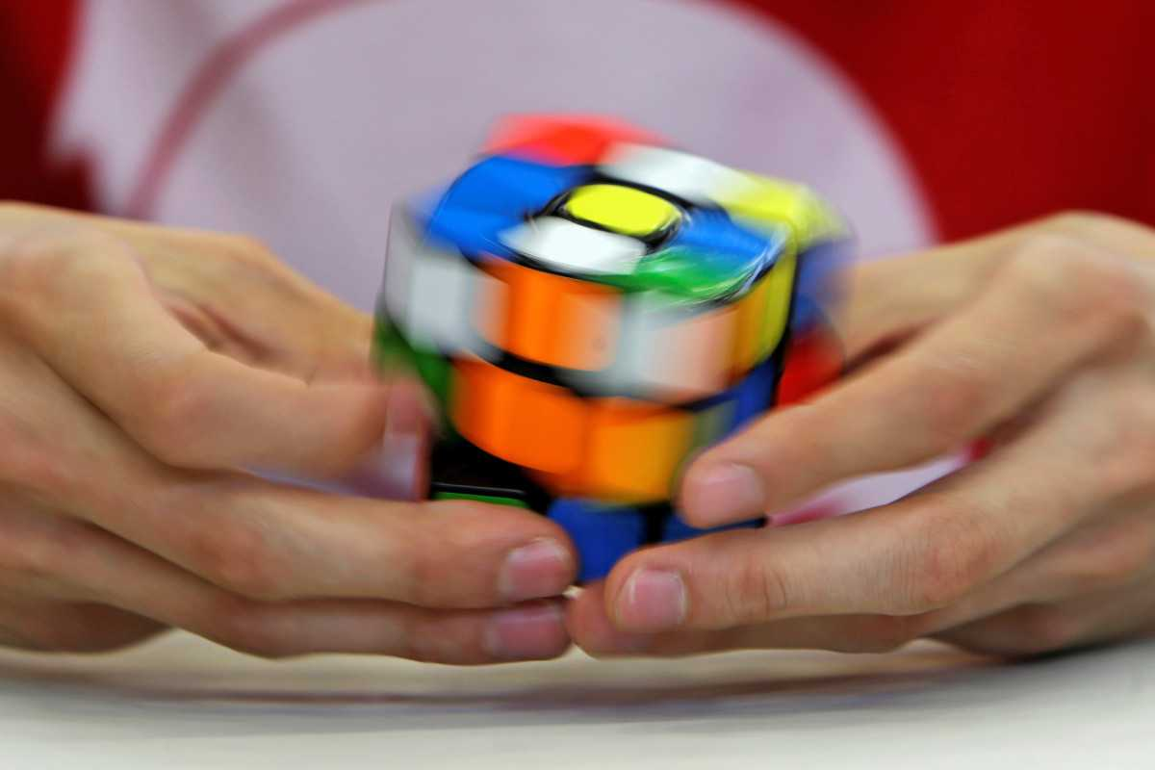
Speedcubing
People who are keen on speedy assembly of the Rubik's cube are called speedcubes. And the speed assembly itself – speedcubing. A solution commonly used by speed cubers was developed by Jessica Fridrich.

Slide 8
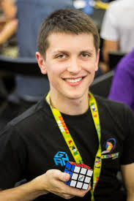
Records
The world record time for solving a 3×3×3 Rubik's Cube is 4.59 seconds, held jointly by Feliks Zemdegs of Australia set on 27th January 2018 at the Hobart Summer 2018

Slide 9
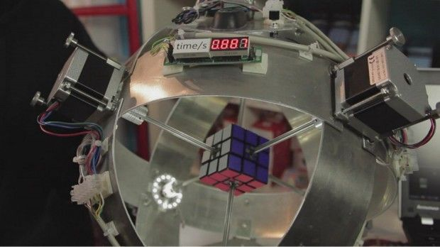
Artificial Intelligence
In November 2015, a machine created by Zachariah Gromko (Zachary Gromko), a student from the United States, collected Rubik's cube for 2.39 seconds.

Slide 10
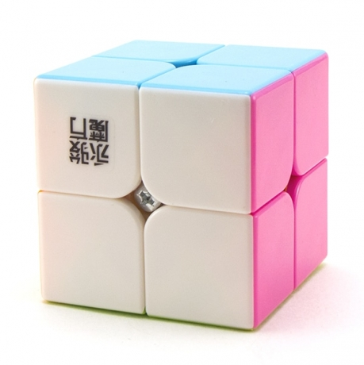
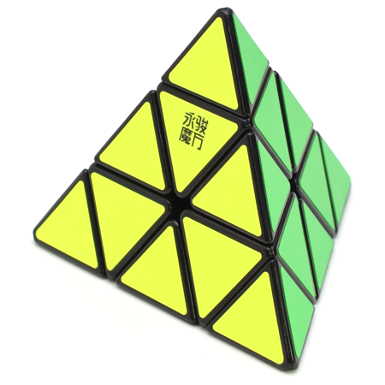
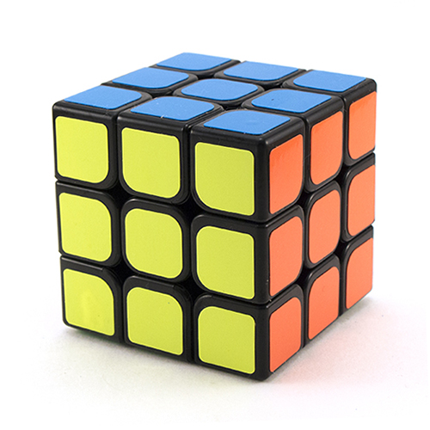
My collection
I myself also love Rubik's cube. There are 4 different puzzles in my collection. In the future I want to collect the entire collection.
MoYu YuPo 2x2x2
MoYu YuLong Pyraminx
Mirror Cube
MoYu Guanlong 3x3x3

Slide 11
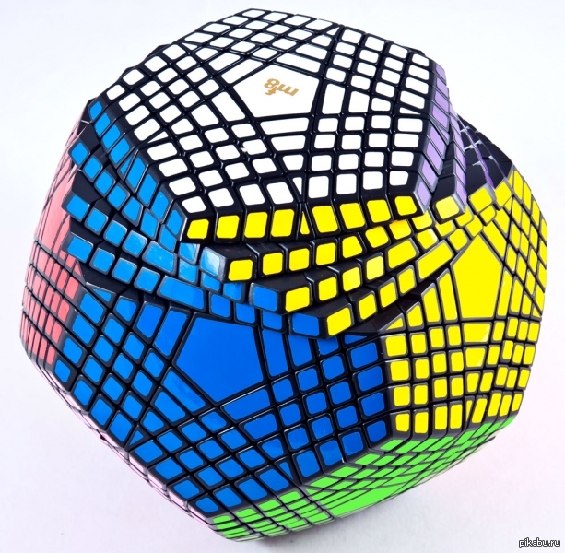
The most complex puzzle game
Petamix is the most difficult puzzle from the existing analogues of Rubik's cube.
Petamins from the Rubik's family of cubes is a puzzle consisting of 12 different colored faces, each of which is a pentagon with nine layers.

Slide 12
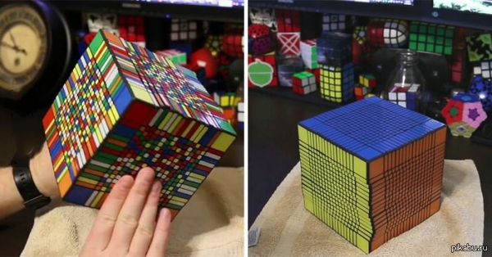
Rubik's Cube 17x17x17

Slide 14
Information sources
Wikipedia.org/wiki/Rubik’s_cube
Google
Picabu.ru/story
Personal experience

