Slide 1
Black Friday
Prepared by Trunov arsen
Checked by voropaeva t. G.
School-Gymnasium №1 of Mamlutka

Slide 2
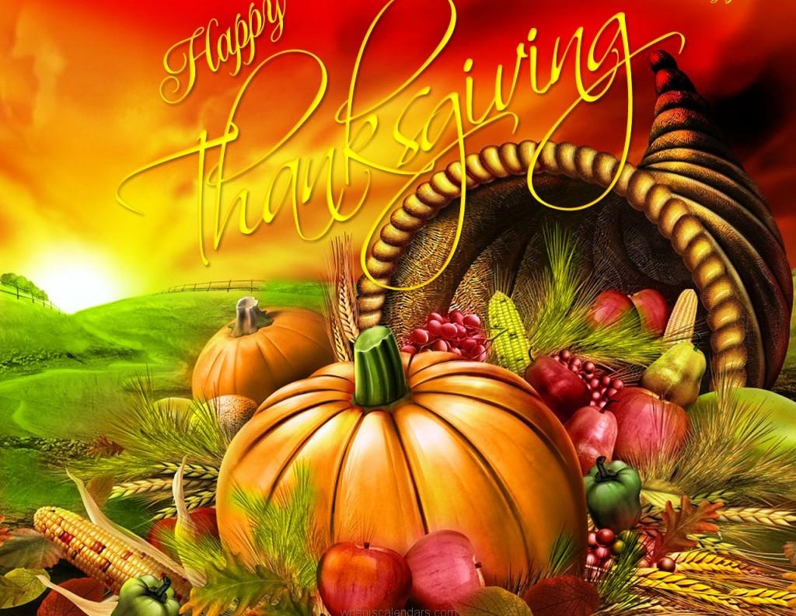
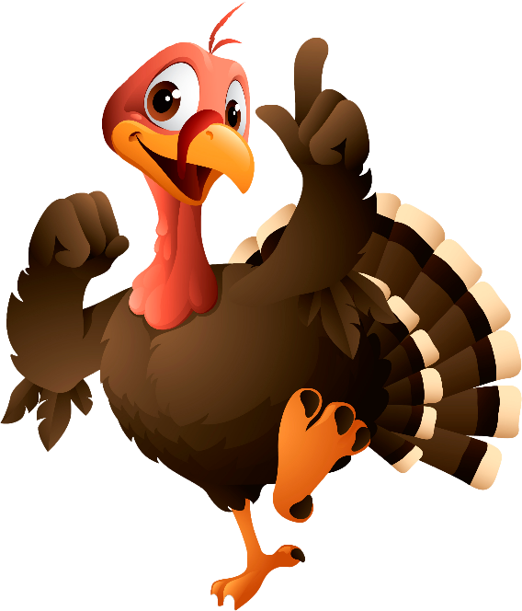
What is Black Friday?
Black Friday is an informal name for the day after Thanksgiving, which has been regarded as the beginning of the country’s Christmas shopping season since 1952.

Slide 3
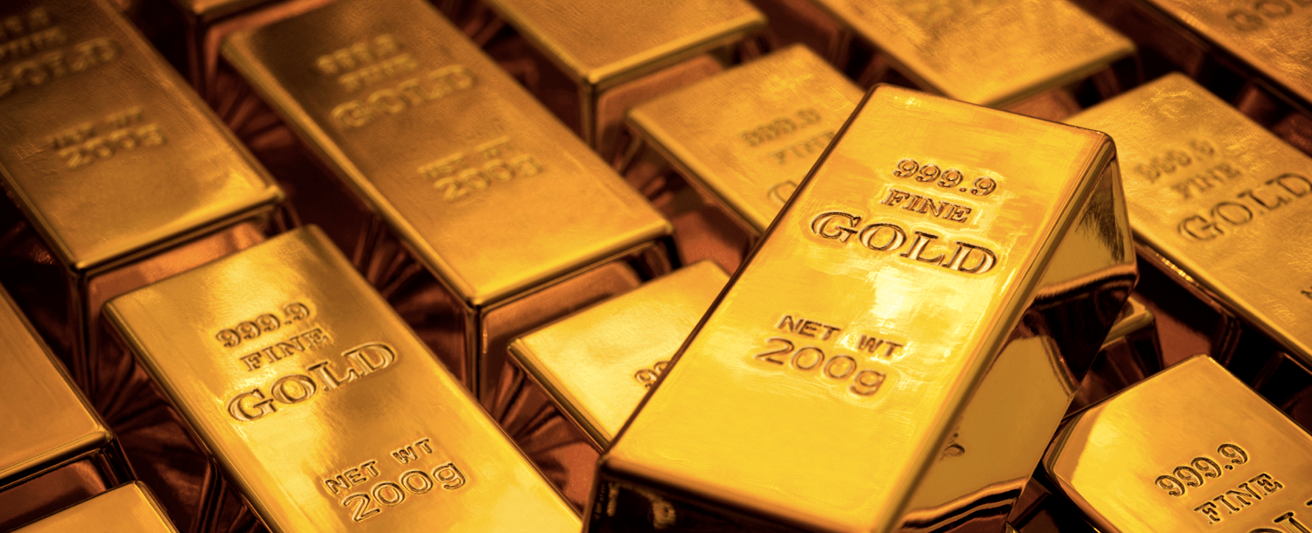
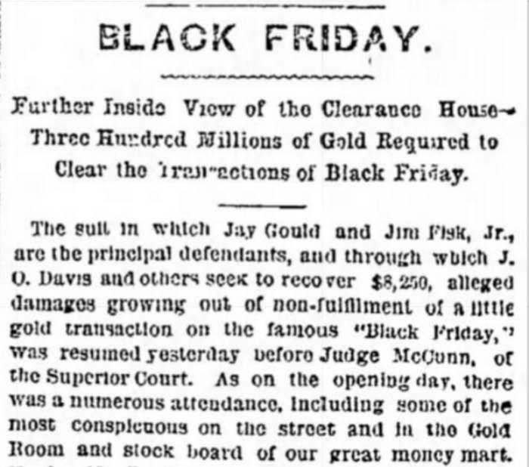
The first mention of The Black Friday
Its name "Black Friday" was not in honor of sales. For a long time the so-called collapse of the gold market on September 24, 1869. After it was used for other stock market crises on Wall Street.

Slide 4
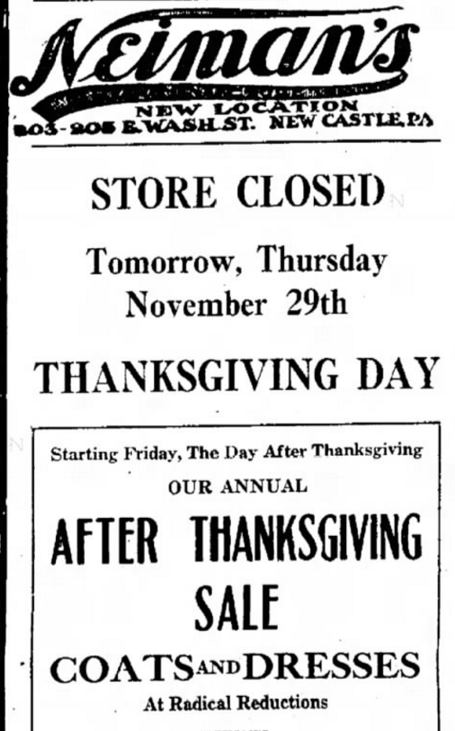
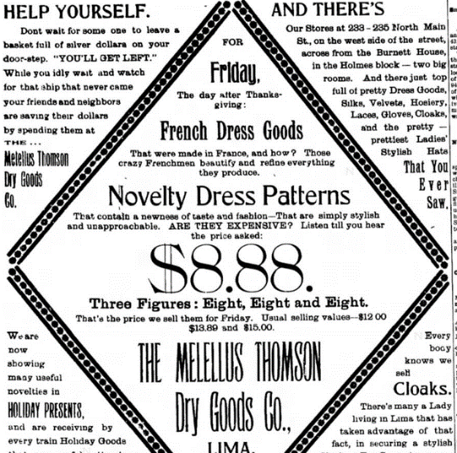
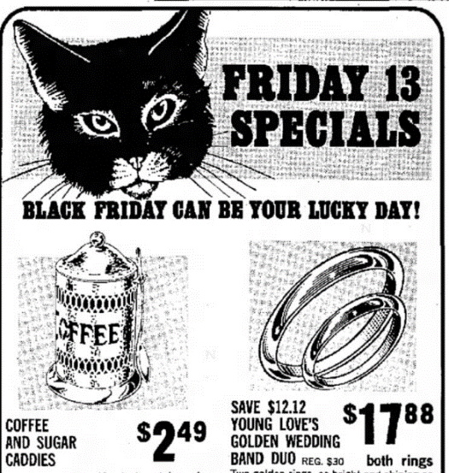
Promotions of XX century
“Sale of coffee and sugar - $2.49
Both rings - $17.88
Novelty dress patterns - $8.88”

Slide 5
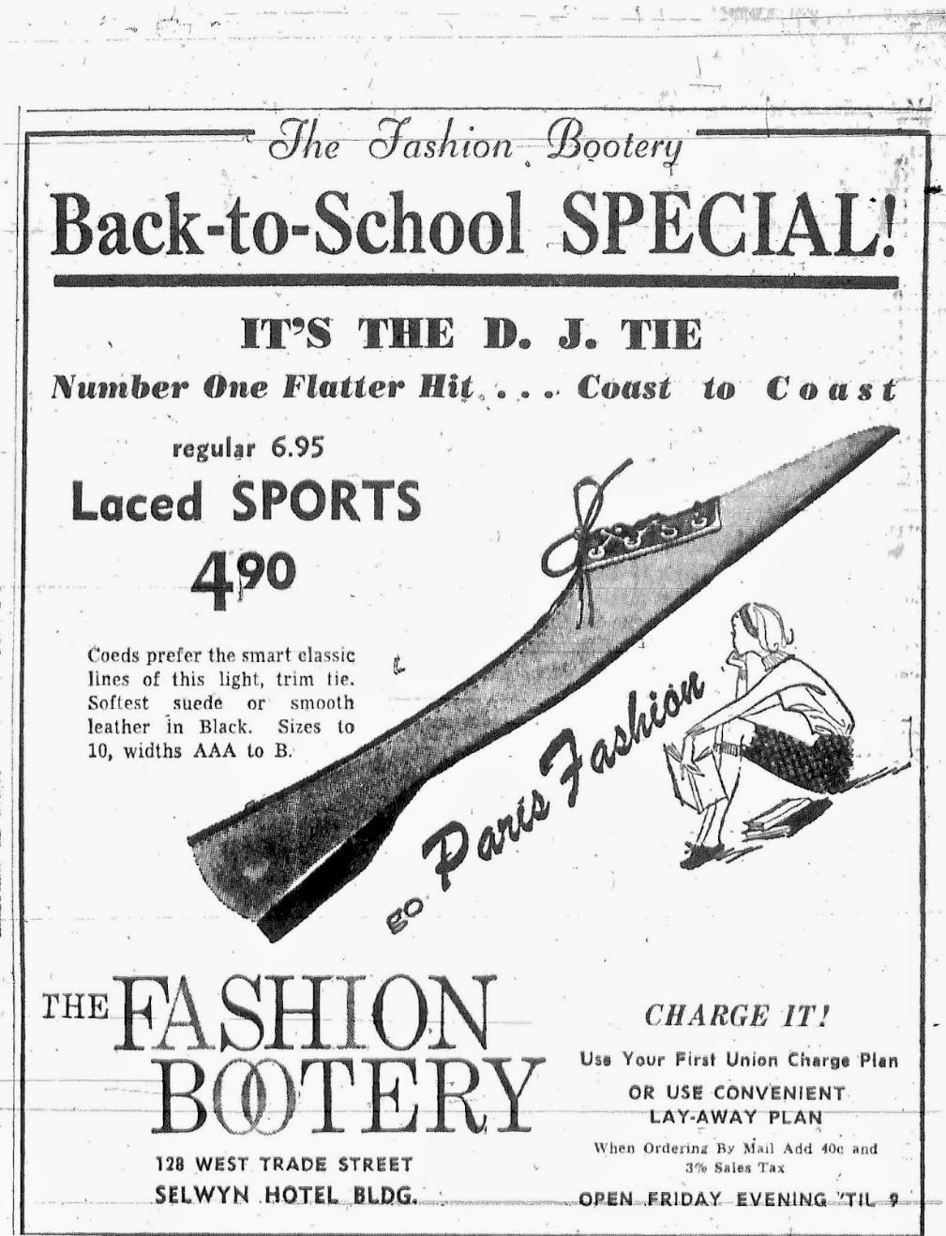
Ads from magazines

Slide 6
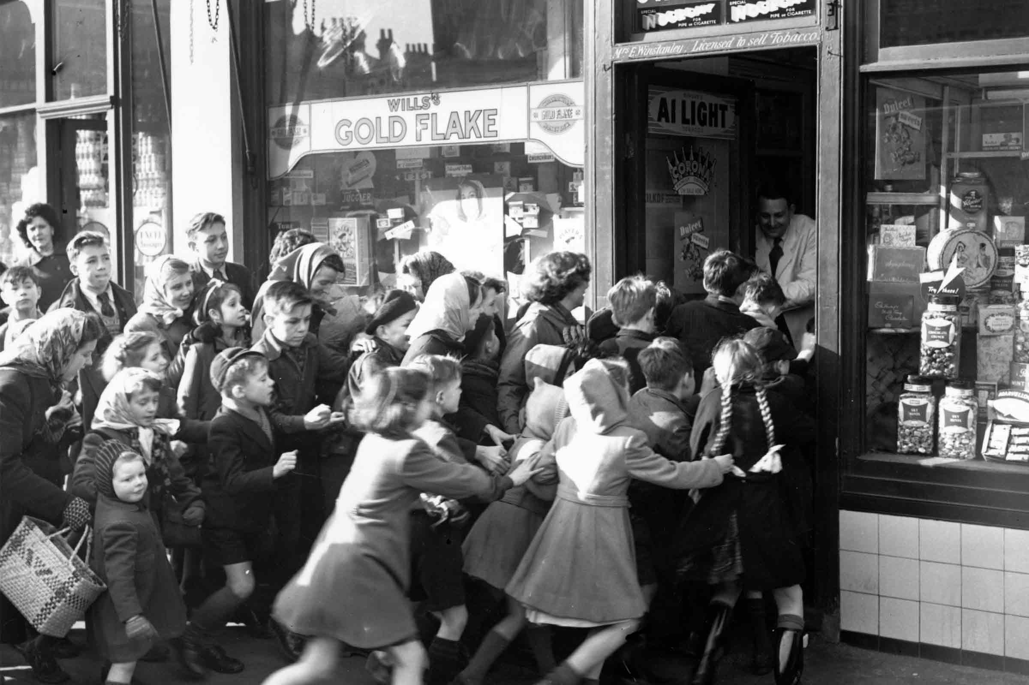
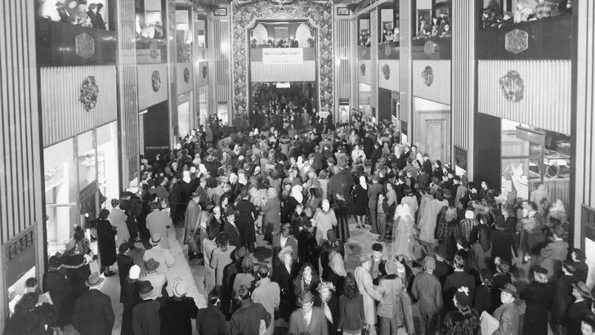
Black Friday at 60-70th
In 60-70th of XX century “Black Friday” was associated with huge traffic jams on the roads and shopping centers.

Slide 7
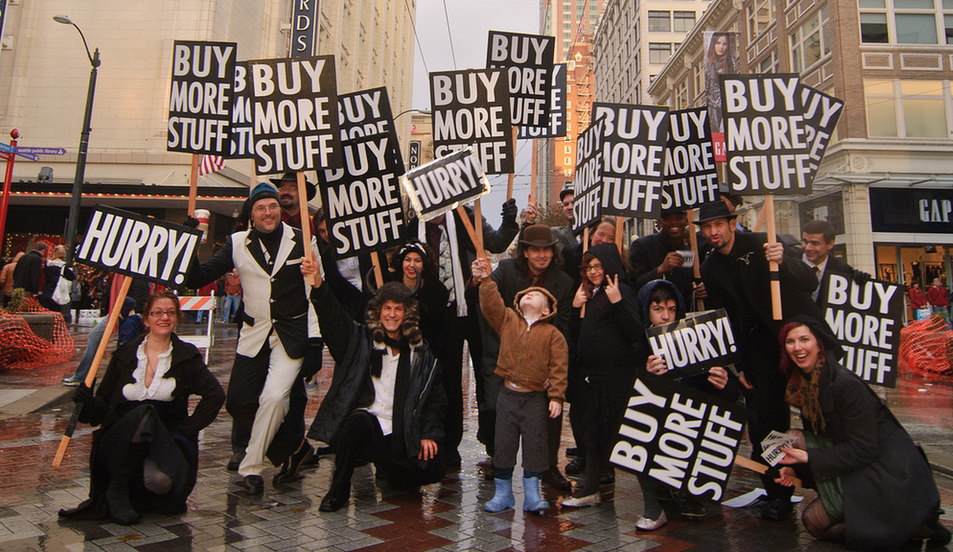
Black Friday
Most major retailers open very early, as early as overnight hours, an promotional sales. Black Friday is not an official holiday, but California and some other states observe “the day after Thanksgiving“ as a holiday. Black Friday has routinely been the busiest shopping day of the year.

Slide 8
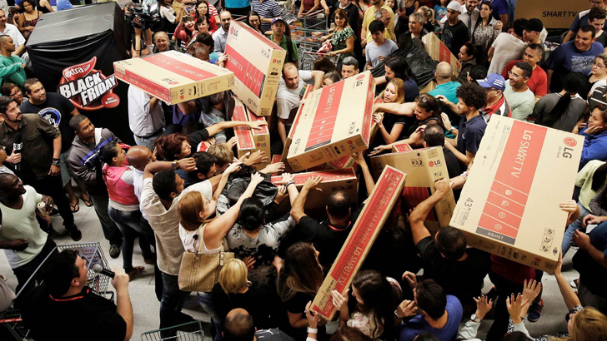
Black Friday at now
In our time the concept of Black Friday has changed in comparison with the past. People have become more aggressive. They began to spend on these sakes more money than in the past time. Peak of sales was in 2013.

Slide 9
Buyers spending

Slide 10
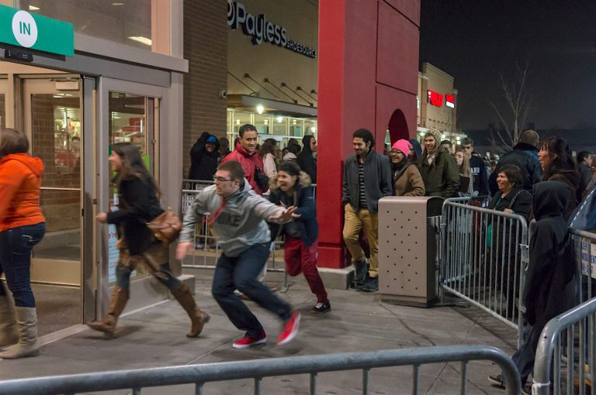
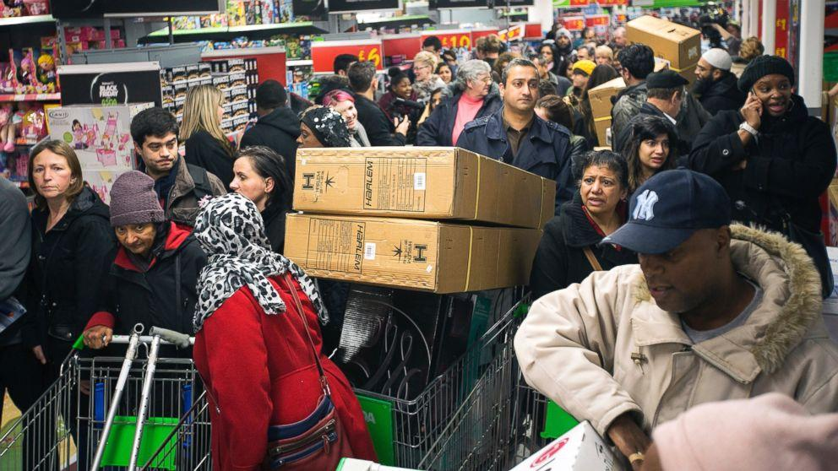
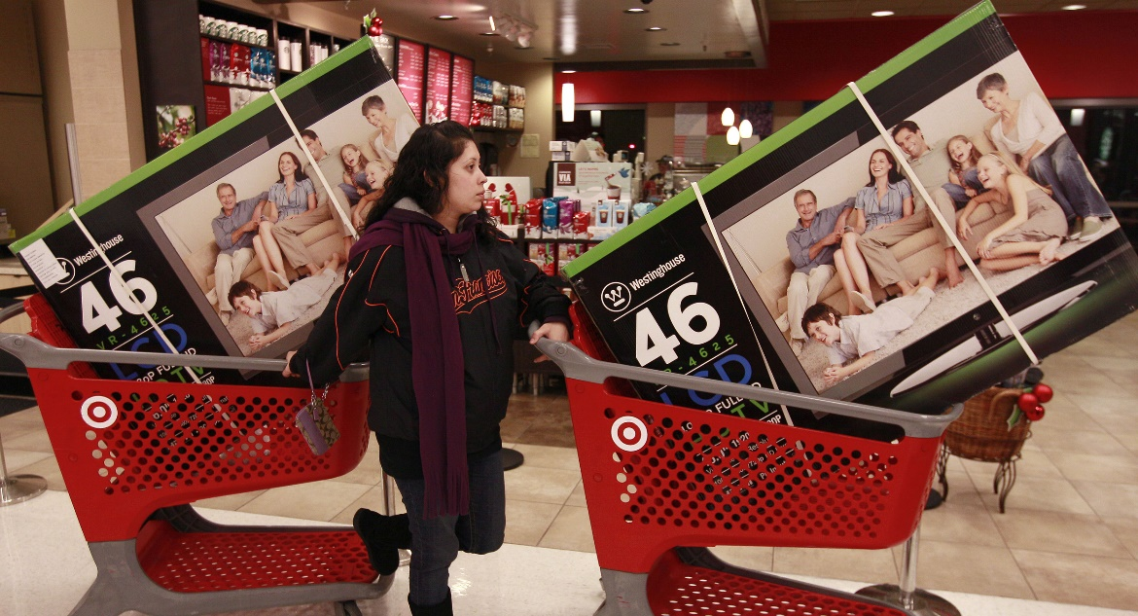
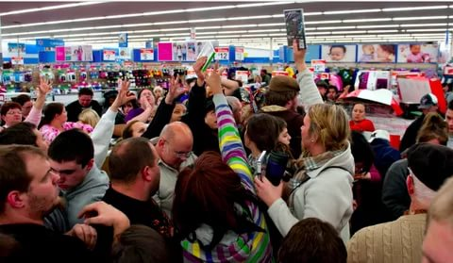

Slide 11
Happy Black Friday!

Slide 12
Sources
https://en.wikipedia.org/wiki/Black_Friday_(shopping)
https://keddr.com/2017/11/istoriya-vozniknoveniya-i-traditsii-chernoy-pyatnitsyi/
http://www.odinpost.com/ru/main/articles/chernaja-pjatnica-black-friday/
https://vesti-ukr.com/kultura/211938-kak-pojavilac-chernaja-pjatnitsa-ictorija-i-traditsii-lehendarnoj-racprodazhi
https://tjournal.ru/53203-black-friday-history

