Slide 1
Two sorts of charges
Two rulers are made from the same kind of white plastic.
You can charge the rulers by rubbing both of
them with a cloth.

Slide 2
vocabulary
Repel-отталкивать
a positive (+) charge-положительный (+) заряд
negative (-) charge-отрицательный (-) заряд.

Slide 3
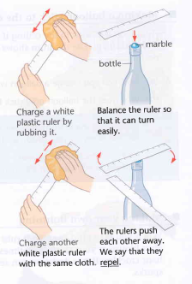
Two objects that have the same electrical charge repel each other.
Copy and complete the sentences.
Both white rulers are made of the same kind of________.
They are both rubbed with the same________.
So the electrical charge on both rulers must also be the________.
Two objects that have the same electrical charge repel each other.

Slide 4
2. Copy and complete the sentences.
Both white rulers are made of the same kind of________.
They are both rubbed with the same________.
So the electrical charge on both rulers must also be the________.
Two objects that have the same electrical charge repel each other.

Slide 5
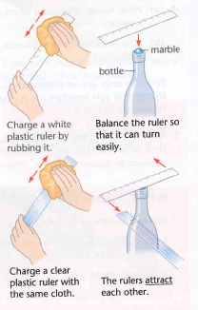
Testing a different plastic
Copy and complete the sentences.
The clear plastic ruler _______ the white plastic ruler.
But if two charges are the same, they repel each other.
So the electrical charge on the clear plastic must be_______ from the electrical charge on the white plastic.

Slide 6
What do we call the different charges?
The charge on a clear plastic ruler is different from the charge on a white plastic ruler. This is because the rulers are made of different kinds of plastic.
A clear plastic ruler is made from acrylic plastic.
When you charge something made from acrylic plastic, you give it a positive (+) charge.
A white plastic ruler is made from polythene.
When you charge something made from polythene, you give it a negative (-) charge.

Slide 7
Different charges attract each other.
Charges that are the same repel each other.

