Slide 1
A little bit about the United Kingdom
Created by
Antropova Elena,
Rogochova Elena
Teacher: Tatyana Voropaeva
School-Gymnasium №1of Mamlutka

Slide 2
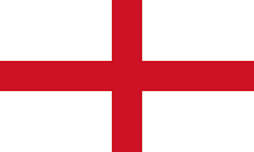
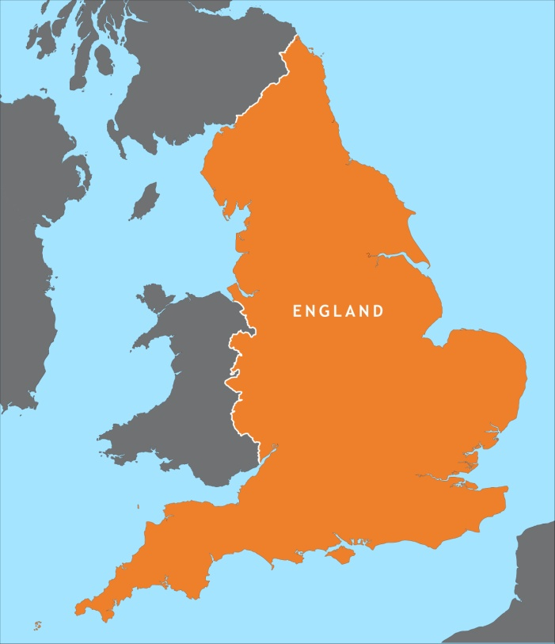
England
England is the largest and the richest country of Great Britain
The capital of England is London
National language – English
Regional languages – Cornish
Legislature - UK Parliament

Slide 3
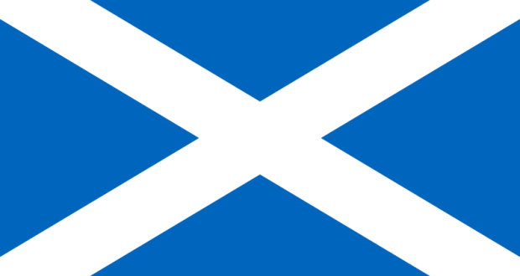
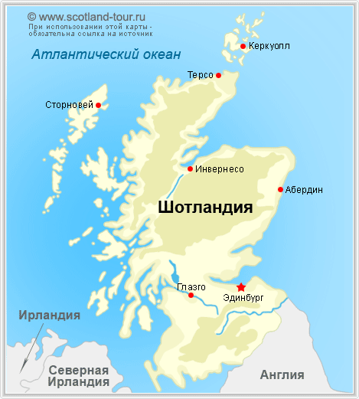
Scotland
Nowadays, this country is one of the most visited tourist places in the whole world
Capital - Edinburgh
Official languages - Scottish English
Recognised regional languages – Scottish, Gaelic, Scots
Currency - Pound sterling

Slide 4
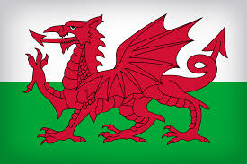
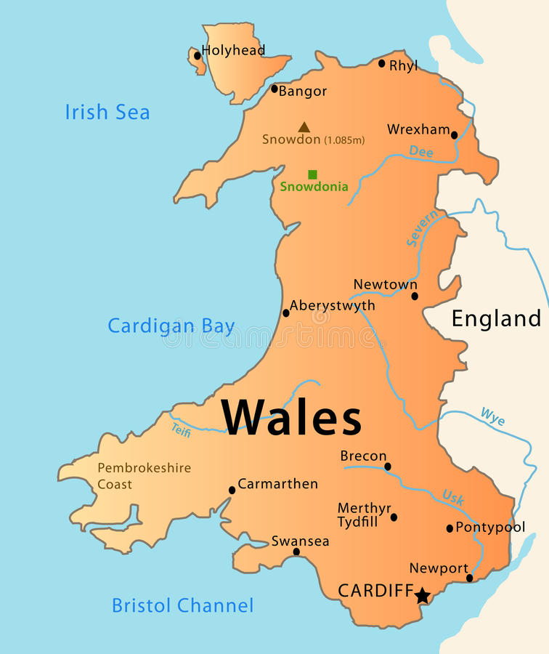
Wales
Wales is a country that is part of the United Kingdom and the island of Great Britain
Official languages – Welsh, English
Capital – Cardiff
Patron saint - Saint David

Slide 5
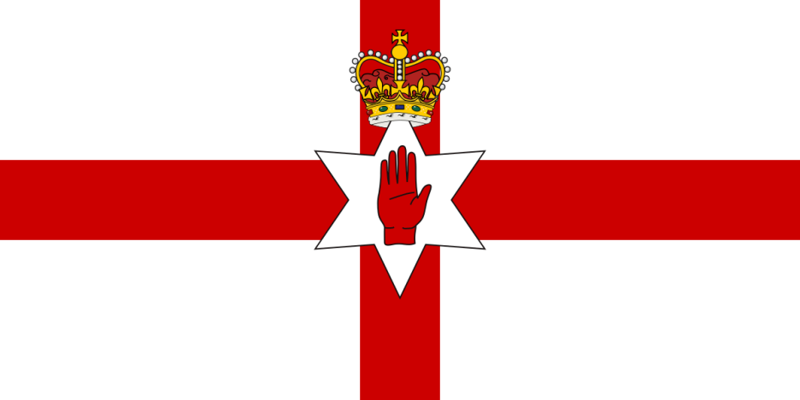
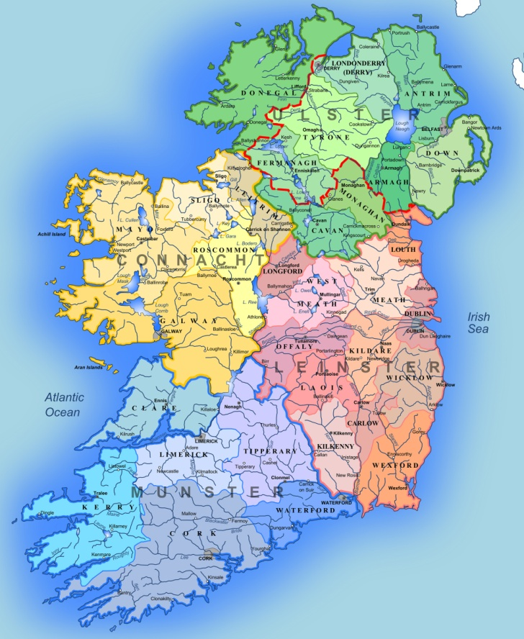
Ireland
Ireland is an island in the North Atlantic
Largest city – Dublin
Languages - English, Irish, Ulster Scots
The name Ireland derives from Old Irish Eriu. This in turn comes from the Proto-Celtic *Iveriuwhich is also the source of Latin Hibernia. Iveriu derives from a root meaning 'fat, prosperous'

Slide 6
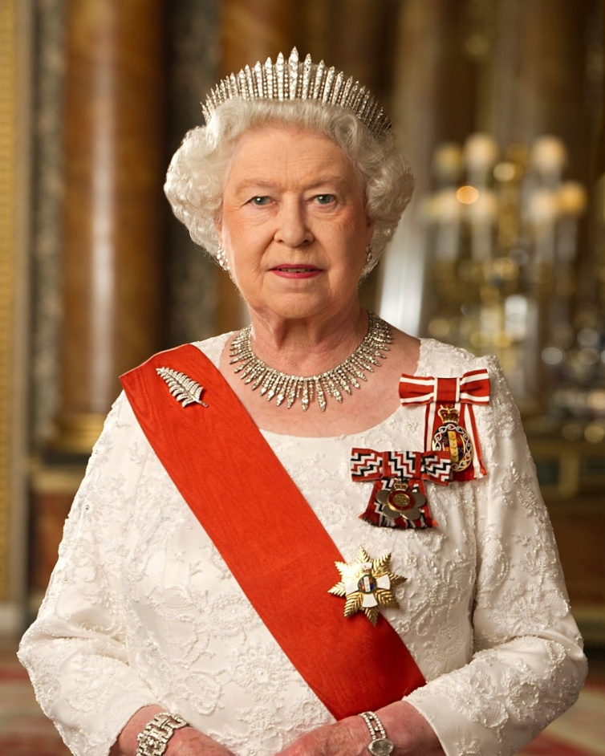
Elizabeth II
Elizabeth II is the Queen of the United Kingdom. She was born on April 21st, 1926. Her full name is Elizabeth Alexandra Mary and she is the monarch of sixteen sovereign states, their respective overseas territories and dependencies. Elizabeth was born in London and educated privately at home. From the very childhood she was very keen on studying. Her most favourite subjects included arts and sport. Her youth was troubled by the Second World War. At the age of 15 Elizabeth had been appointed Colonel-in-Chief. The significant moments in Queen’s life have included the births and marriages of her children and grandchildren, the investiture of her oldest son - the Prince of Wales, and the celebration of such milestones as Silver, Golden and Diamond Jubilees.

Slide 7
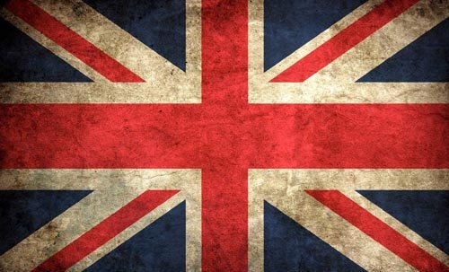
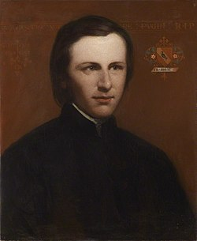
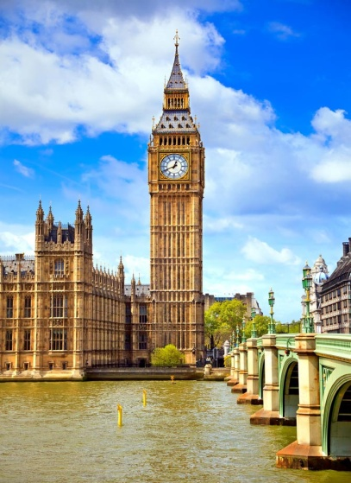
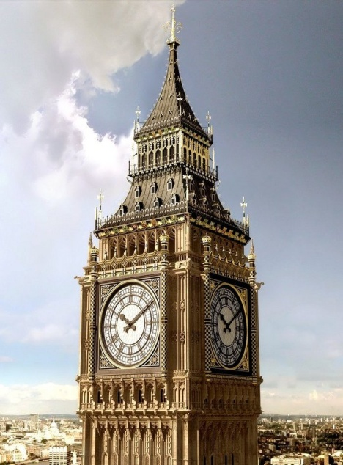
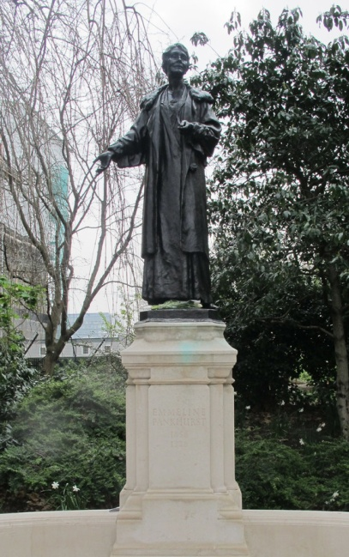
Big Ben
Big Ben is the largest of the six bells of Westminster Palace in London.
The tower was built in 1858. The project architect was Augustus Pugin. The height of the tower and spire is 96.3 m.
The Clock Tower is the largest four-sided clock mechanism in the world, and in addition, with the most accurate clocks.
At the base of each of the four clock dials there is a Latin inscription “Domine Salvam fac Reginam nostram Victoriam primam” (“God save our Queen Victoria I”).
There used to be a prison in Big Ben. The last prisoner of Big Ben was a fighter for women’s rights Emmeline Pankhurst. Now, next to the Parliament there is a monument to her.

Slide 8
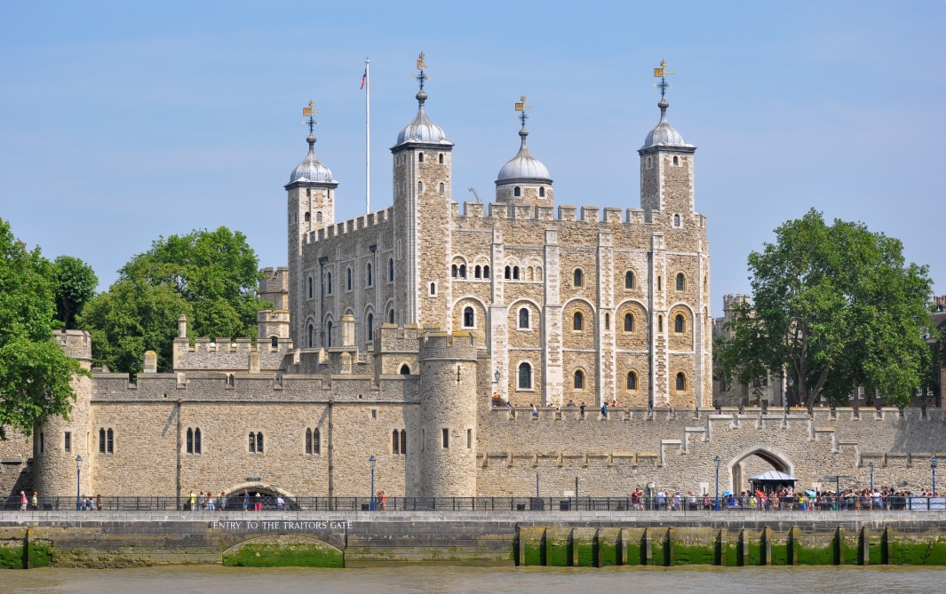
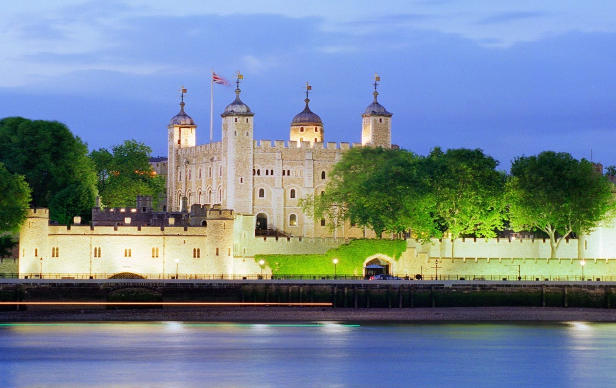
THE Tower of London
The Tower of London is one of the most imposing and popular of London's historical sites. It comprises not one, but 20 towers. The oldest of which, the White Tower, dates back to the llth century and the time of William the Conqueror
Nowadays a lot of tourists visit the Tower of London, because of the Tower's evil reputation as a prison. The Tower is famous as home of the Crown Jewels. Today they can be viewed in their new jewel house. They include the Crown of Queen Elizabeth the Queen Mother which contains the celebrated Indian diamond

Slide 9
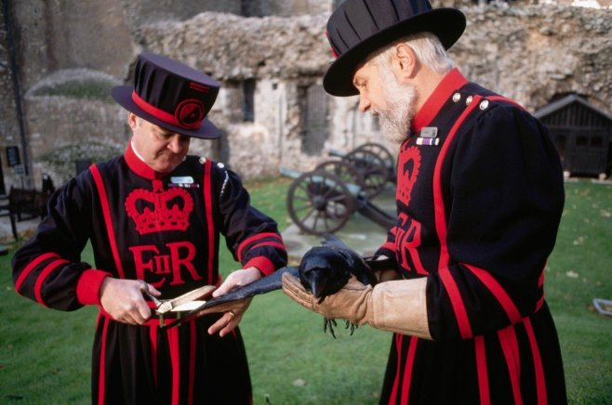
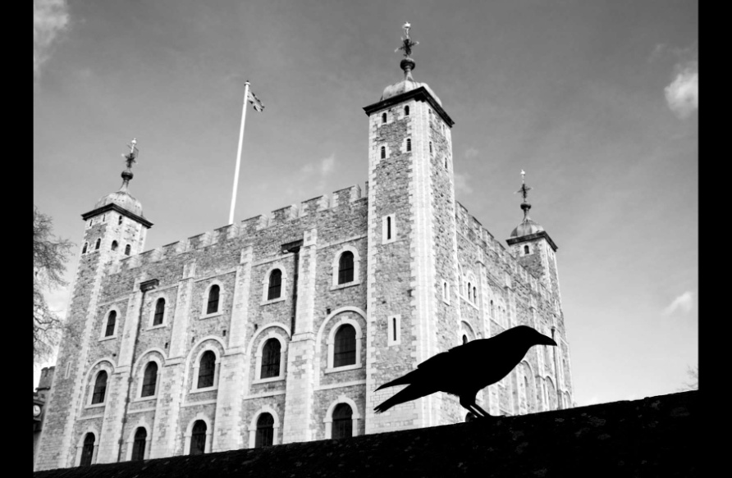
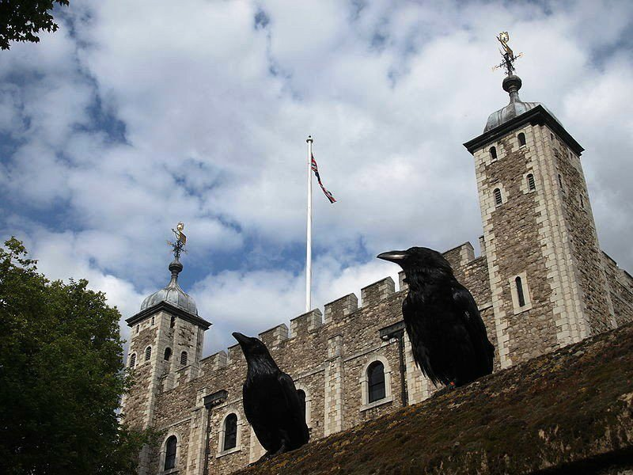
Ravens of the Tower of London
Of course, no visit to the Tower would be complete without seeing the ravens; huge black birds who are an official part of the Tower community. Legend states that if the ravens were to leave the Tower the Crown will fall, and Britain with it. Under the special care of the Raven Master, the ravens are fed a daily diet of raw meat. And there is no danger of them flying away, because their wings are clipped

Slide 10
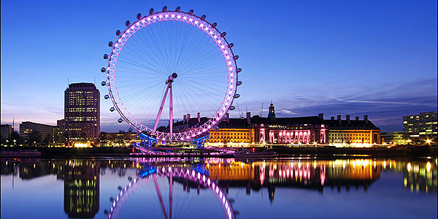
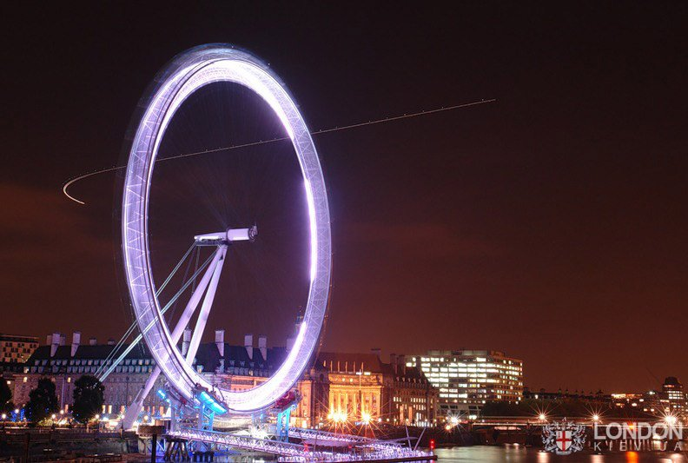
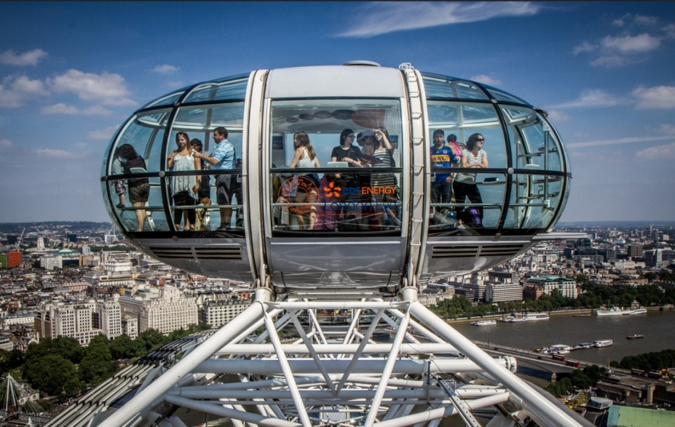
The London eye
It is a giant Ferris wheel, located on the South Bank of the River Thames.
The ride on such tall wheel is called flight
London eye offers tourists great observation point so suitable for the photography
Each capsule of the wheel also takes pictures of it's passengers at the end of the flight

Slide 11
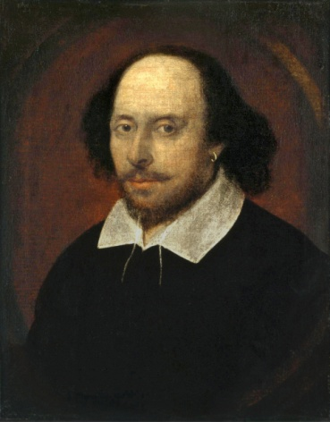
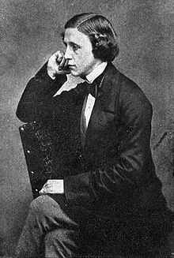
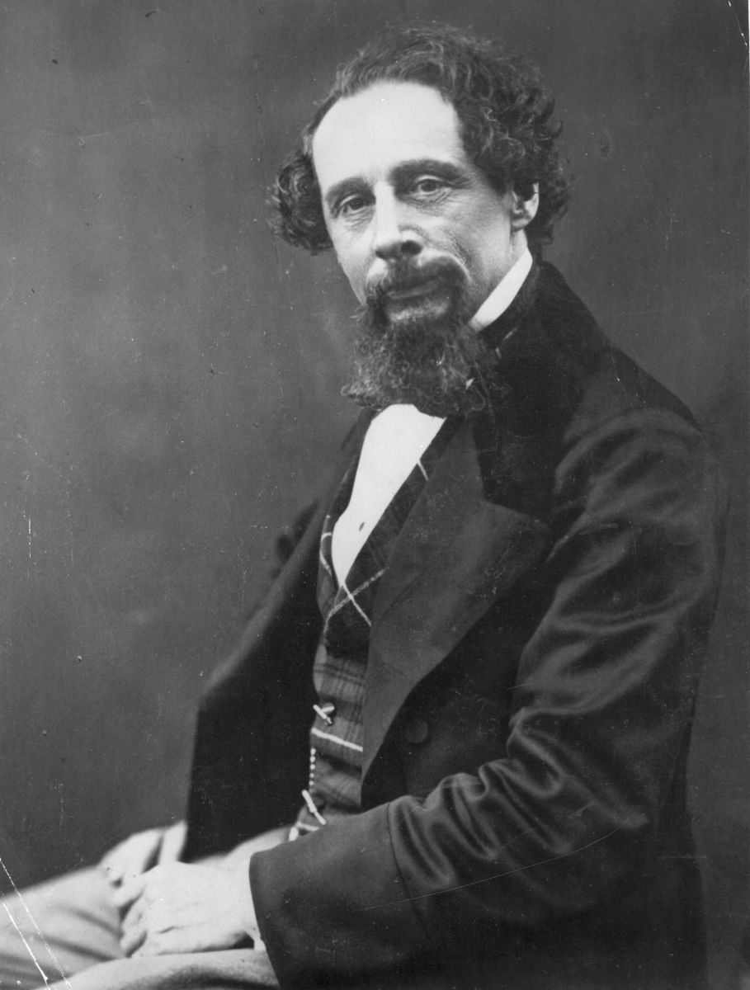
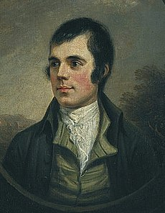
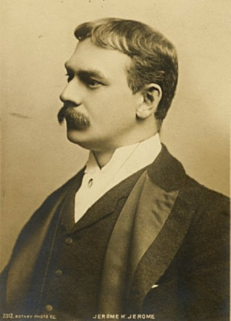
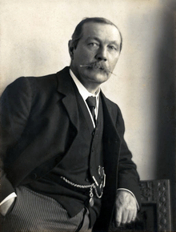
ENGLISH Literature
William Shakespeare (1564-1616)
Charles Dickens (1812 - 1870)
Robert Burns (1759 - 1796)
Jerome K. Jerome (1859 – 1927)
Lewis Carroll (1832 - 1898)
Conan Doyle (1859 - 1930)

Slide 12
Sources
http://www.alleng.ru/engl-top/007.htm
https://en.wikipedia.org/wiki/England
https://simple.wikipedia.org/wiki/Scotland
http://online-teacher.ru/study/scotland
https://en.wikipedia.org/wiki/Wales
https://en.wikipedia.org/wiki/Ireland
http://www.interactive-english.ru/opisaniya-foto/2012-07-10-08-55-50/big-ben-26/
http://www.alleng.ru/engl-top/011.htm
http://study-english.info/uk-photo128.php
https://en.wikipedia.org/wiki/English_literature

