Slide 1

THE Dances

Slide 2
The work was created by Fazledinova Zarina
The Form 9 “A”
School-Gymnasium №1 of Mamlutka
Teacher: Tatyana Voropaeva

Slide 3
Dance is a performing art form consisting of purposefully selected sequences of human movement.

Slide 4
Dance is generally, though not exclusively, performed with the accompaniment of music and may or may not be performed in time to such music. Some dance (such as tap dance) may provide its own audible accompaniment in place of music. Many early forms of music and dance were created for each other and are frequently performed together. Notable examples of traditional dance/music couplings include the jig, waltz, tango, disco, and salsa.

Slide 5
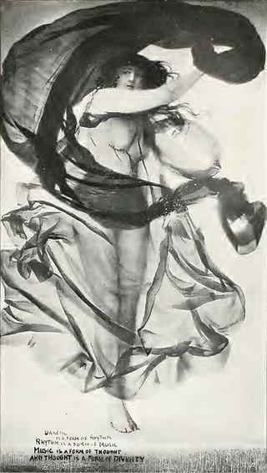
Lululaund - The Dancing Girl (painting and silk cloth. A.L. Baldry 1901, before p.107), The inscription reads; "Dancing is a form of rhythm/ Rhythm is a form of music/ Music is a form of thought/ And thought is a form of divinity."

Slide 6
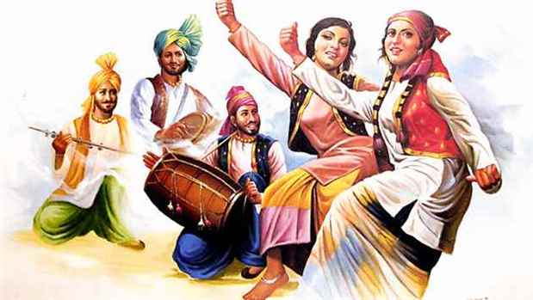
Cultural traditions

Slide 7
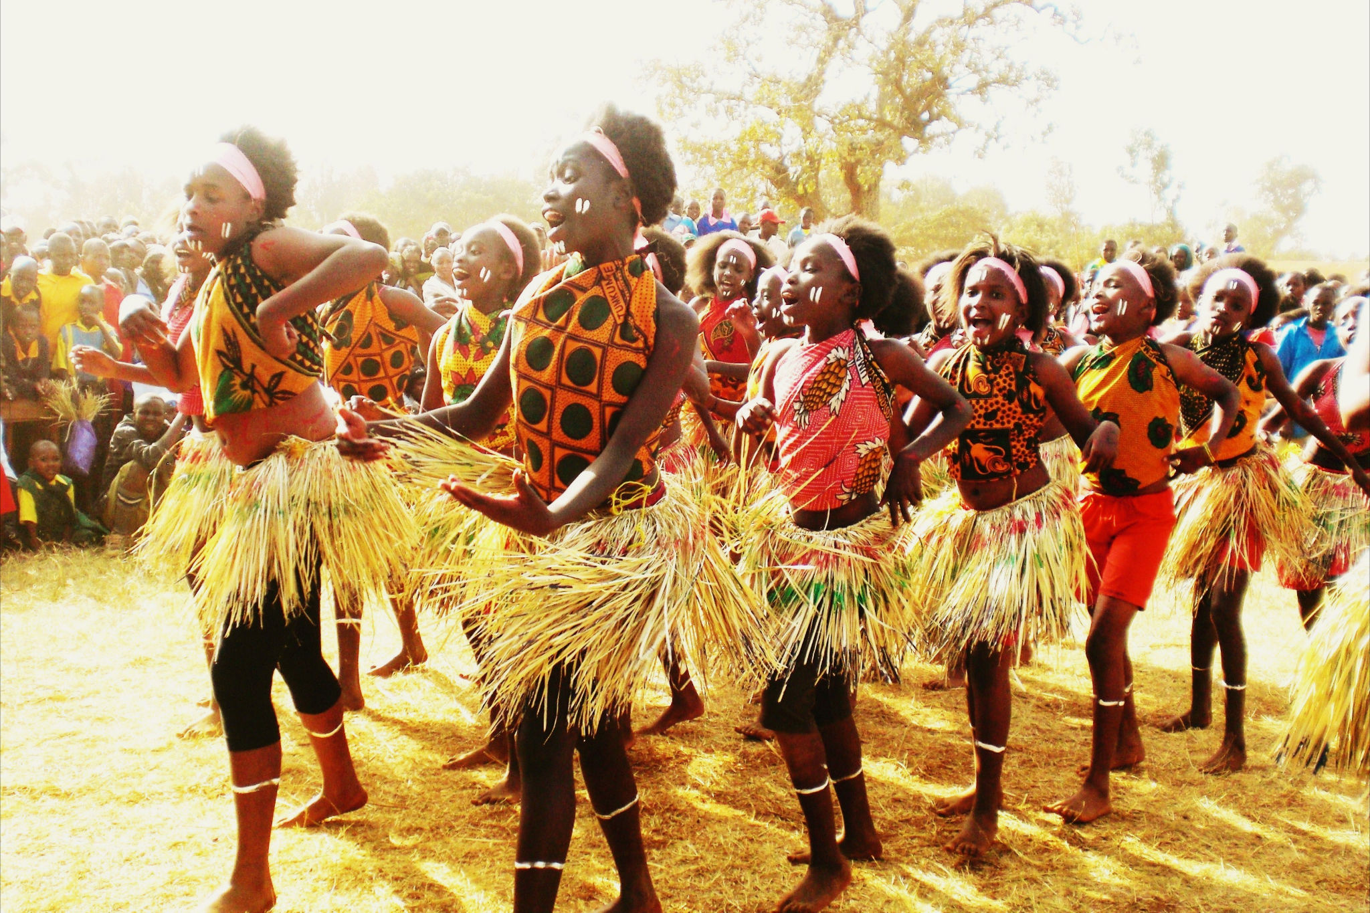
Africa
Traditional dances impart cultural morals; give vent to repressed emotions, such as grief; motivate community members to cooperate, whether fighting wars or grinding grain; enact spiritual rituals; and contribute to social cohesiveness.

Slide 8
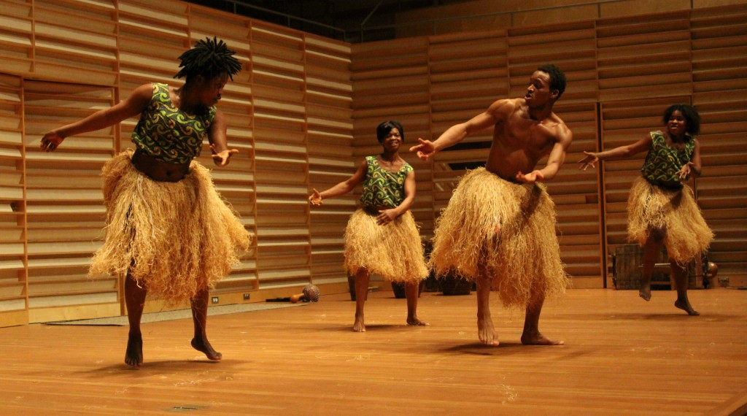
Thousands of dances are performed around the continent. These may be divided into traditional, neotraditional, and classical styles: folkloric dances of a particular society, dances created more recently in imitation of traditional styles, and dances transmitted more formally in schools or private lessons.

Slide 9
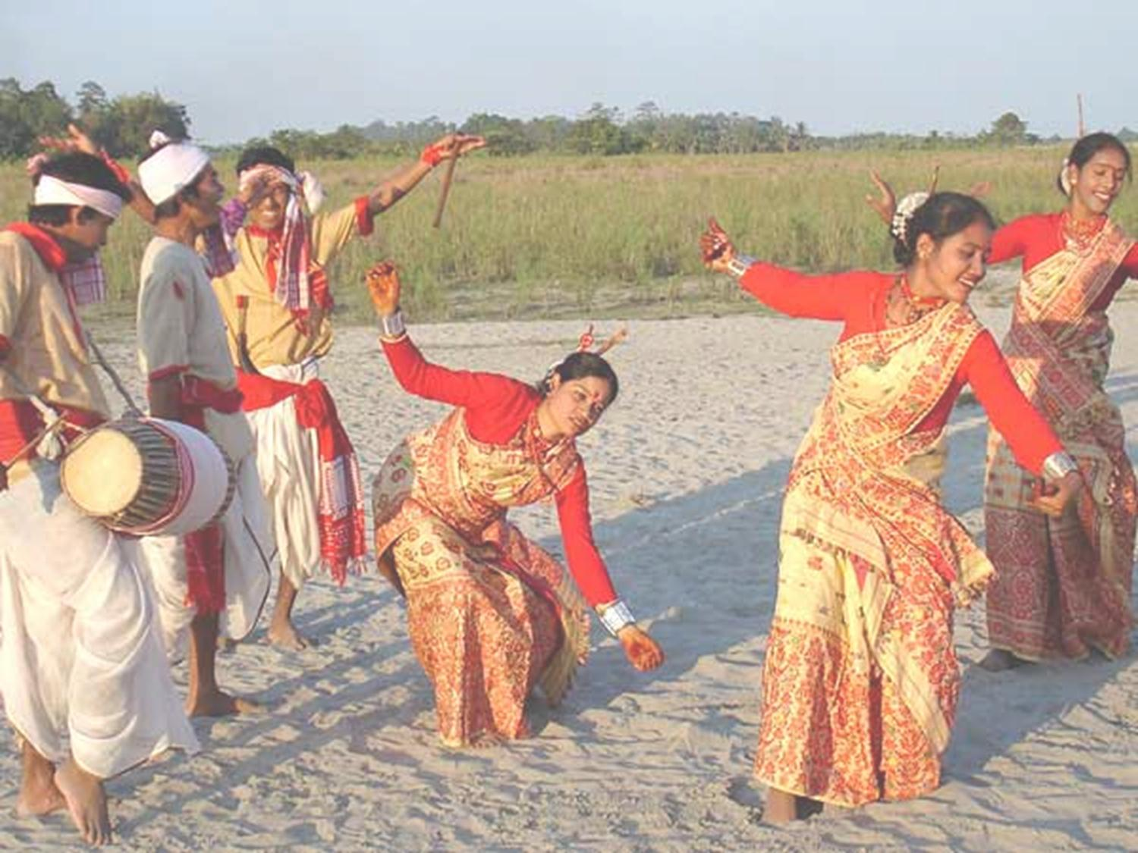
Asia
All Indian classical dances are to varying degrees rooted in the Natyashastra and therefore share common features: for example, the mudras (hand positions), some body positions, and the inclusion of dramatic or expressive acting. Indian classical music provides accompaniment and dancers of nearly all the styles wear bells around their ankles to counterpoint and complement the percussion.

Slide 10
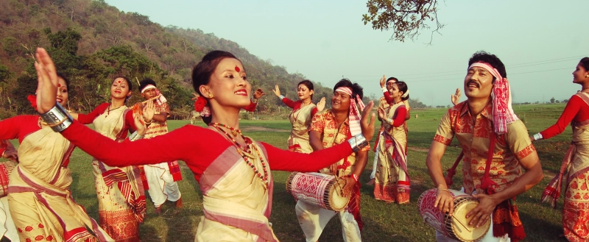
There are now many regional varieties of Indian classical dance. Dances like "Odra Magadhi", Mithila, Odisha . The Punjab area overlapping India and Pakistan is the place of origin of Bhangra. Bhangra is not just music but a dance, a celebration of the harvest where people beat the dhol (drum), sing Boliyaan (lyrics) and dance. The dances of Sri Lanka include the devil dances (yakun natima). Their influence can be seen on the classical dances of Sri Lanka.

Slide 11
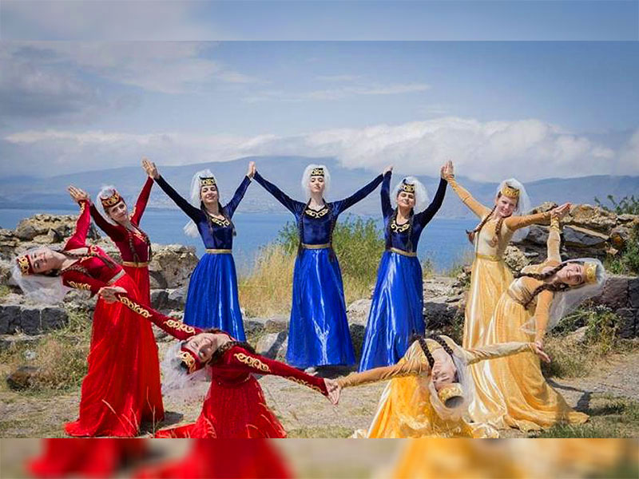
The dances of the Middle East are usually the traditional forms of circle dancing which are modernized to an extent. All these forms of dances would usually involve participants engaging each other by holding hands or arms (depending on the style of the dance). They would make rhythmic moves with their legs and shoulders as they curve around the dance floor. The head of the dance would generally hold a cane or handkerchief.

Slide 12
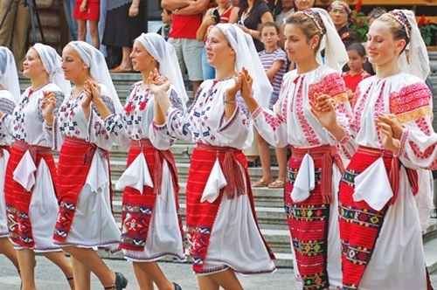
Europe and North America
Folk dances vary across Europe and may date back hundreds or thousands of years. Some, such as the maypole dance are common to many nations, while others such as the céilidh and the polka are deeply-rooted in a single culture. Some European folk dances such as the square dance were brought to the New World and subsequently became part of American culture.

Slide 13
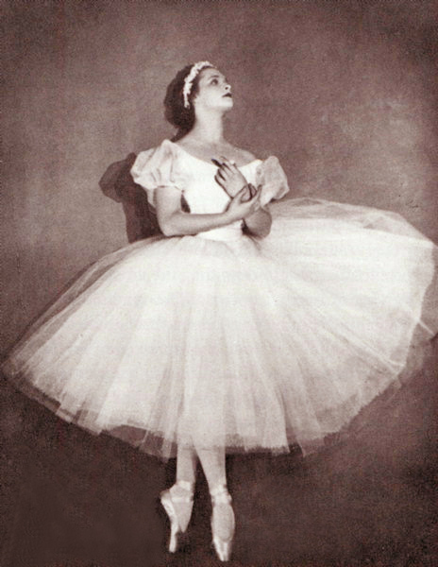
Ballet developed first in Italy and then in France from lavish court spectacles that combined music, drama, poetry, song, costumes and dance. Members of the court nobility took part as performers. The first ballet dance academy was the Académie Royale de Danse (Royal Dance Academy), opened in Paris in 1661. Shortly thereafter, the first ballet troupe, associated with the Academy, was formed; this troupe began as an all-male ensemble but by 1681 opened to include women as well.

Slide 14
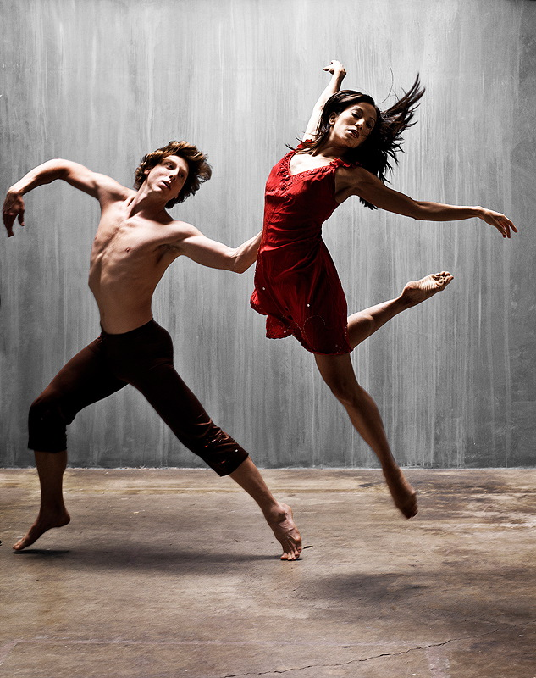
20th century concert dance brought an explosion of innovation in dance style characterized by an exploration of freer technique. Early pioneers of what became known as modern dance include Loie Fuller, Isadora Duncan, Mary Wigman and Ruth St. Denis. In the 1920s, important founders of the new style such as Martha Graham and Doris Humphrey began their work. Since this time, a wide variety of dance styles have been developed.

Slide 15
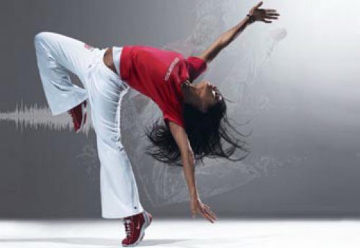
African American dance developed in everyday spaces, rather than in dance studios, schools or companies. Tap dance, disco, jazz dance, swing dance, hip hop dance, the lindy hop with its relationship to rock and roll music and rock and roll dance have had a global influence. Dance styles fusing classical ballet technique with African-American dance have also appeared in the 21st century, including Hiplet.

Slide 16
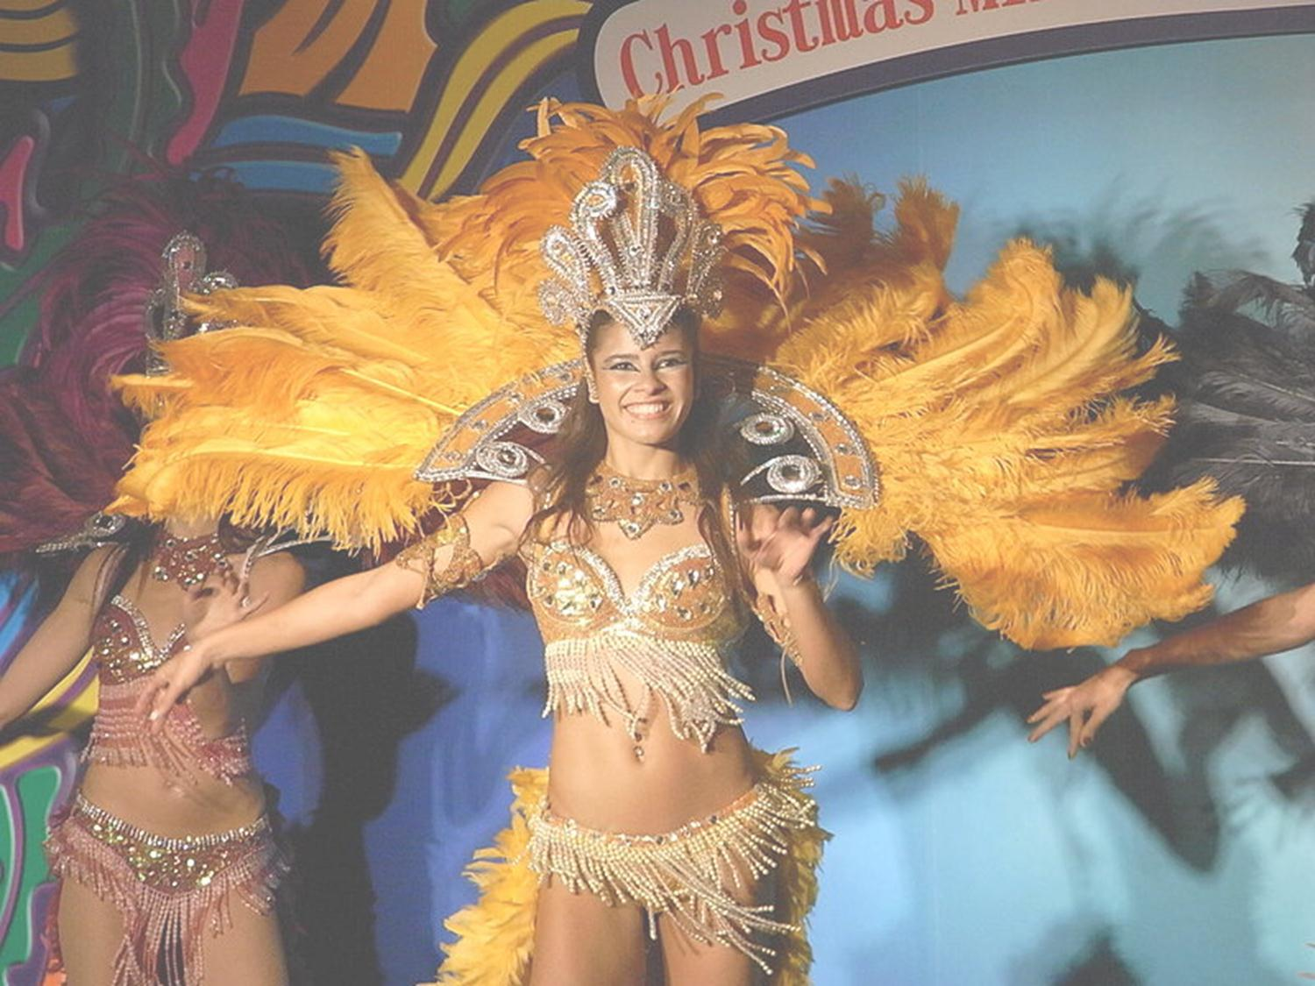
Latin America
Dance is central to Latin American social life and culture. Brazilian Samba, Argentinian tango, and Cuban salsa are internationally popular partner dances, and other national dances—merengue, cueca, plena, jarabe, joropo, marinera, cumbia, and others—are important components of their respective countries' cultures. Traditional Carnival festivals incorporate these and other dances in enormous celebrations.

Slide 17
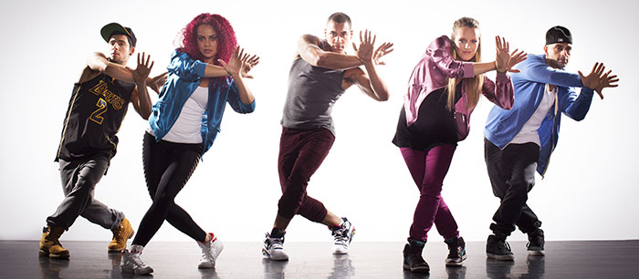
United States
Hip Hop originated in New York, specifically in the area known as the Bronx. It was created for those who struggled in society and didn't seem to have a voice in the community that surrounded them because of their lack of wealth. It helped those in the same situation come together and speak about difficult topics by using movement and feeling.

