Slide 1

THE DINOSAURS
Student: Karina Musharapova
Grade: 9
Teacher: Voropaeva T.G.
School-Gymnasium №1
Mamlutka, 2018

Slide 2

Millions of years ago, long before there were any people, there were dinosaurs. Dinosaurs were one of several kinds of prehistoric reptiles that lived during the Mesozoic Era.
The dinosaurs dominated the Earth for over 165 million years, but mysteriously went extinct 65 million years ago. Paleontologists study their fossil remains to learn about the amazing prehistoric world of dinosaurs.

Slide 3

What are dinosaurs?
Dinosaurs were land-dwelling reptiles that walked with an erect stance. Their unique hip structure caused their legs to stick out from under their bodies, and not sprawl out from the side (like other reptiles ). When dinosaurs first evolved from more primitive archosaurs, they were bipedal (walked on two legs). Much later, some dinosaur groups returned to a four-legged stance, having hind legs much larger than their front legs

Slide 4
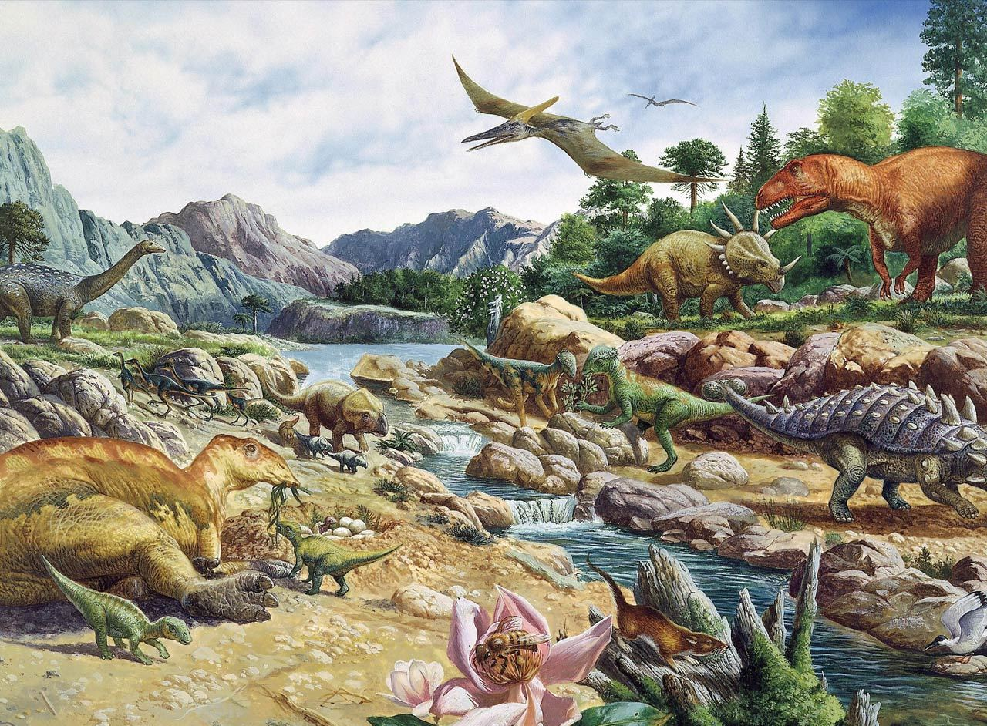

Slide 5
There were lots of different kinds of dinosaurs that lived at different times.
Some were HUGE, some were small. Some walked on two legs, some walked on four . Some were speedy , and some were slow and lumbering . Some were carnivores and some were herbivores . Some were armor-plated, some had thick, bumpy skin, some had horns , some even had primitive feathers.
No one knows what colors or patterns they were, how they sounded, how they behaved, how they mated, or even how to tell whether a fossil came from a male or a female dinosaur.

Slide 6
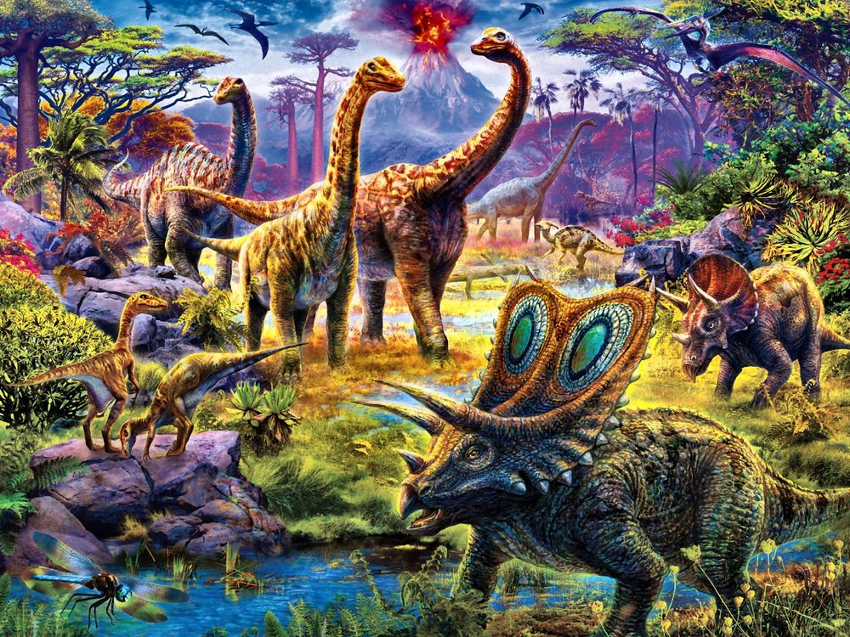

Slide 7

Why dinosaurs became extinct
Dinosaurs suddenly became extinct about 65 million years ago, at the end of the Cretaceous period, which was a time of high volcanic and tectonic activity. There are a lot of theories why the extinction occurred. The most widely accepted theory is that an asteroid impact caused major climactic changes which the dinosaurs couldn't adapt to.
All that's left of the dinosaurs are fossils.

Slide 8

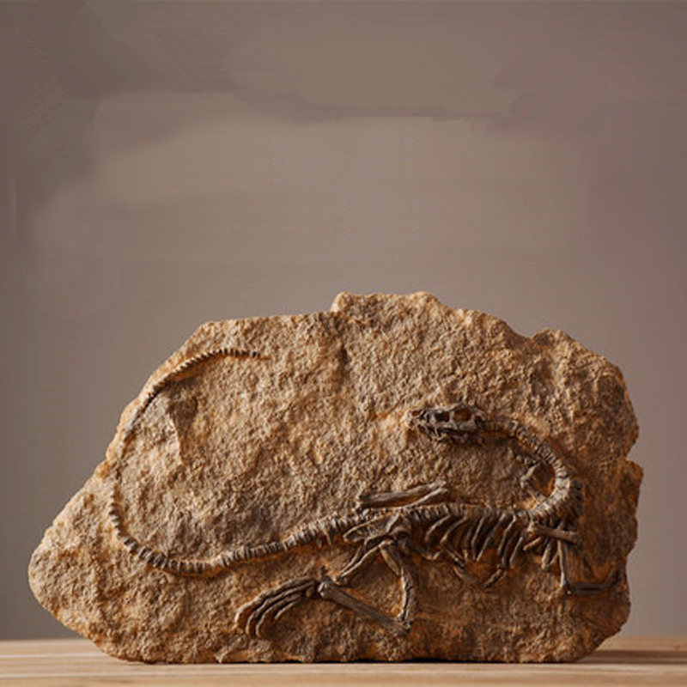

Slide 9
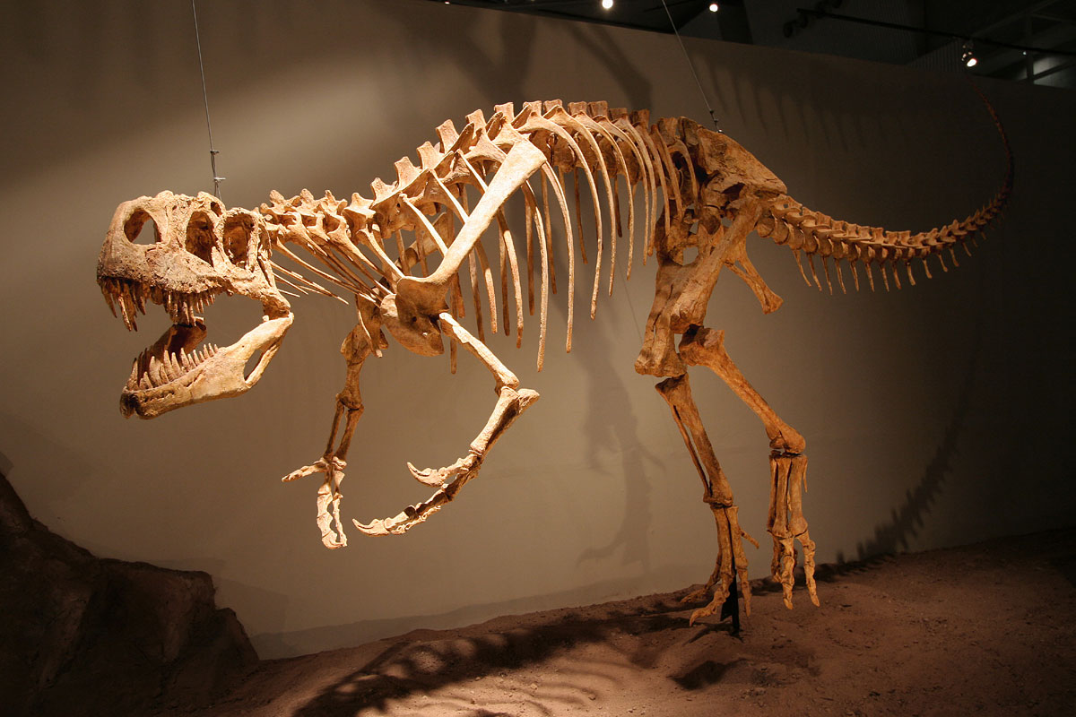

Slide 10
Dinosaur Species
There are currently over 330 described dinosaur species and this number is growing. This, of course, is only a sample of all the different kinds of dinosaurs.

Slide 11
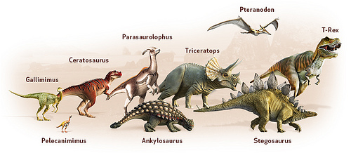
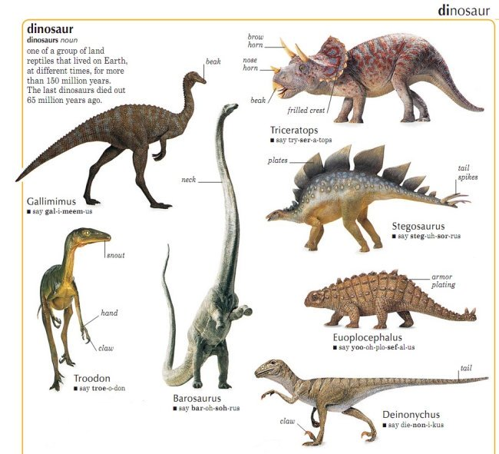

Slide 12
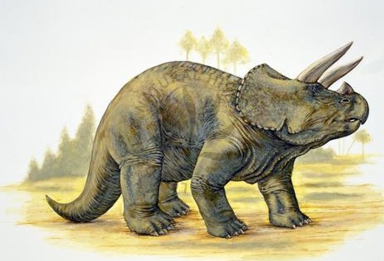
Triceratops
Triceratops had a single, short nasal horn and horns as long as hockey sticks protruding above its eyes. Its head, sometimes as much as three meters (10 ft) long, was the largest ever possessed by a land animal. It had large eyes and a relatively large brain.
Triceratops was probably a feisty animal. Many specimens have bones damaged in combats with rivals or predators.
Triceratops remains were first discovered near Denver, Colorado, in 1887. At first they were identified as the remains of a recently extinct species of buffalo.

Slide 13
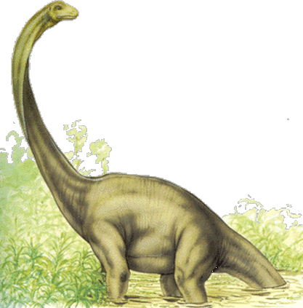
Diplodocus
Diplodocus was an enormous dinosaur that grew as long as 100 feet. But most of this length was taken up by its incredibly long neck and even longer tail. Diplodocus' body accounted for only about 13 feet of its entire length, while its tiny head measured a relatively small two feet. Diplodocus was a huge animal, it only weighed 11 tons.

Slide 14
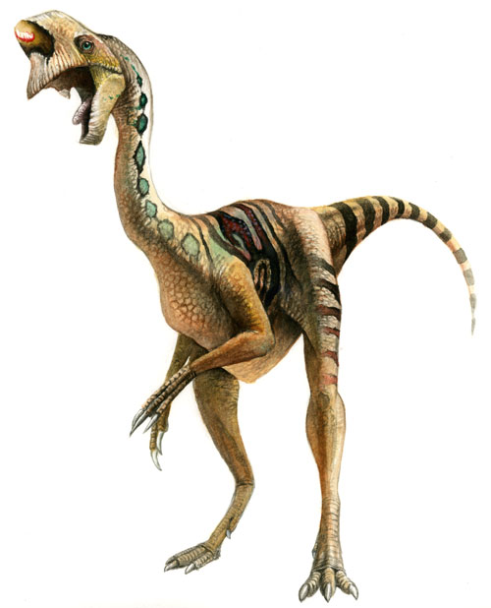
Oviraptor
Oviraptor was an unusual dinosaur. Measuring five to six feet long, it had a short head and a massive pair of toothless jaws shaped like a beak. With strong muscles in its mouth, Oviraptor must have had a powerful bite that was useful for breaking through hard surfaces, such as the eggs of other dinosaurs. Another interesting feature was a unique crest above Oviraptor's snout that was full of air passages and openings for its nose.

Slide 15
SOME FACTS
All dinosaurs laid eggs. About 40 kinds of dinosaur eggs have been discovered.
The Megalodon was the biggest prehistoric fish. It looked like a shark, though it was three times bigger
Dinosaurs lived on all of the continents

Slide 16

SOME FACTS
The word "dinosaur", meaning terrible lizard, was given in 1842 by the English paleontologist Richard Owen. Dino derives from the Greek word 'deinos' meaning "terrible, powerful, wondrous" + 'Saur' derives from the Greek word 'sauros' meaning “lizard”
Many Paleontologists believe that birds are the descendants of theropod dinosaurs

Slide 17
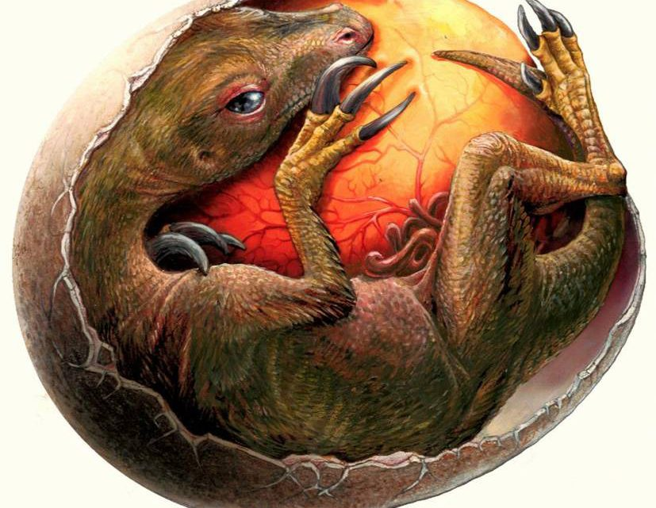

Slide 18
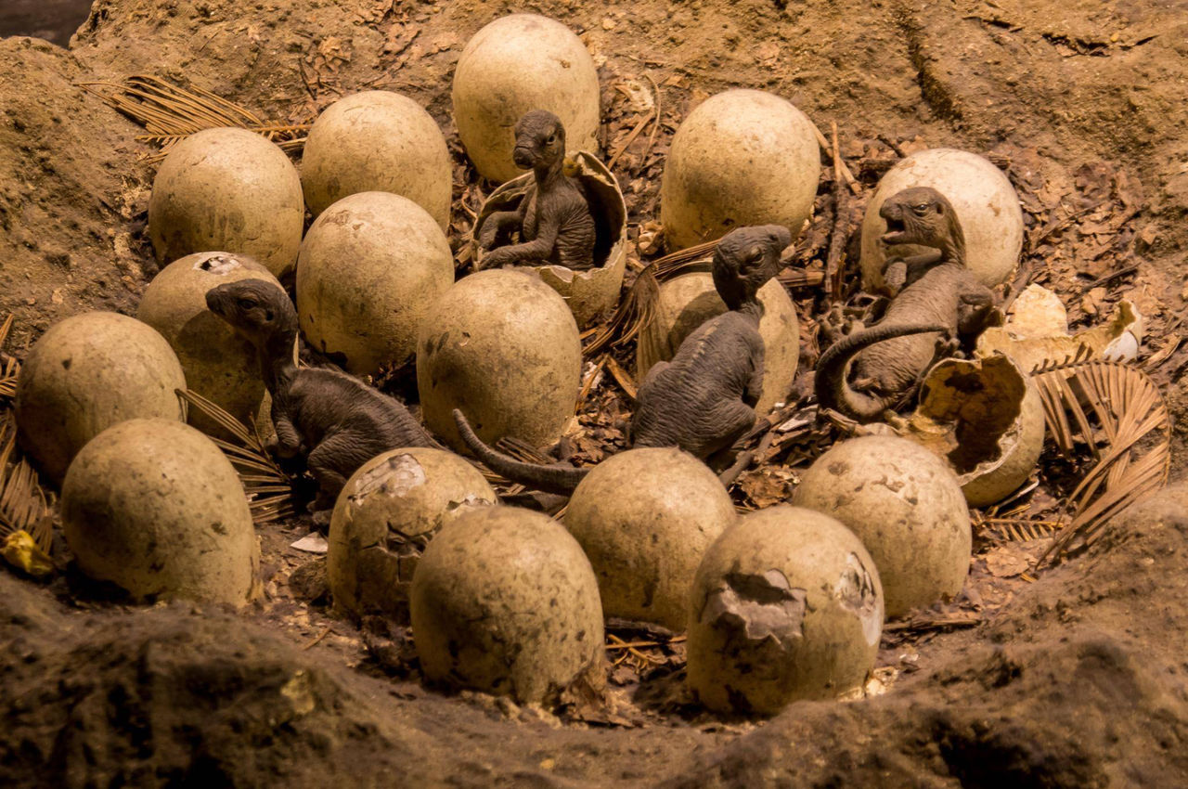

Slide 19
The end.

