Slide 1
THE history of red buses
prepared by student of 9 class Tolokonnikova Kseniya
Teacher: Tatyana Voropaeva

Slide 2
Red double-decker, London bus - a unique symbol of Great Britain, its magnificent capital city of London.

Slide 3
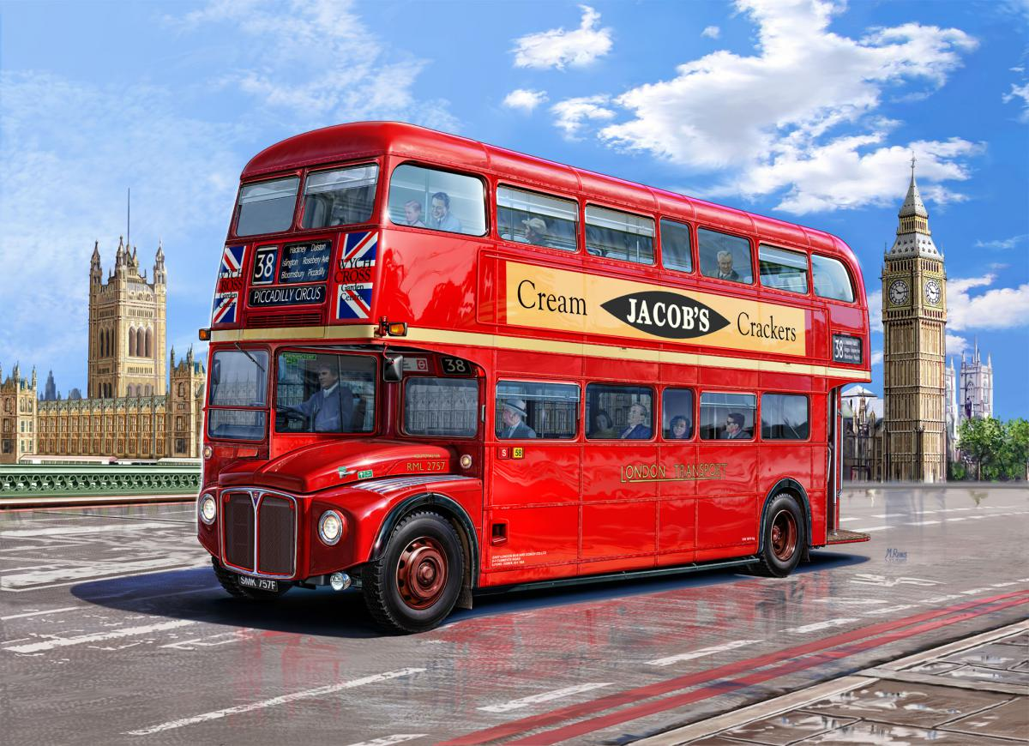

Slide 4
Why Are London Buses Red?
London's red buses are among the most iconic symbols of the capital. The reason behind their colour dates to the early 1900s, when the transport system was operated by different rival companies.
London General Omnibus Company (or L.G.O.C.) owned most of the buses and in 1907 painted its entire fleet red to stand out from competitors.
Since 1933, the colour was adopted by London Transport and it has remained ever since.
It is the same colour which is also used on the London Underground roundel, the Royal Mail, Kit and Kat and McDonald's.

Slide 5
Actually, London buses aren't all that red
But there's a snag. The surfaces of London buses are mostly not red. This becomes clear when seen from above. Here's a view we somehow managed to get from Victoria station.

Slide 6
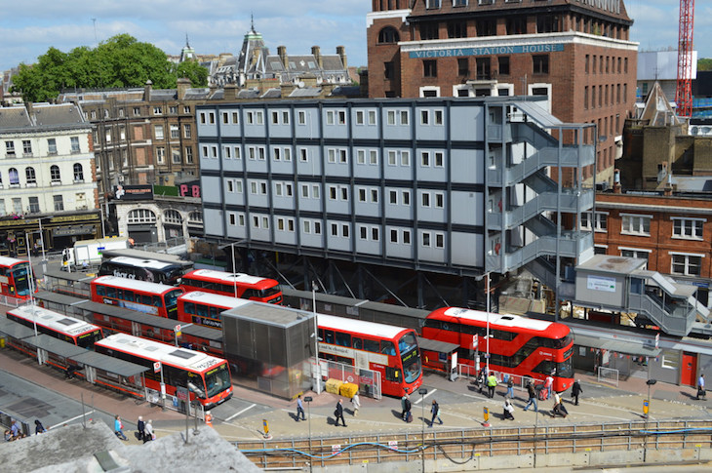

Slide 7
As you can see, bus roofs are largely white, to reflect sunlight and thereby reduce heating in summer.
Now subtract the area taken up by the windows and adverts — the latter can encanker the whole backside of a bus. We'd guess that the typical vehicle is only 30-40% red.

Slide 8
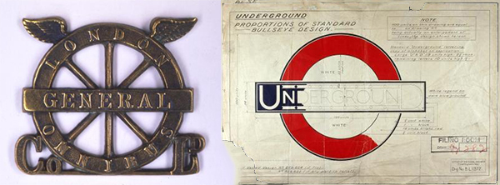
The Roundel logo

Slide 9
In 1912 LGOC became part of the Underground Group, uniting bus services and the underground railway. A roundel symbol which combined the LGOC’s ‘winged wheel’ and the Underground’s ‘bar and circle’ was introduced on maps and used as the company logo. This symbol was designed to help passengers distinguish travel information from commercial advertising.

Slide 10
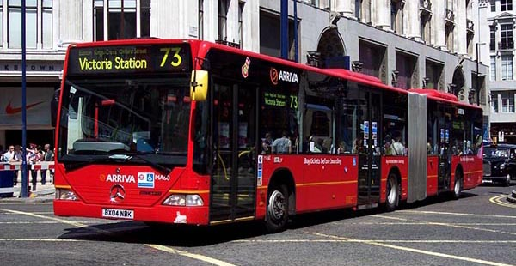
Bendy Buses became known as ‘The Free Bus'

Slide 11
Fare evasion on articulated 'bendy' buses was almost double the amount of a conventional bus. This was due to the three-door design and long carriage meaning passengers could sneak on and off without paying. Bendy buses were taken out of service in 2009 because they blocked junctions and were a danger to cyclists.

Slide 12
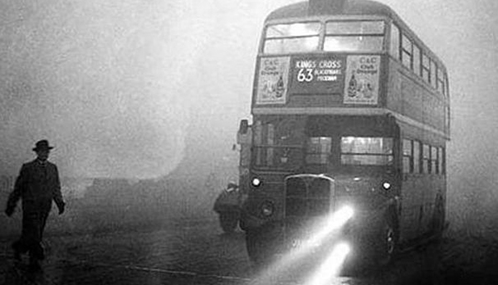
London is haunted by a phantom double-decker

Slide 13
Last spotted in 1990, the phantom number seven bus appears in Cambridge Gardens (W10) at 1.15 am. People have reported the bus driving towards them in the middle of the road, with no lights and no one at the wheel. Convinced they are about to collide with the bus, drivers often swerve out of the way, only to look back and find the bus has vanished without a trace. The phantom bus has even claimed the lives of some, most notably in 1934 when a car burst into flames at the exact spot the bus is regularly sighted.

Slide 14
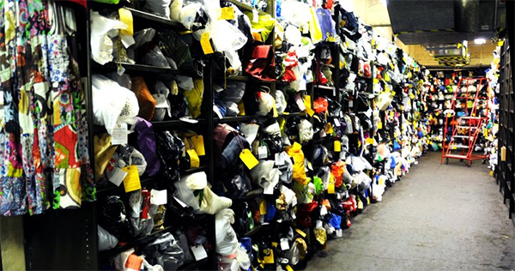
What is the weirdest object found on a bus?

Slide 15
There is a long list of weird objects that turn up at Transport for London’s Lost Property Office. Whether it be stuffed puffer fish, breast implants, harpoon guns and prosthetic limbs – they've all turned up in the past. Perhaps the most unfortunate passenger is an elderly gentleman who claimed his false teeth, only to return an hour later grimacing while he explained they weren’t his after all. The most common items are books, umbrellas and bags.

Slide 16
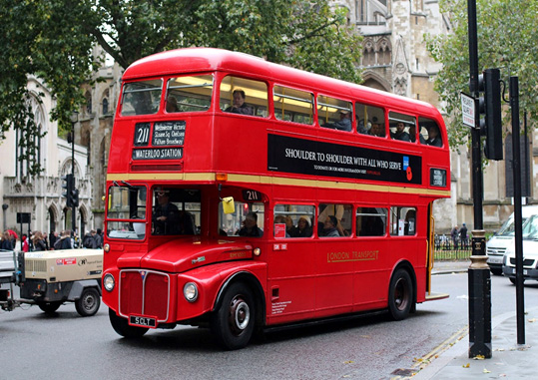
Thank you for your attention, I hope my story was interesting enough.

