Slide 1
Madame Tussaud‘s Museam London Prepared by Minchenko Kseniya Form 9 Teacher: Tatyana Voropaeva School-Gymnasium №1 North Kazakhstan Mamlutka Town

Slide 2
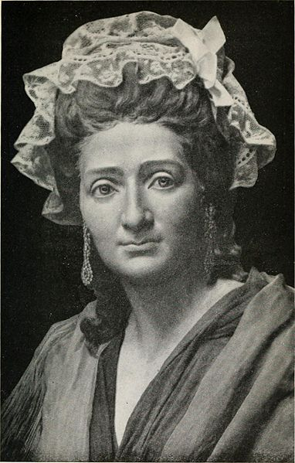
Anna Maria Tussauds
Madame Tussaud was an artist and lived in Europe more than 200 years ago. During the French Revolution, she was ordered to go to the cemetery and remove the wax masks from the severed heads of the royal family. This eerie task helped her to find the cause of her life. She made so many wax figures that she was lucky to show them to various cities in Britain. Later, her sons opened a permanent exhibition in London, in the building where the museum is still located.

Slide 3
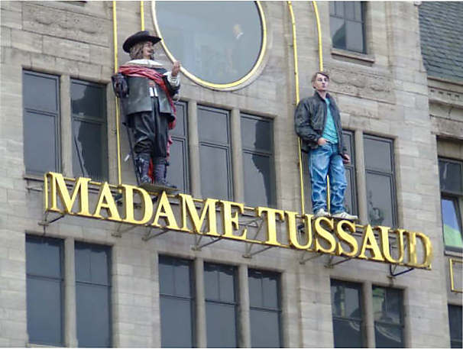
Madame Tussauds museum

Slide 4
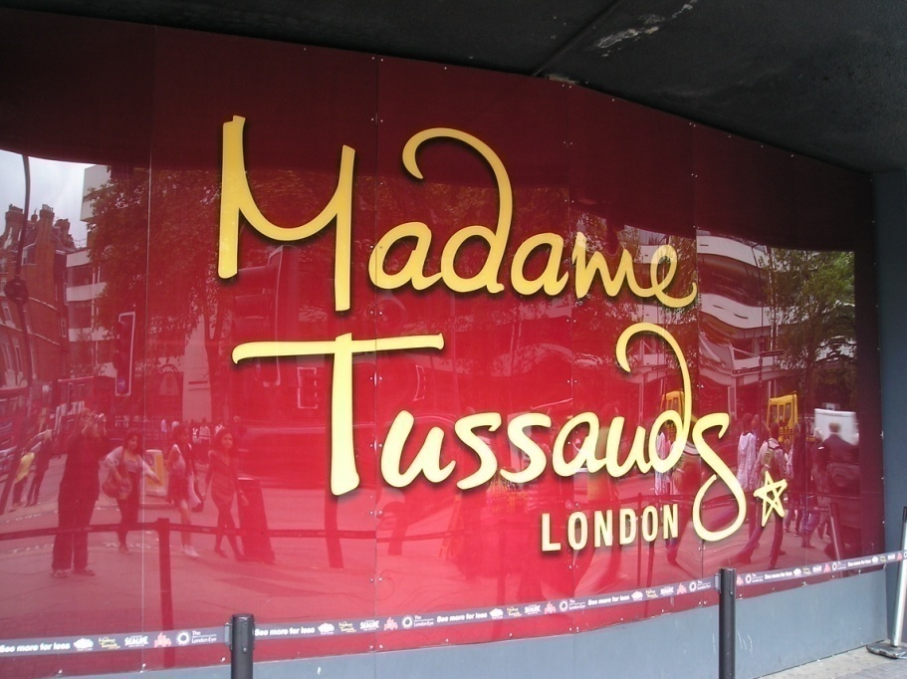
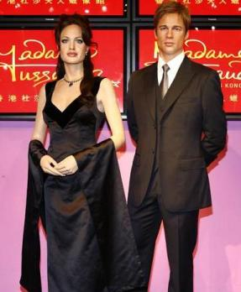
In the Madame Tussauds museum, which is located in London, more than 400 wax figures or portraits are exposed, as they are called by the museum staff. They are as alive, and visitors even find it hard to believe that they are not real.

Slide 5
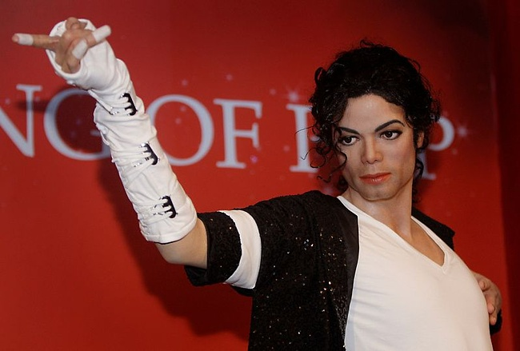
Every year this world-famous museum is visited by 2.5 million people. They are attracted by the opportunity to be close to the stars, which otherwise they would never have met. In this museum works of art can be touched! It is so popular that the US has recently opened its branches. They can see all American stars. The London museum on Baker Street is their daddy, he has more than 2 centuries, and during this period, 500 million people have passed through his halls

Slide 6
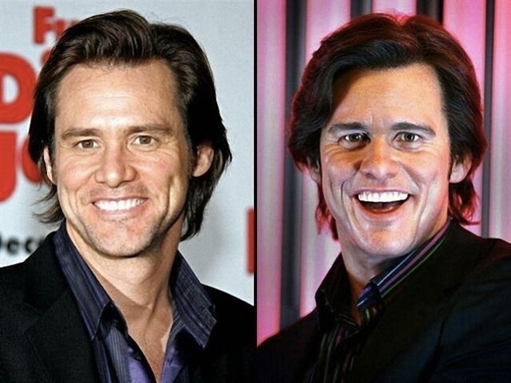
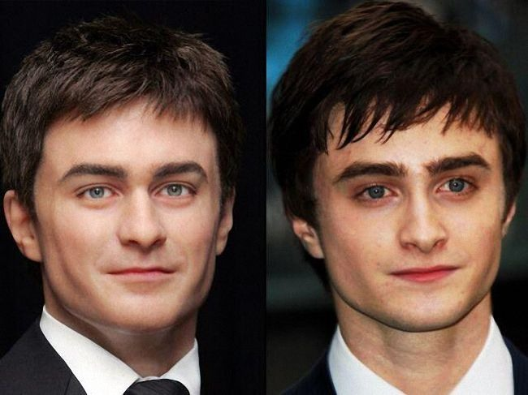
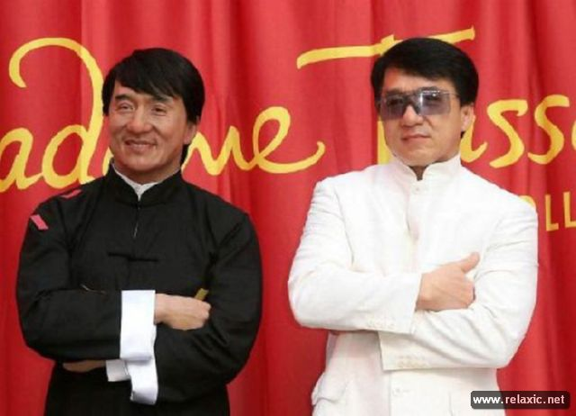
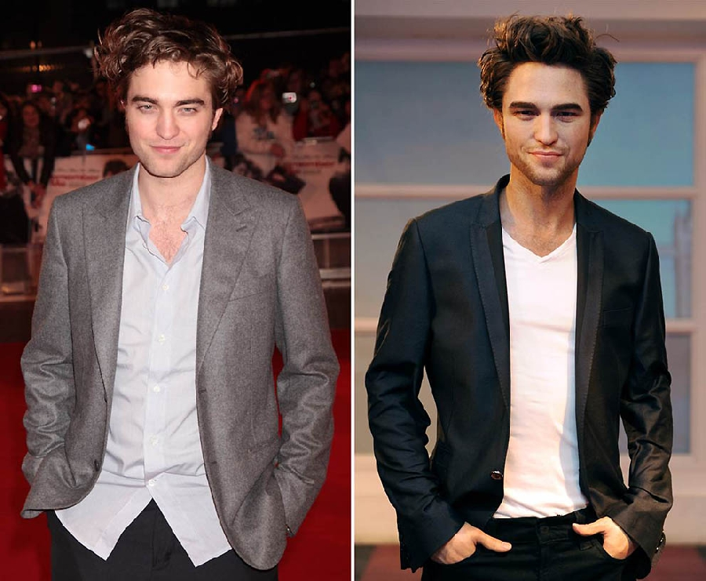

Slide 7
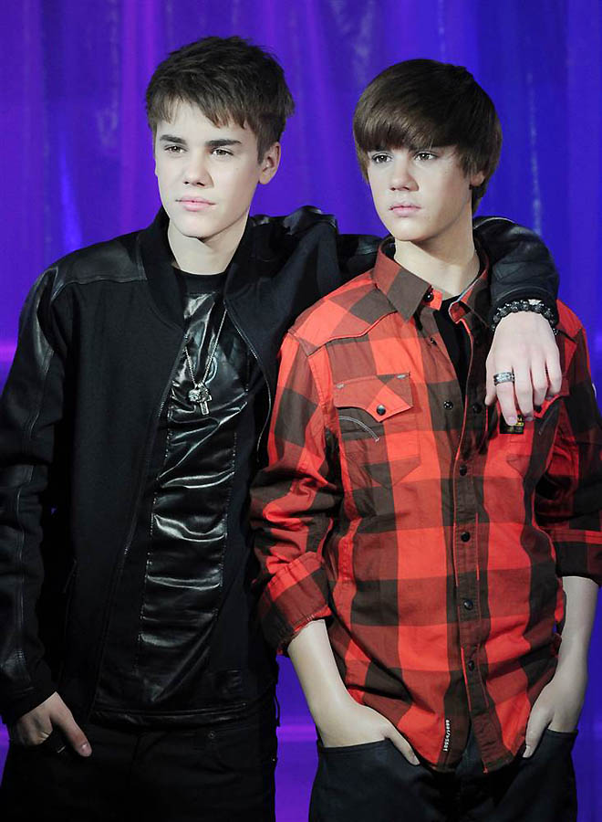

Slide 9
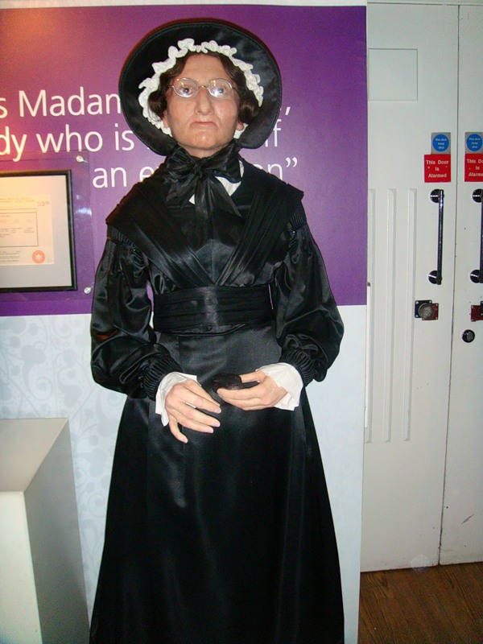
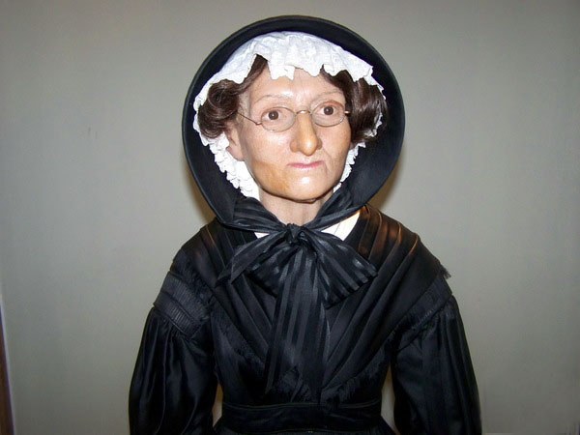
. Visitors to the museum are greeted not by a portrait of a star, but by a small wax figure of an elderly woman, an amazing woman who founded this business

Slide 10
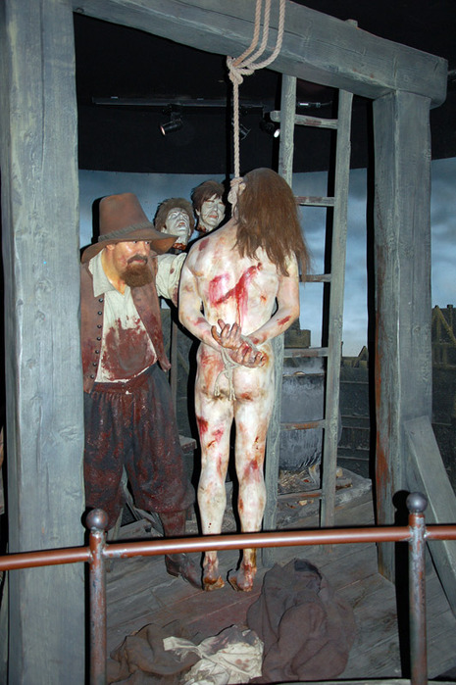
Chamber of Horrors
. In the "Chamber of Horrors" you can see villains, serial killers, butchers and their victims. It is a journey through an eerie and bloody history of 5 centuries in length. This room is only in the London museum, and dates back to the bloody origins of its creation. At the time of Queen Victoria this room was called "a separate room. According to the statistics of the museum, which is led by its employees, this room is more popular with women, which is surprising

Slide 11
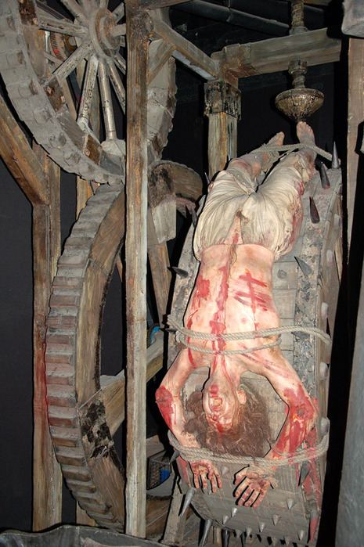
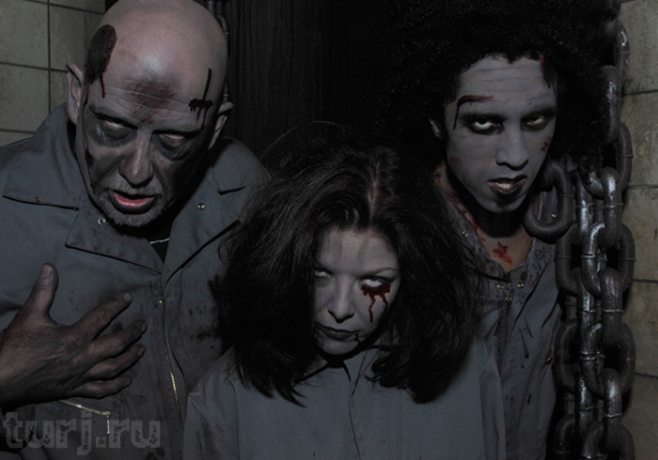
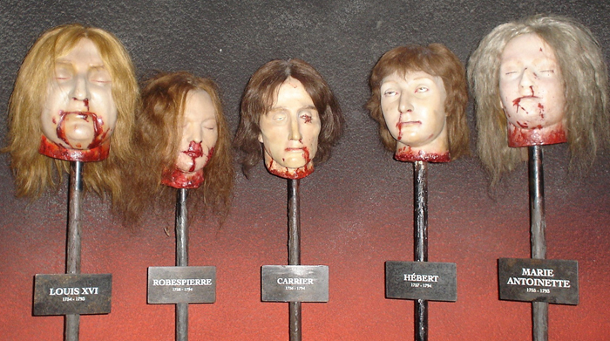
The whole secret is in the eerie atmosphere of this room, in its special effects. It's both sound and lighting, it's full of all special effects.

Slide 12
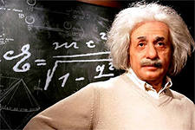
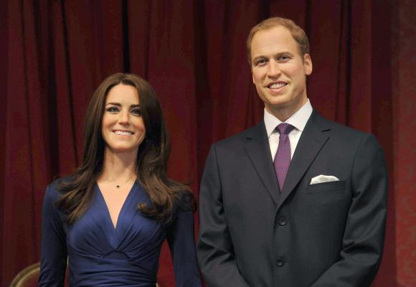
At 7 am the museum is full of work. The team of workers is putting the exhibits in order after yesterday. In the museum there is a person who is responsible for the order of the hairstyles of the figures, is responsible for the costumes, etc. The museum has a wardrobe, where duplicates of clothes of exhibits are stored, from buttons to suits. It is understandable, because visitors often steal glasses rings, which are on the exhibits, and other props

Slide 13
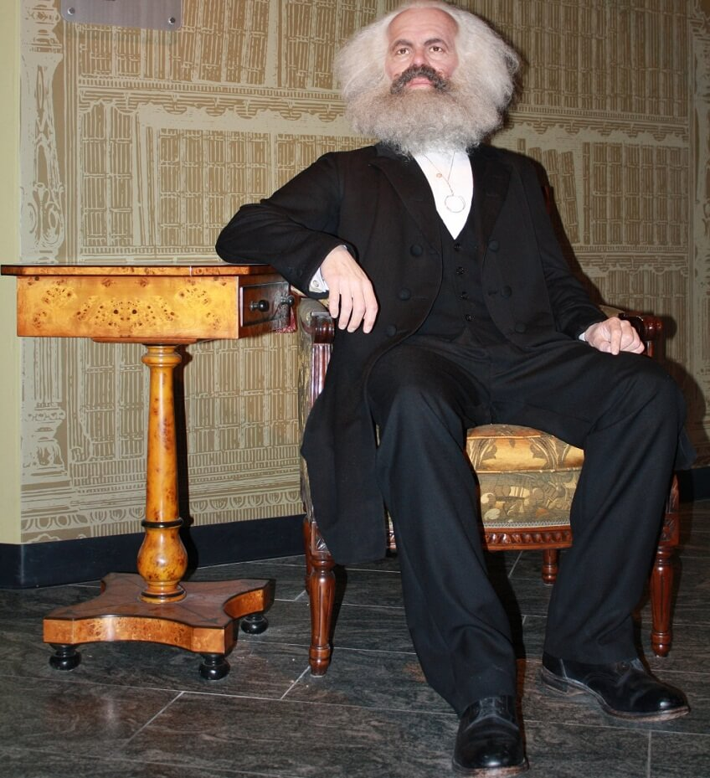

Slide 14
