Slide 1


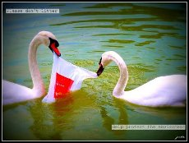
Theme: How green you are!

Slide 2
Цель урока:
Прочтут текст с извлечением полезной информации; выпишут новые слова.

Slide 3
Образовательная - научить беглому чтению и говорению об окружающей среде , определить значение новой лексики с помощью контекста.
Развивающая - развитие навыков и умений устной речи, правильного письма, фонетического произношения.
Воспитательная - воспитывать бережное отношение к окружающей среде.

Slide 4

Наглядный материал: постеры, маркеры, слайды.
Т.С.О.: интерактивная доска.

Slide 5
Procedure:

Slide 6
1 Warm up

Slide 7
Brainstorming
What is the weather like today?
Make up the cluster “World Weather Yesterday”
+18
S
-10
Sn
Rome
Astana
Berlin
World Weather
Moscow
London
New York

Slide 8
Answer the questions
Which city was the hottest?
Which city was the coldest?
Which month do you think is it?

Slide 9
2 Review.

Slide 10
Look at the sentences. They are mixed up. Can you match them? (interactive board)
When I’m unhappy, I go to the doctor.
When I’m happy, I don’t talk.
When I’m tired, I listen to music.
When I’m angry, I drink hot tea.
When I’m cold, I sing.
When I’m ill, I bite my nails.
When I’m worried, I go to bed.

Slide 11
Checking-up of homework
(Ex.10 p.99)

Slide 12
II Pre-task.
Write the missing letters
Sc_ool _rite w_ite
_now fr_end lis_en
He_vy _rong wa_k

Slide 13
Pre-reading task.
Ex.2 p.100
Read environmentalist’s advice and put them in order of importance for yourself.

Slide 14
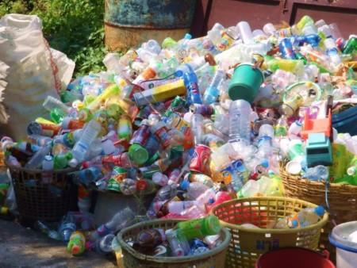
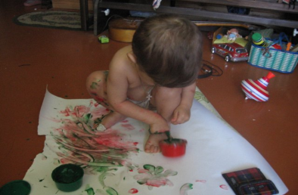
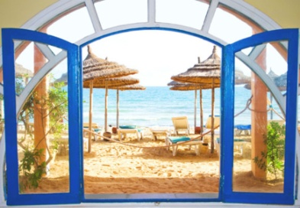
3) New words
a litter
to spoil
view

Slide 15
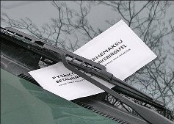
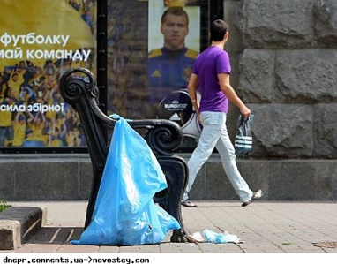
A fine
A litterbug

Slide 16
III Presentation
Reading text “Litter is a problem” in groups. (Ex 4 p.101)

Slide 17
IV Follow up
1 group an Association “Litter”
2 group Cinquaine “Litter”

Slide 18
Association “Litter”
literbug
environment
illnes
Litter
Litter bin
Old newspapers
fine
fine
garbage
punishment

Slide 19
Cinquaine “Litter”
Litter
Dirty, unhealthy
Spoil , ill , punish
Litter is a health problem
Litterbug

Slide 20

V Wrap-up
Homework Ex.9 p.102
Give advice to each other (Don’t throw litter!)
Marks.

Slide 21


