Slide 1
19.02.2016
Modal verbs
Done by:
Usmanov Bekzod

Slide 2
Modal verbs
can
may
must

Slide 3
The aim of the lesson:
1.Give more information about: Modal verbs
2.To develop pupils’ skills in reading,
writing, grammar, translating, speaking and improve their logical thinking.
3. To bring them up to love English.

Slide 4
Group rules:
- Turn off your mobile phone
- Pay attention
- Friendship
- Help each other
- Listen to each others’ ideas
- To come to decision
- Respect each other
- Save the time

Slide 5
Can | may | must
қила олмоқ, қила билмоқ | қила олмоқ, рухсат бермоқ | Қилишинг шарт
I can swim. Мен суза оламан. He can help. | I may swim. Менга сузишга рухсат беришди He may help. | I must swim. мен сузишим шарт He must help.

Slide 6
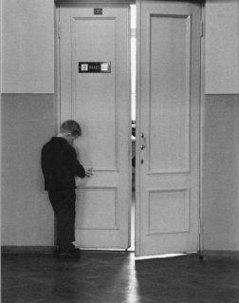
May утвердительные предложения
1 лицо
2 лицо
3 лицо
He may go out
She may go out
It may go out
You may go out
I may go out
We may go out
You may go out
They may go out

Slide 7
I can. Can I. I can’t
1 лицо
2 лицо
3 лицо
He can run
Can he ride?
He can’t swim
You can run
Can you ride?
You can’t swim
I can run
Can I ride?
I cannot swim
We can run
Can we ride?
We can’t swim
You can run
Can you ride?
You can’t swim
They can run
Can they ride?
They can’t swim

Slide 8
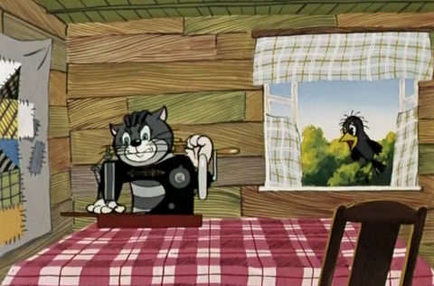
Can краткие ответы
1 лицо
2 лицо
3 лицо
Yes, he/she/it can
No, he/she/it can’t.
Yes, you can/
No, you can’t.
Yes, I can/
No, I can’t.
Yes, we can/
No, we can’t.
Yes, you can/
No, you can’t.
Yes, they can/
No, they can’t.

Slide 9
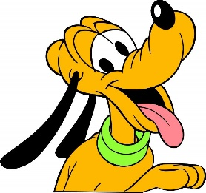
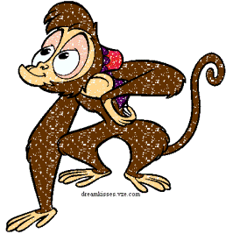
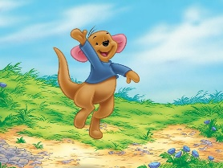
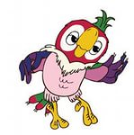
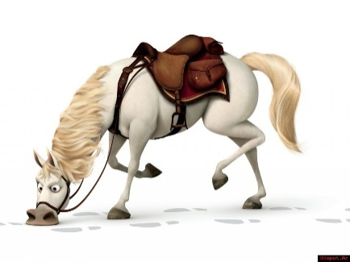
Вставь форму can
I …. clean my room
must
Kangaroos … jump.
Parrots … swim.
Can
… horses drink milk?
Monkeys … climb trees.
… dogs read books?
You … open the window. It’s hot. .
May
Cats … play with a ball.
Elephants … eat fruits.
can
… bears sleep in winter?

Slide 10
Исправьте ошибки
It cant fly.
can’t
can
He cans swim well.
May I
I may close the door?
She must’nt give her cat seeds and nuts.
mustn’t
You must to wash hands before meal.
must

Slide 11
Сделайте предложения отрицательными
not
She mustn’t get up at 7 o’clock.
She must get up at 7 o’clock.
We may not watch TV every evening.
We may watch TV every evening.
He mustn’t go to school at Saturday.
He must go to school at Saturday.
I may not play computer games.
I may play computer games.
They must not go to bed at 10 o’clock.
They must go to bed at 10 o’clock.
You may not take my phone.
You may take my phone.
I cannot dance very well.
I can dance very well.
It can’t eat a bone.
It can eat a bone.

Slide 12
Сделайте предложения вопросительными
May you go for a walk?
You may go for a walk.
Mustn’t we make noise at night?
We mustn’t make noise at night.
Can he skate and ski well?
He can skate and ski well.
Must it sleep on this rug?
It must sleep on this rug.
Can’t she speak English?
She can’t speak English.
May they not go out?
They may not go out.

Slide 13
Переведите
Can you cook a cake?
Ты умеешь готовить торт?
They may watch TV in the evening.
Им разрешают смотреть телевизор вечером.
We mustn’t listen to music at a lesson.
Нам нельзя слушать музыку на уроке.
He can play tennis well.
Он хорошо умеет играть в теннис.
She can play the piano and guitar.
Она умеет играть на пианино и гитаре.
I must clean my room.
Я должен убираться в своей комнате.
May not you play computer games?
Тебе не разрешают играть в компьютерные игры?

Slide 14
Ответьте на вопросы
Can you cook?
May you eat pizza?
Must you brush your teeth every day?
Can your friend ride a bike?
Can’t you drive a car?
Must your mother wake you up every morning?
May you talk on the mobile phone at a lesson?
Must you read books every day?

Slide 15
Home task
Make the 5 senteces about modal verb

