Slide 1

In my life
The aim:
To be able to speak about life experiences using present perfect

Slide 2
Present perfect
When we talk about life experiences or things we have done in our life. But we do not tell the exact time.

Slide 3
Affirmative:
Subject+have/has + past participle(Verb 3)
I
you
We have + past participle (verb 3)
You
they
He/she/it has + past participle (verb 3)

Slide 4
Examples:
I have read a lot of books.
He has worked in different places.
We have learned three foreign languages.

Slide 5
Negative form:
Subject+have/has+not +past participle (V3) or
Subject+have/has + never +past participle (V3)
I
You have+not (never)+past part (V3)
We
They
He/she/it has+not (never)+past part (V3)

Slide 6
Examples:
I have not read any books by Shakespeare.
Or
I have never read any book by Shakespeare
She has not met any famous person in her life
Or
She has never met any famous person in her life.

Slide 7
Interrogative or question form:
Have/has+subject+past participle (verb3)?
I
Have You past part (Verb 3)?
We
They
Has he/she/it+past part (verb 3)?

Slide 8
Examples:
Have you ever read any books by Shakespeare?
Yes, I have/No, I haven’t
Has she ever met any famous person in her life?
Yes, she has/ No, she hasn’t

Slide 9
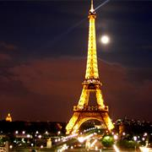
Exercises:
The Eiffel Tower
I have seen the Eiffel Tower.
I have never seen the Eiffel Tower.

Slide 10
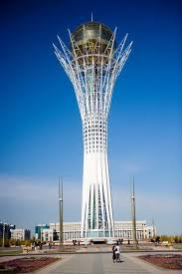
Baiterek

Slide 11
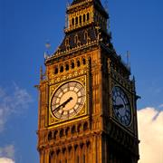
Big Ben

Slide 12
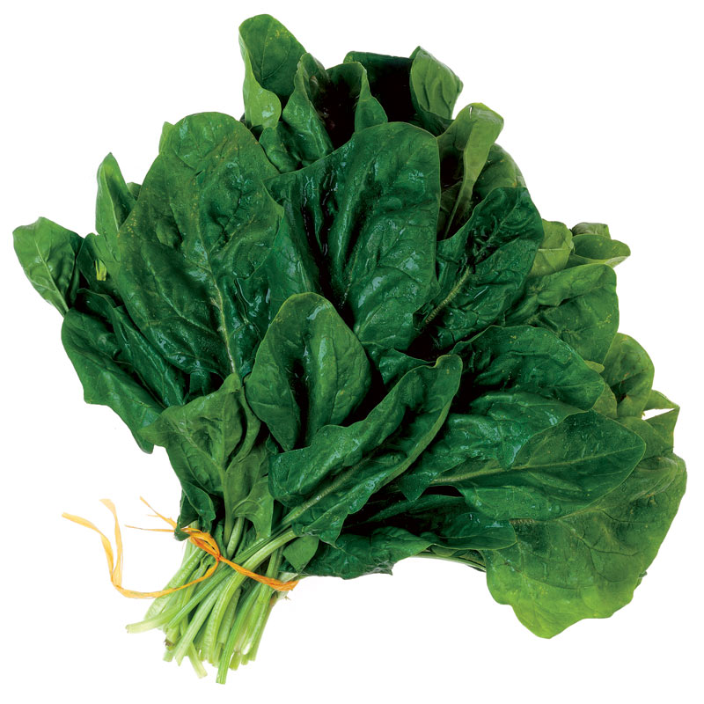
Spinach leaves

Slide 13
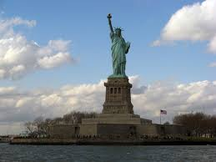
The statue of Liberty

Slide 14

Hollywood

Slide 15
questionnaire

Slide 16
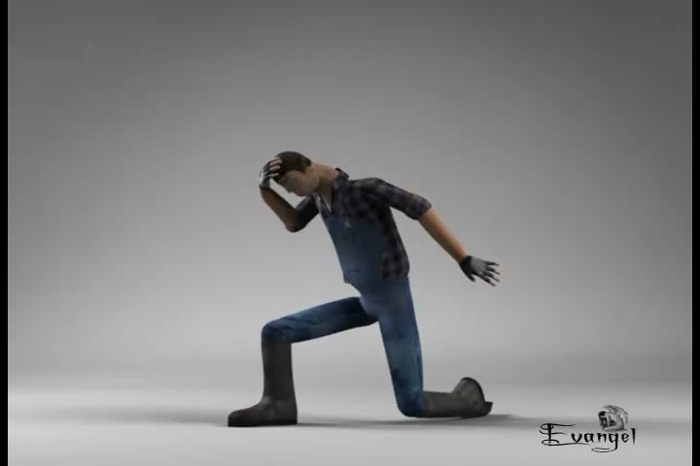
Сергіту сәті

Slide 17
Make up true sentences about yourself
1. I (live) ______ in another country.
2. I (eat) ______ crocodile.
3. I (dance)______in theatres across the world.
4. I (work)_______in a famous theatre.
5. I (pass)________my driving test.
6. I (drive)_______a саг.
7. I (buy)_________a house.
8. I (meet)_________a famous actor.
9. I (play)__________with baby tigers.
10. I (see)________my favorite band in concert.

Slide 18
Home work
Activity book: exercises-1,2,3

Slide 19
The lesson is over Thank you!

