Slide 2
American School System

Slide 3
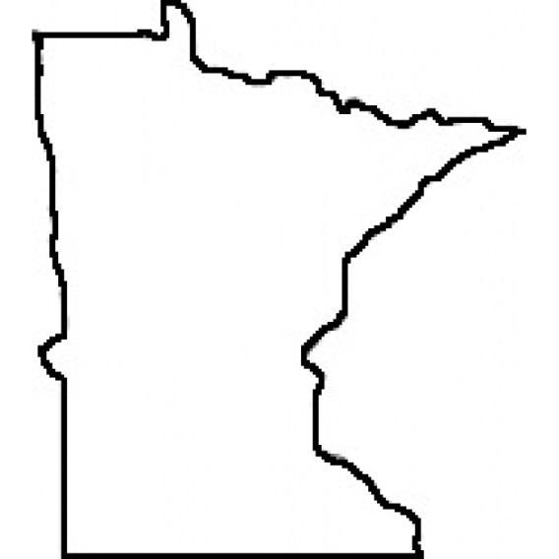
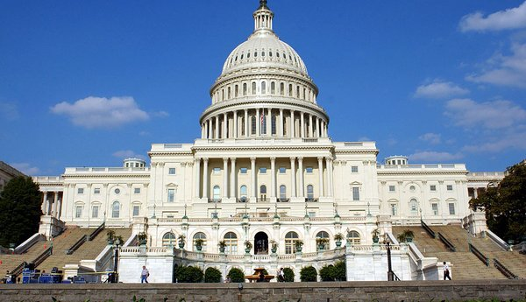
Funding
Public education is universally available, with control and funding coming from the state, local, and federal government

Slide 4
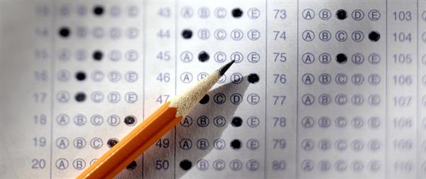
Jurisdiction
Public school curricula, funding, teaching, employment, and other policies are set through locally elected school boards, who have jurisdiction over individual school districts. State governments set educational standards and mandate standardized tests for public school systems
Rochester School Board

Slide 5
Private Schools
Private schools are generally free to determine their own curriculum and staffing policies
88% of school-age children attend public schools, 9% attend private schools, and nearly 3% are homeschooled
Private schools have various missions and cater to different students:
college-bound students
gifted students (naturally intelligent in some way)
students with learning disabilities or other special needs
students with specific religious affiliations

Slide 6
When Does School Start?
Most children enter the public education system around ages five or six. The American school year traditionally begins at the end of August or the day after Labor Day in September, after the traditional summer recess
the end of each school year in late May or early June.

Slide 7
Education Levels
Elementary school
Middle/junior school
High School/Secondary School

Slide 8
Pre-School
In large cities, sometimes there are private preschools catering to the children of the wealthy.
Children are 3-4 years old when they enter pre-school and begin to learn:
The alphabet (letters and sounds)
Numbers
Shapes
Cutting and Drawing
Socializing and sharing
Attending pre-school is not necessary, but children are expected to have learned these things before entering elementary school

Slide 9
Elementary School
Elementary school includes kindergarten through fifth grade (usually). In elementary school, basic subjects are taught and students often remain in one or two classrooms throughout the school day, with the exceptions of physical education ("P.E." or "gym"), library, music, and art classes.

Slide 10
Middle School
Middle school/junior high school includes the grade levels intermediate between elementary school and senior high school.
. "Middle school" usually includes sixth, seventh and eighth grade (Age level from 11 to 14)
Core subjects for this level are: Science (biology, chemistry, physics), Mathematics, Citizenship Education, Natural Science, Art, & Drawing and Designing

Slide 11
High School/Secondary School
High school is the school attended after middle school
High school includes grade levels 9-12 (Age levels 14-18)
Core subjects taught are Science, Mathematics, English, Social Studies, and Physical Education
Elective subjects may include: visual arts, performing arts, technical education, computers, athletics, publishing, foreign language, and health education
Federal law says that you may not drop out of school until you are 16 years old
In 2007, 8.1% or 6.2 million students aged 16-24 dropped out of high school, including nearly three out of 10 Hispanics

Slide 12
High School Advanced Courses
Many high schools provide Advanced Placement (AP) courses. These are special forms of honors classes where the curriculum is more challenging and lessons more aggressively paced than standard courses.
Upon completion of an AP class, you may elect to take an AP exam. If you receive a passing score on the exam, you may receive college credit for the class
AP courses are usually taken during the 11th or 12th grade of high school, but may be taken as early as 9th grade.

Slide 13
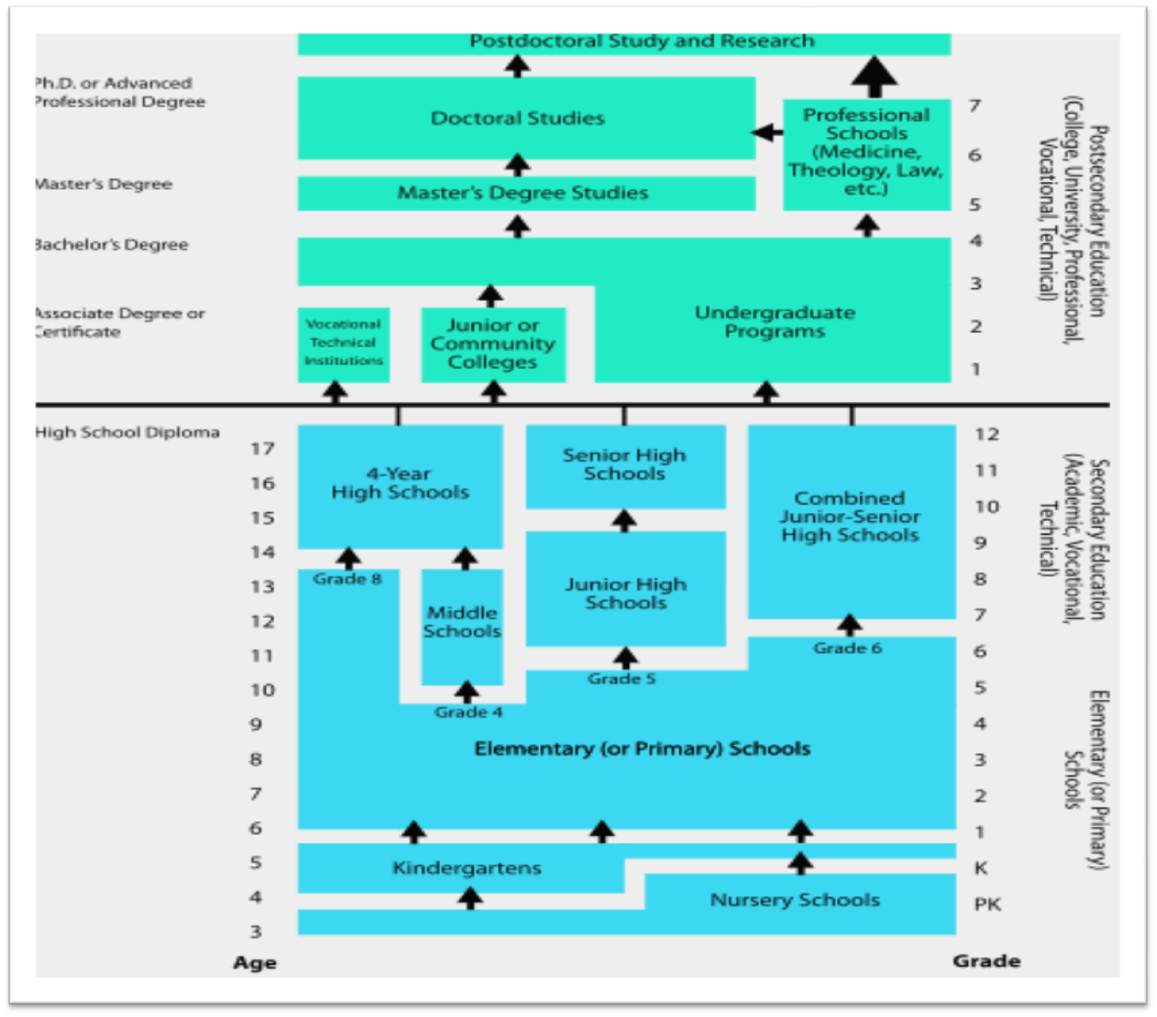

Slide 14
Educational Attainment in the U.S.

Slide 15
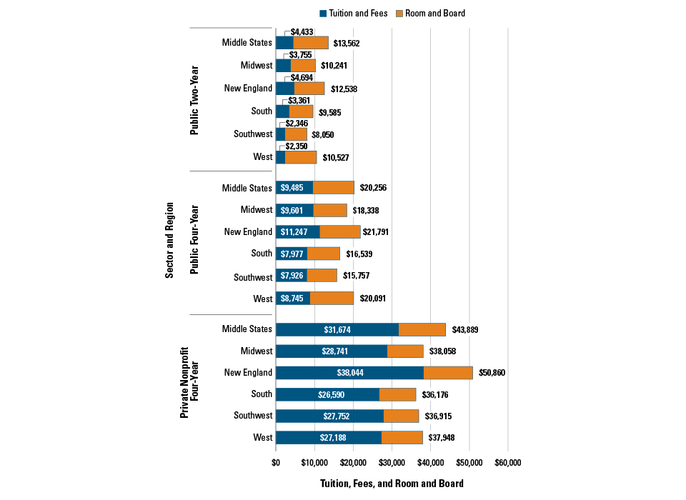

Slide 16
U.S. Grading Scale
Example Grading Scale
E, N, U or F | D |  |  | C |  |  | B |  |  | A
 | - |  | + | - |  | + | - |  | + | - |  | +
Below 60% | 60-62 | 63-66 | 67-69 | 70-72 | 73-76 | 77-79 | 80-82 | 83-86 | 87-89 | 90-92 | 93-96 | 97-100

Slide 17
U.S. Grade Point Scale
A=4.0 B=3.0 C=2.0 D=1.0 F=0.0
Ex: Last semester Susie had 3 A’s and 3 B’s.
Susie’s Grade point average (GPA) is 3.5
4+4+4+3+3+3/6= 3.5
A=Excellent, D=Marginal, F=Failure.

Slide 18
LIST OF TOP 10 UNIVERSITIES OF THE UNITED STATES
1. Harvard University 2. Stanford University 3. University of California - Berkeley 4. Massachusetts Institute of Technologies 5. California Institute of Technology 6. Columbia University 7. Princeton University 8. The University of Chicago 9. Yale University 10. Cornell University

Slide 19
QUESTIONS?

