Slide 1
Рифмовки для фонзарядки
Френдак Галина Емельяновна,
учитель английского языка
Копьёвской средней школы

Slide 2
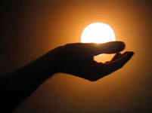
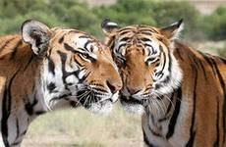
[ h ]
I have a hello in my hand and it just for you
I have a hello in my hand, my hello comes to you
I have a hello in my arms and it just for you
I have a hello in my arms, my hello comes to you
I have a hello in my cheeks and it just for you
I have a hello in my cheeks, my hello comes to you

Slide 3
[ ə: ]
The early bird catches the warm
And upon my word
I know two chaps and yet the third
Could learn a lesson from that bird

Slide 4
[b] , [r]
A Bear brings a basket of berries to bears

Slide 5
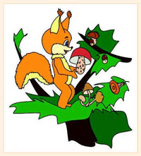
[r]
A squirrel dries
mushrooms
for winter

Slide 6
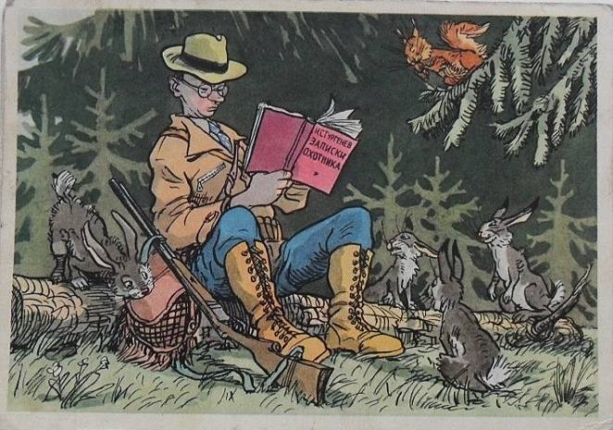
[h]
Hunters hunt for hares in the hunting.

Slide 7
[p] , [r]
Mr. Rule explains
rules to pupils

Slide 8
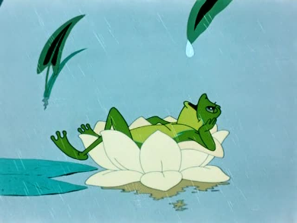
Clock, clock, clock,
A dog plays with a frog,
The frog plays with the dog,
Clock, clock, clock.
[ ɔ ]

Slide 9
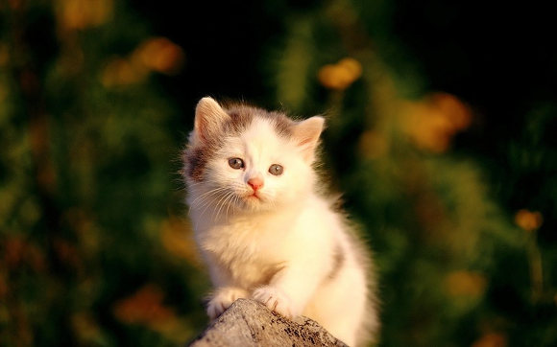
A little cat, a little cat,
A little cat is not very fat.
It is not fat, because it is sad.
It is very, very sad.
[ æ ]

Slide 10
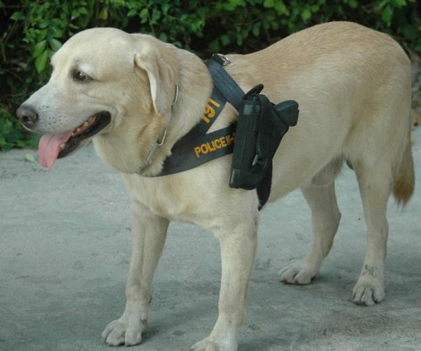
A white dog is happy dog,
Because it has a holster.
A black dog is poor dog,
Because it has not a holster
[ ɔ ]

Slide 11
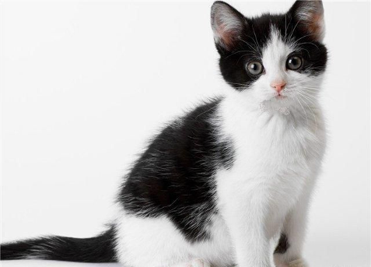
I have a cat
His name is May
His coat is white
And spots are grey

Slide 12
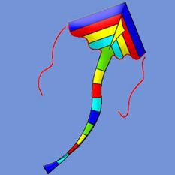
[ k]
We see a kite in the sky,
The kite is very bright,
I like my beautiful kite.

Slide 13
[m]
Mice, mice, mice,
Mice wear ties,
Mice like ties,
Ties are nice.

Slide 14
[ h ]
Half heart is no heart.

Slide 15
[ p ]
Polly,
put the kettle on,
Polly,
put the kettle on,
Polly,
put the kettle on,
We’ll all have tea.

Slide 16
[ w ]
Why do you cry, Willy?
Why do you cry?
Why, Willy?
Why, Willy?
Why, Willy?
Why?

Slide 17
[ ʃ ]
She sells sea shells
on the sea shore,
The shells that she sells
are sea shells, I am sure

Slide 18
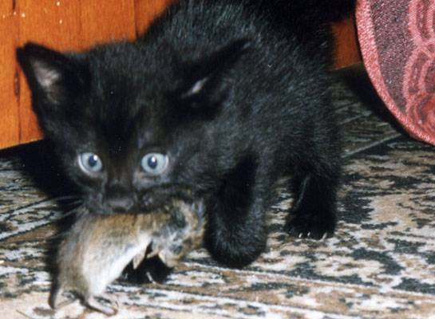
[ æ ]
A black cat sat on a mat and ate a fat rat

Slide 19
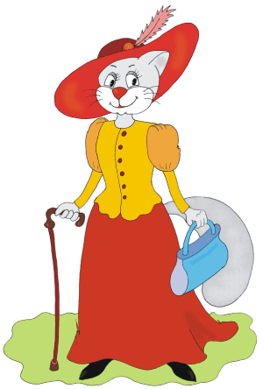
[ æ ]
Where are you going,
my little cat?
I’ m going to town
to buy a hat.
What? A hat for a cat?
A cat in a hat?
Who ever saw a cat in a hat?

Slide 20
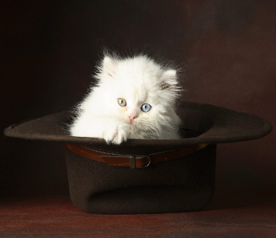
[ æ ]
Fat Pat
had a fat cat.
Pat’s fat cat
sat in Pat‘s hat.

Slide 21
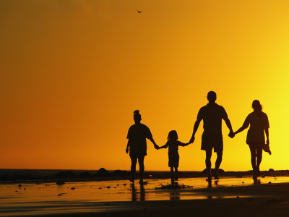
[ ð ]
Father, mother,
Sister, brother,
Hand in hand
With one another

Slide 22
[ ŋ ]
Good morning,
good morning,
Good morning to you,
Good morning,
good morning
I am glad to see you

Slide 23
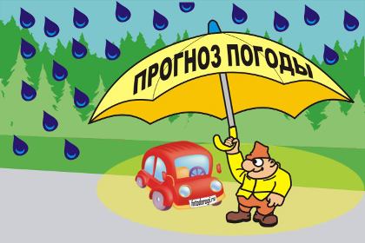
[ ŋ ]
Evening red and morning grey,
Send the traveler on his way;
Evening grey and morning red,
Bring the rain upon his head.

Slide 24
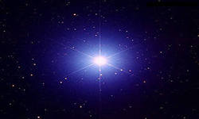
[ w ]
Twinkle, twinkle,
little star
How I wonder
what you are.
Up above
the world so high,
Like a diamond
in the sky.

Slide 25
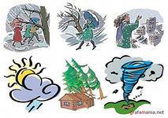
[ w ]
When the weather is warm
We mustn’t storm.
But be thankful together
Whatever the weather.

Slide 26
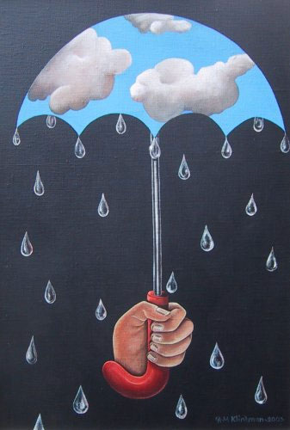
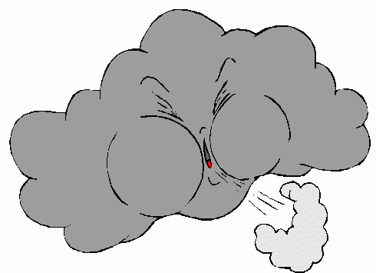
[ w ]
When the weather is wet
We mustn’t fret.
When the weather is cold
We mustn’t scold.

Slide 27
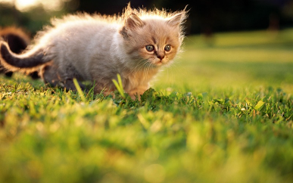
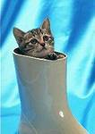
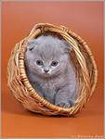
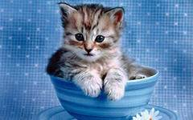
[ l ]
Little cat, little cat
Where is your flat?
I’m a little cat,
I have no flat.

Slide 28
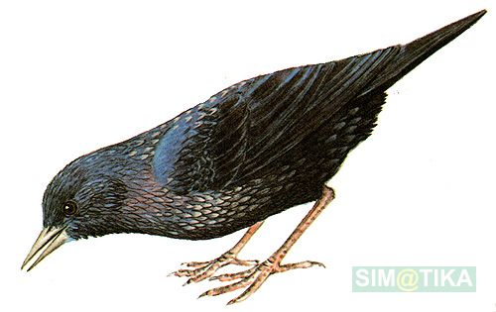
[ l ]
Little bird, little bird,
Look at me!
I have a bird-house
Oh, come and see!
Little boy, little boy
Under the tree
I like this house,
Give it to me!

Slide 29
[ ə: ]
Early to bed,
Early to rise
Makes a man
Healthy, wealthy
and wise.

Slide 30
[ ð ]
This is the season
When mornings are dark
And birds do not sing
In the woods and the park.
This is the season
When children ski
And Father Frost
Brings the New Year tree.

Slide 31
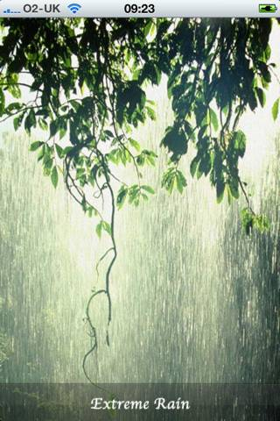
[ r ]
Rain on the grass
And rain on the tree
Rain on the house-top
But not on me.

Slide 32
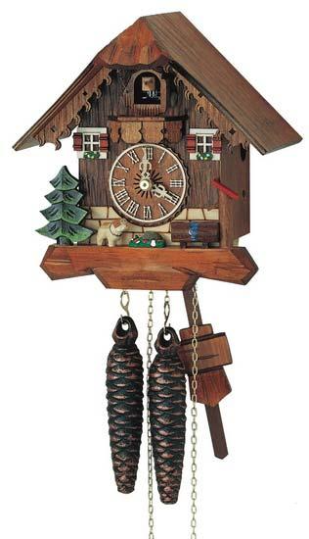
[ t ]
“Tick,” the clock says.
“Tick, tick, tick
What you have to do,
do quick!

Slide 33
[ s ]
A sailor went to sea
To see what he could see
Was sea, sea, sea.

Slide 34
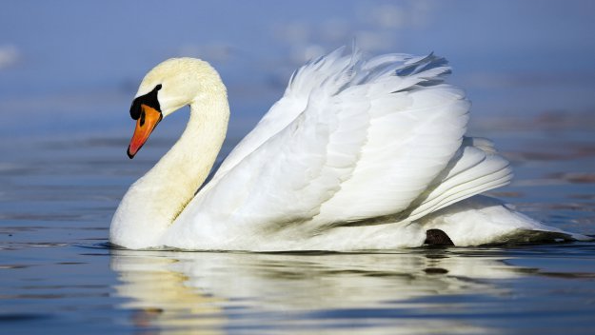
[ s ]
Swan swam over the sea.
Swim, swan, swim!
Swan swam back again.
Well swum, swan

Slide 35
[ au ]
Hickory, dickory, dock
The mouse ran up the clock.
The clock struck one,
The mouse ran down.
Hickory, dickory, dock.

Slide 36
[ ɛə ]
Flowers here,
Flowers there,
Flowers growing
Everywhere.

Slide 37
[nait ]
Good night, mother,
Good night, father.
Kiss your little son.
Good night, sister.
Good night, brother.
Good night, everyone.

Slide 38
Использованные ресурсы
http://im4-tub-ru.yandex.net/i?id=17198227-14-72&n=21 солнце на ладони
http://im4-tub-ru.yandex.net/i?id=33951218-21-72&n=21 здравствуй
http://yaolga.users.photofile.ru/photo/yaolga/150557599/xlarge/167757709.jpg обниматься
http://im0-tub-ru.yandex.net/i?id=150305186-71-72&n=21 тигры
http://www.resimseli.com/data/media/62/users385ykj7xc.jpg полсердца
http://img1.liveinternet.ru/images/attach/c/2/69/946/69946839_39050971_MG003_Cat20Tea20Party.jpg девочка с чайником
http://dskuv2492.mskobr.ru/images/cms/data/post-57861-1252926756.jpg плакса
http://img0.liveinternet.ru/images/attach/c/1/56/910/56910913_r13.jpg ракушки
http://biostrazh.ru/images_content/krysolov.jpg кот с крысой
http://freelance-nsk.ru/files/personazhi3-sm.jpg кошка
http://im7-tub-ru.yandex.net/i?id=6710234-25-72&n=21 кошка в шляпе
http://vinipuhovo.ru/published/publicdata/U197319VINI/attachments/SC/products_pictures/Пупс%20Я%20тебя%20люблю%2022%20см%20Paola%20Reina%20157_enl.jpg пупс
http://osradio.ru/uploads/fotki/old/10627/balabekova-zinaida15.jpg семья
http://content.podarki.ru/goods-images/a49f41bc-05cc-4579-bcfd-e2fe3a421798.jpg змей
http://i26.fastpic.ru/big/2012/0531/af/9991a4ba2028b7788bfb7dca57507baf.jpg мышь
http://img01.chitalnya.ru/upload2/735/660847923718392.jpg поросенок
http://i04.fsimg.ru/5/tlog_box/1653/1653395.jpg цифры
http://img-fotki.yandex.ru/get/5503/salix0265.5/0_569d8_416216be_XL охотник

Slide 39
http://i014.radikal.ru/1107/74/4aa530b50e6c.gif доброе утро
http://www.failopomoika.com/forums/monthly_05_2013/user33678/post1049535_img1_58576f74b88fdf0c7fc44c9b9cc0279e.jpg доброе утро
http://www.allpolus.com/uploads/posts/2011-05/1304670203_rirrri1.jpg мышки с зонтом
http://citizenwells.files.wordpress.com/2011/12/starnasa2.jpg звезда
http://im0-tub-ru.yandex.net/i?id=42876174-05-72&n=21 бриллиант
http://img1.liveinternet.ru/images/attach/c/2/67/715/67715751_Snow_White.png белоснежка
http://im7-tub-ru.yandex.net/i?id=96623802-67-72&n=21 погода
http://www.biser.info/files/images2node/biser.info_16283786274b65bc12ebed2_t.gif солнышко
http://kita.com.ua/uploads/tiny_mce/loadimg/th_b710e83570bd1bae8083d07234c0b6fb.gif?hash=408 ветер
http://forum.moya-semya.ru/uploads/av-44576.jpg зонт
http://f1.live4fun.ru/pictures/img_21069210_479_0.jpg котенок в чашке
http://radikal.ua/data/upload/4fa6c/49112/a676905e8b.jpg котенок в корзинке
http://img81.imageshack.us/img81/45/kedi846ardq7.jpg кот в сапоге
http://www.graycell.ru/picture/big/skvorechnik.jpg скворечник
http://simatika.ru/img/600/600/319.jpg скворец
http://www.artscroll.ru/Images/2008/k/Kopyirin%20Andrey/000010.jpg малыш
http://img-fotki.yandex.ru/get/6103/157699281.5/0_6536e_4fc55536_XL елка
http://animebox.com.ua/uploads/posts/2011-07/1309575074_7ca18a768d8e1a5164489bf3d83b9faa.jpg дождь
http://www.svstime.ru/admin/pictures/168016b.jpg часы
http://www.teplak.ru/pics/upload/86b_9309.jpg кукла
http://prazdnik-land.ru/media/uploads/10/images/13.jpg моряк
http://im7-tub-ru.yandex.net/i?id=56077778-59-72&n=21 лебедь

Slide 40
http://фотогламур.рф/upload/iblock/50e/mouse2.jpg мышь
http://s011.radikal.ru/i316/1206/22/449be282e202.jpg мышь в домике
http://i023.radikal.ru/1105/4a/a46ebe5972fb.jpg кот с мышами
http://chalet-shop.spb.ru/images/detailed/a651004.jpg сад цветов
http://cs303206.userapi.com/v303206947/40a1/mThmT7Ml1jc.jpg сон
http://i028.radikal.ru/1012/c4/fd1418f63cc5.jpg медведь
http://www.bajena.com/pictures/en/squirrel.jpg белка
http://img0.liveinternet.ru/images/attach/c/2/67/365/67365993_zna.jpg учитель
http://img-fotki.yandex.ru/get/3203/mistina.5/0_1bab9_eb508119_XL дети
http://s41.radikal.ru/i091/0906/90/e5092e6ab92d.jpg лягушка
http://i037.radikal.ru/1108/e4/c839e7bd55e6.jpg собака
http://fotoshops.org/uploads/taginator/Jan-2013/skachat-besplatno-ramki-dlya-detskogo-sada.jpg титульная рамка
http://soft.sibnet.ru/data/screenshot/bv10089.jpg фон
http://www.art-saloon.ru/big/item_5143.jpg индеец
http://acer-a500.ru/uploads/posts/2011-09/1316995258_sc20110926-105431.jpg птица
http://img0.liveinternet.ru/images/attach/c/7/96/611/96611962_6d0c2d4a7bb8.jpg сова

